Slide 1
Introduction to robotics
8. Motors
Aistis Raudys ir Vytautas Valaitis
2022

Slide 2
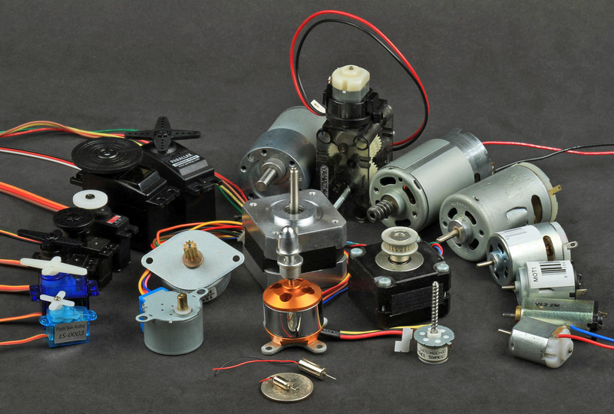

Slide 3
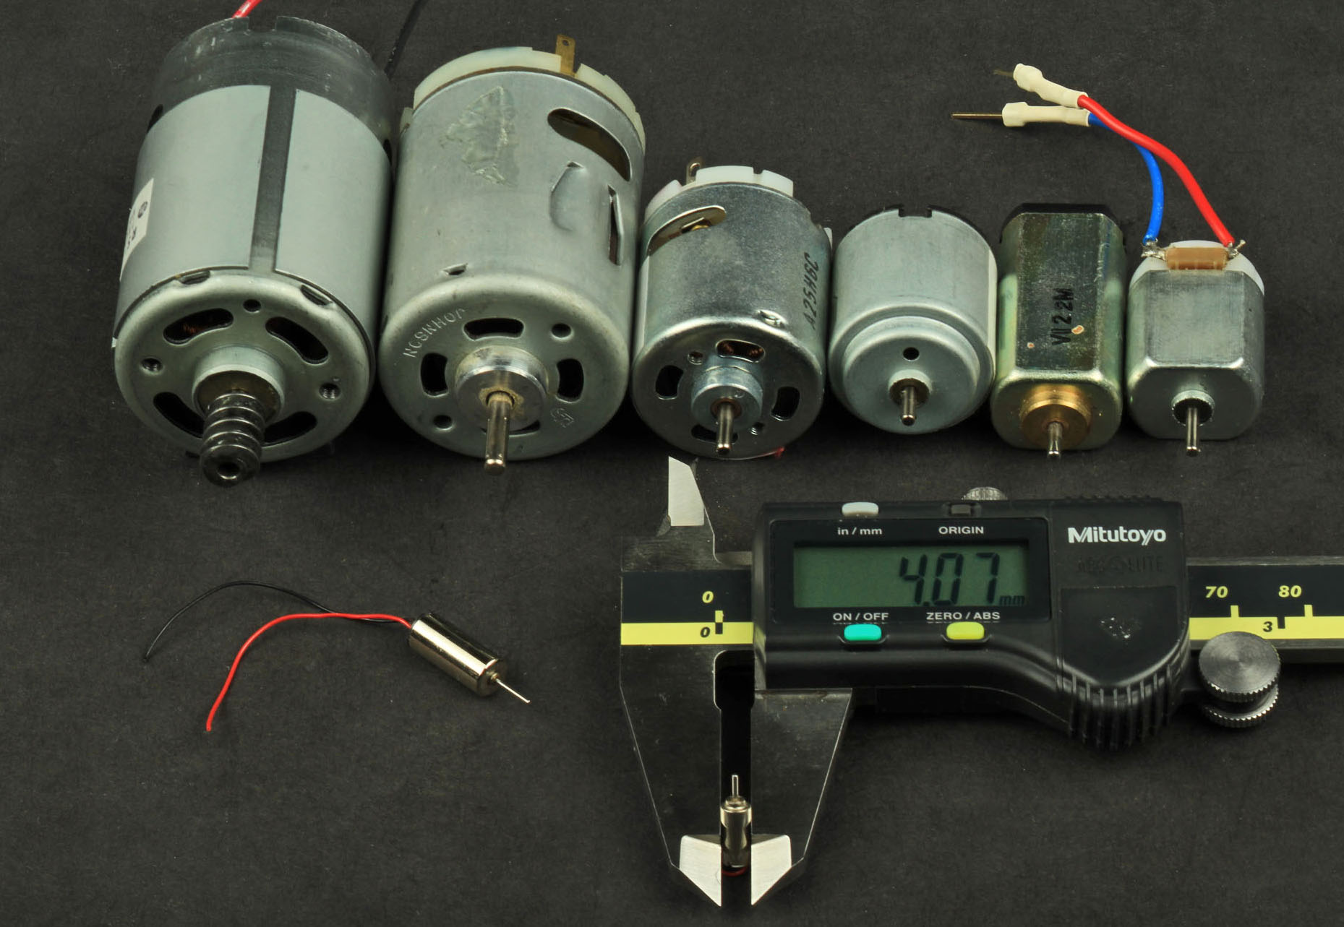

Slide 4
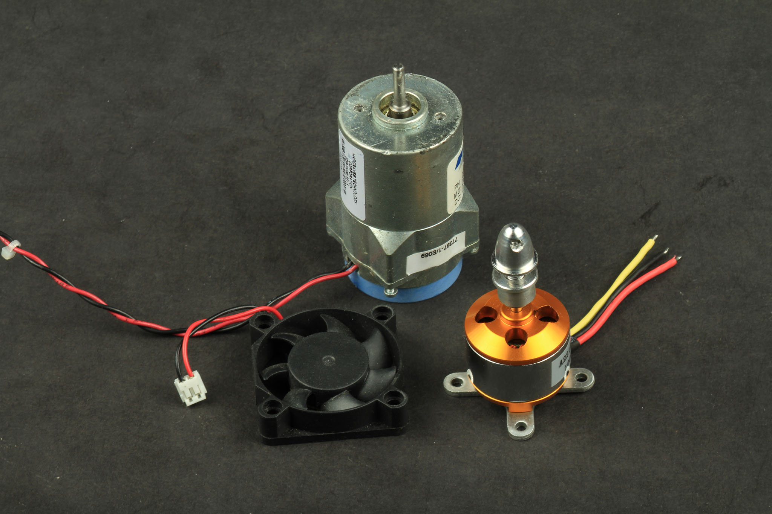

Slide 5
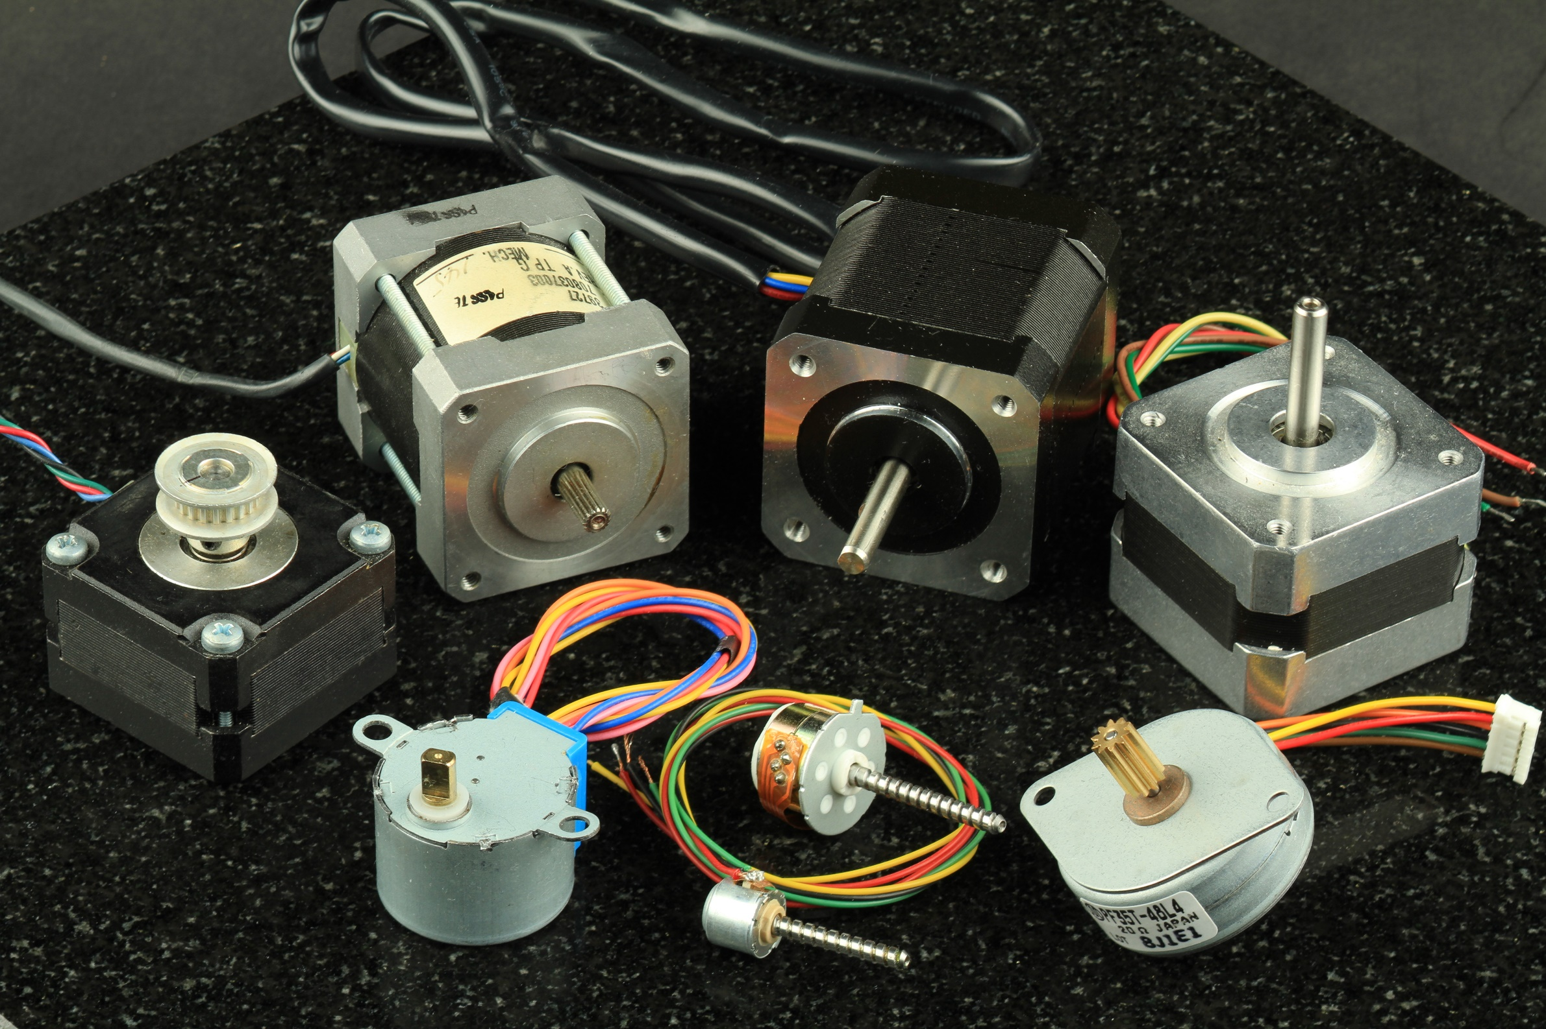

Slide 6
How things move
DC motors
AC motors
Steppers
Servo
Selenoids
Encoders
Controllers
Brushless
BLDC

Slide 7
DC Motor Learning Objectives
Explain the role of a snubber diode
Describe how PWM controls DC motor speed
Implement a transistor circuit and Arduino program for PWM control of the DC motor
Use a potentiometer as input to a program that controls fan speed

Slide 8
What is a snubber diode
and why should I care?

Slide 9
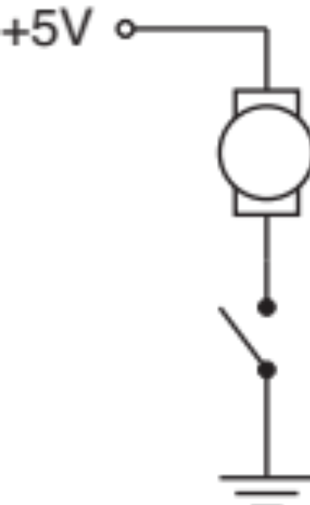
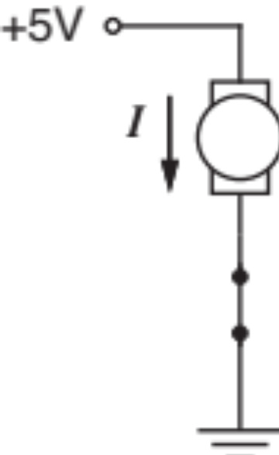
Simplest DC Motor Circuit
Connect the motor to a DC power supply
Switch open
Switch closed

Slide 10
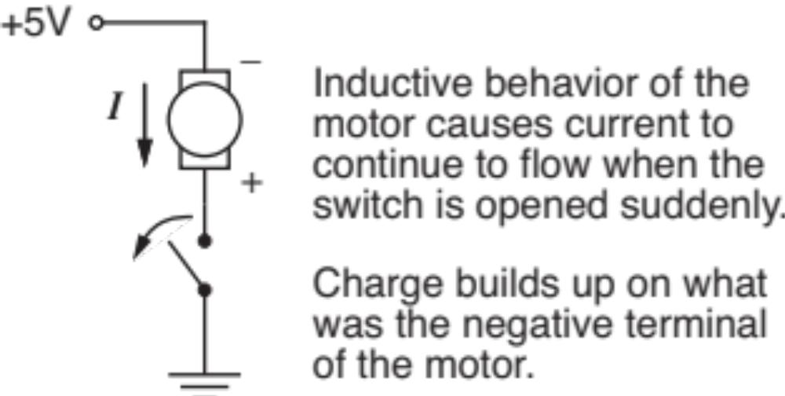
Current continues after switch is opened
Opening the switch does not immediately stop current in the motor windings.

Slide 11
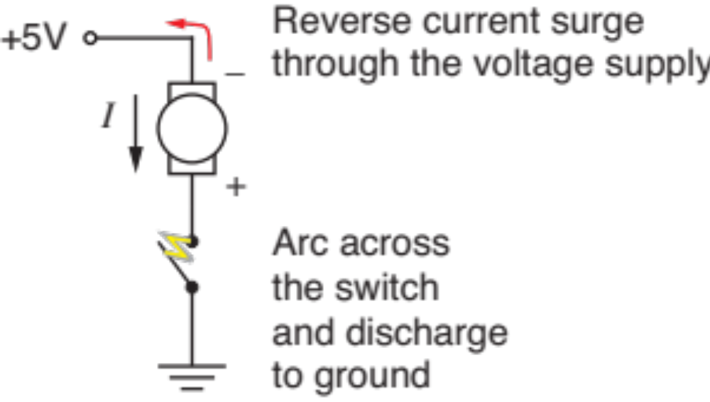
Reverse current
Charge build-up can cause damage

Slide 12
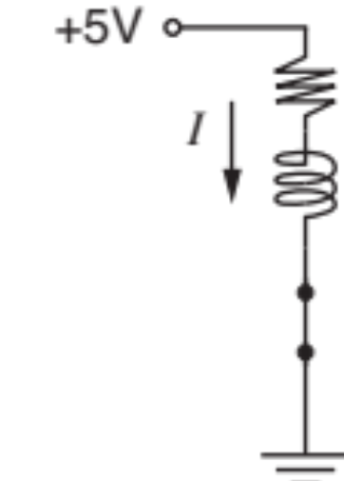
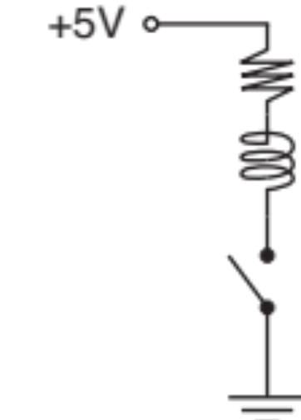
Motor Model
Simple model of a DC motor:
  Windings have inductance and resistance
  Inductor stores electrical energy in the windings
  We need to provide a way to safely dissipate electrical energy when the switch is opened

Slide 13
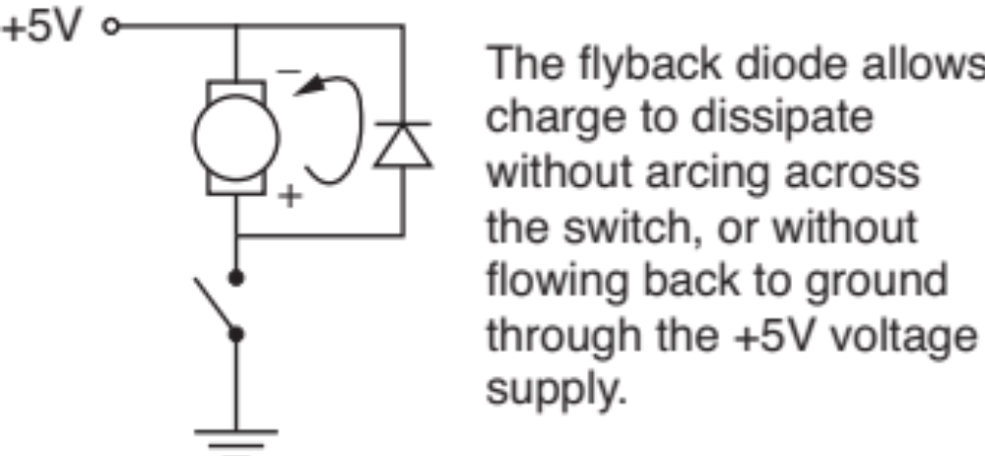
Flyback diode or snubber diode
Adding a diode in parallel with the motor provides a path for dissipation of stored energy when the switch is opened

Slide 14
Pulse-width modulation (PWM)
for DC motor speed control

Slide 15
Controlling DC Motor Speed
The voltage supplied to a DC motor controls its speed
Arduino cannot supply variable DC output
  Arduino lacks a true analog output
  Use Pulse-width modulation (PWM) to simulate a variable DC supply voltage
  PWM is a common technique for supplying variable power levels to “slow” electrical devices such as resistive loads, LEDs, and DC motors
  Arduino Uno has 6 PWM pins: Digital I/O pins 3, 5, 6, 9,10, and 11

Slide 16
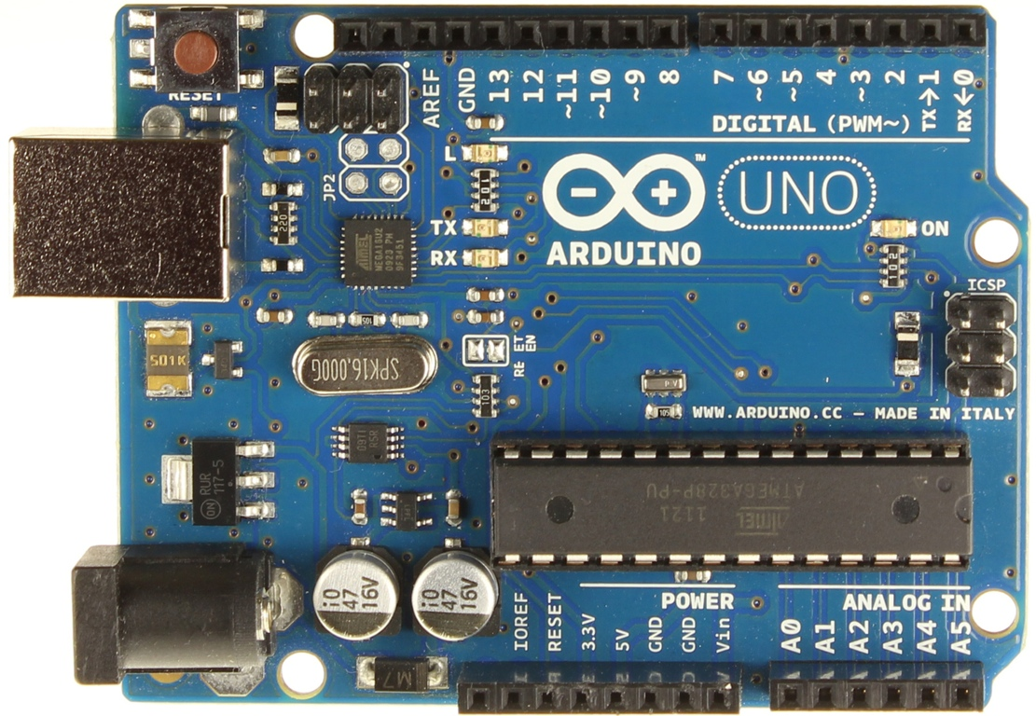
Arduno Uno has 6 PWM pins
Look for the ~ prefix on the digital pin label, e.g. ~3

Slide 17
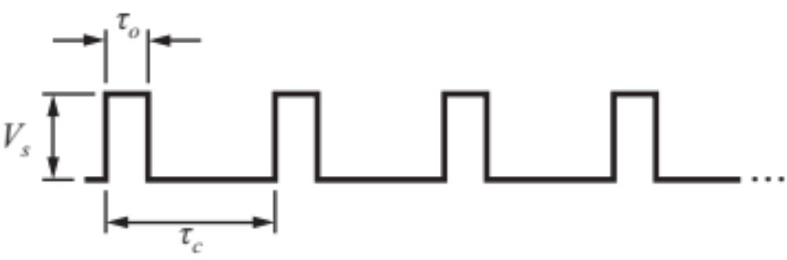


PWM: Pulsed with modulation
PWM simulates DC voltage control for slow loads
The effective voltage is
is called the duty cycle

Slide 18
Arduino PWM commands
Configure the output pin:
Set the duty cycle
The duty cycle is an 8 bit value:
0 ≤ duty_cycle ≤255
PWM_pin = ... ; // one of 3, 5, 6, 9, 10, 11
void setup() {
pinMode( PWM_pin, OUTPUT);
}
void loop() {
int duty_cycle = 150; // between 0 and 255
analogWrite( PWM_pin, duty_cycle );
}

Slide 19
Using a transistor to switch the load

Slide 20
Transistor as the switching device
Each Arduino output channels has a 40 mA limit
The maximum current draw for an Arduino is 200 mA
Use Arduino as the brain
Let another switching element be the brawn

Slide 21
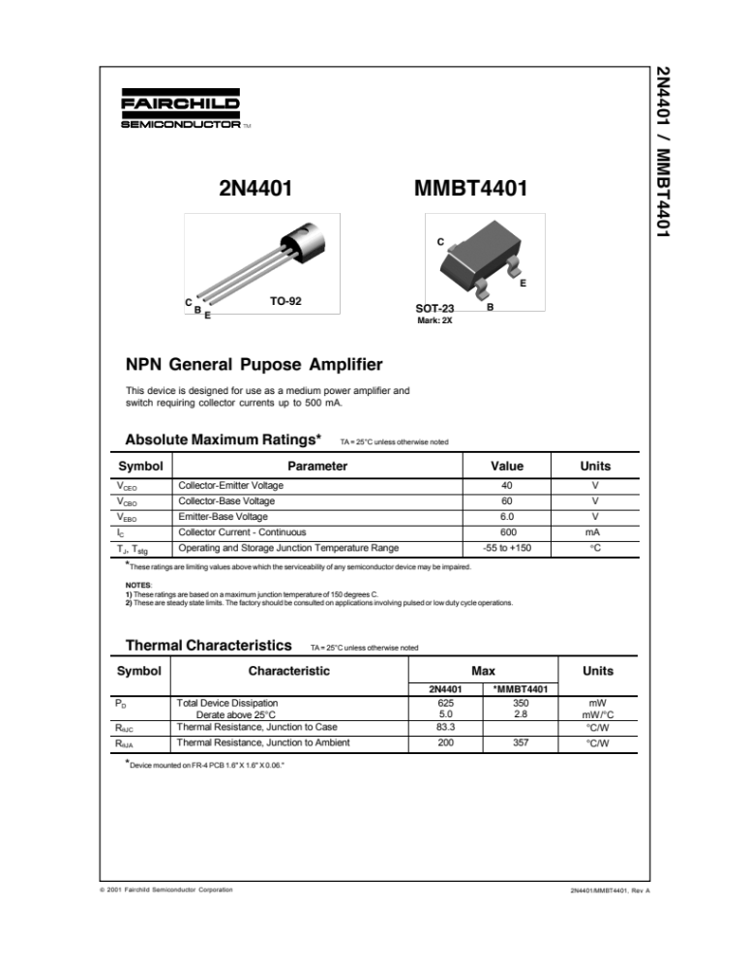

Use an NPN Transistor as a switch
This device is designed for use as a medium power amplifier and switch requiring collector currents up to 500 mA

Slide 22
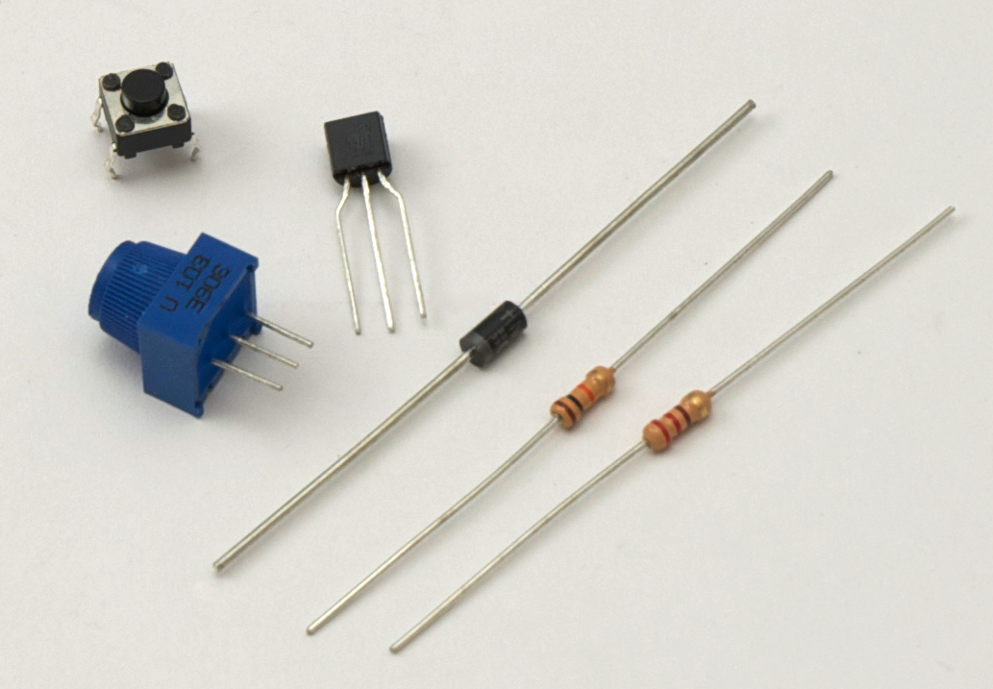
Electronic components in the fan kit
Transistor
Diode
220 Ω or 330 Ω
resistor

Slide 23
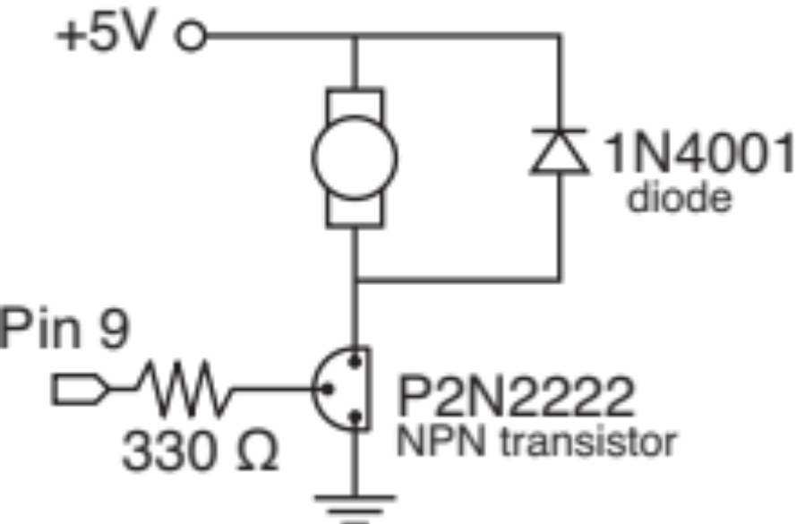
Replace the Switch with a Transistor
A transistor allows on/off control to be automated and it allows switching of more current than an Arduino digital pin can supply.
Pin 9 or another PWM pin drives the transistor base

Slide 24
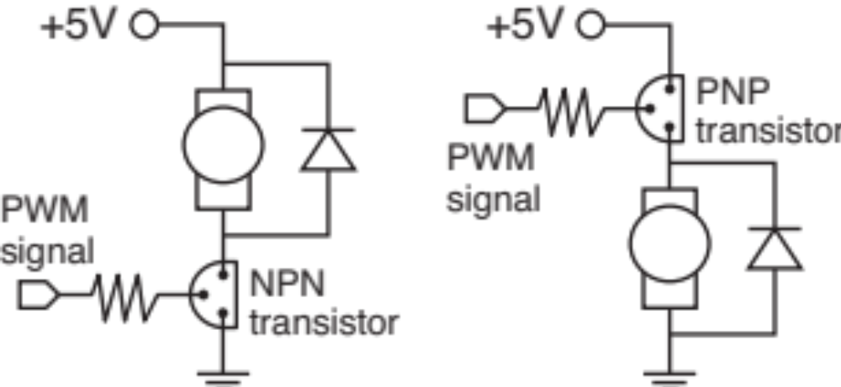
Alternative locations for the transistor
Moving the transistor (and any switch) between the power supply and the motor adds a bit of safety by tying the motor to ground when the system is idle

Slide 25
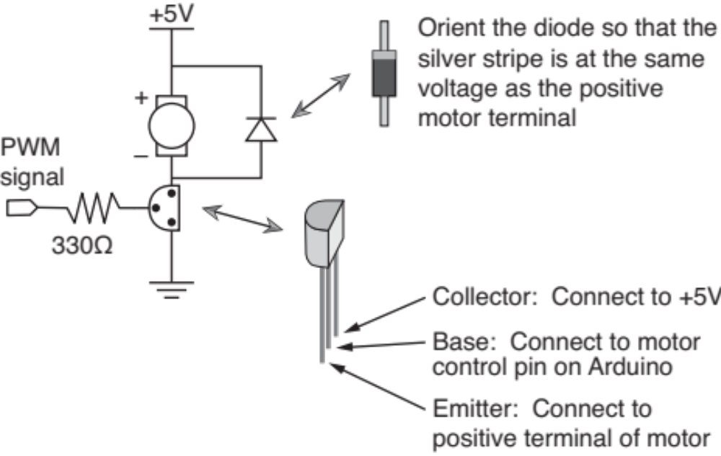
Diode and transistor orientation

Slide 26
Arduno Uno has 5 PWM pins
Look for the ~ prefix on the digital pin label, e.g. ~3

Slide 27
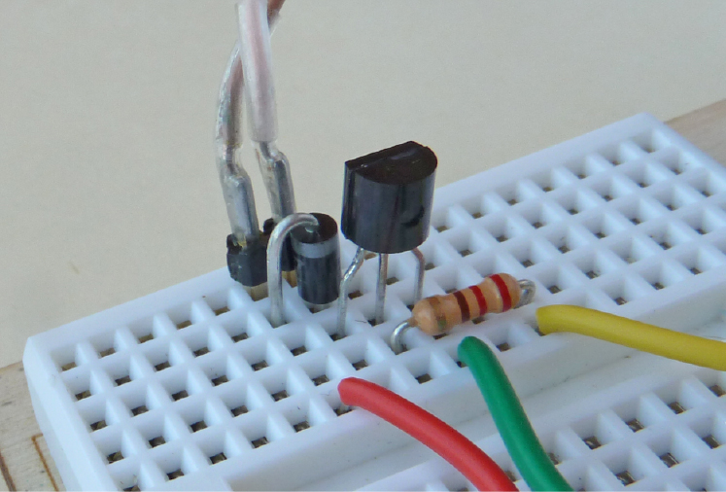
DC Motor Circuit on tiny breadboard

Slide 28
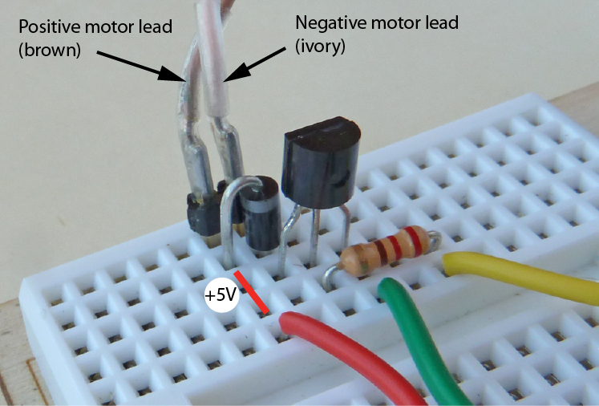
+5V connections

Slide 29
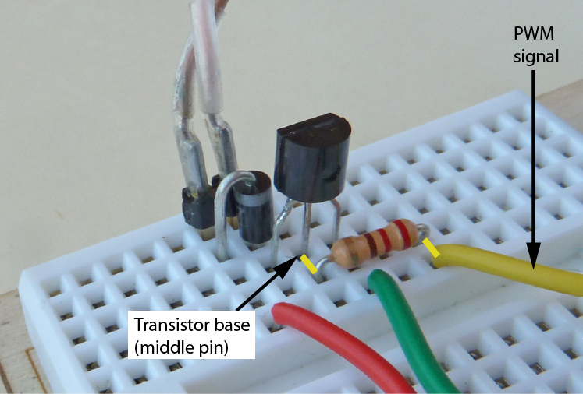
PWM signal is connected to transistor base

Slide 30
Arduino program to spin the DC Motor
Code is in spin_DC_motor.ino
// spin_DC_motor.ino Use PWM to control DC motor speed
int motorPin = 3; // Pin 3 has PWM, connected it to the DC motor
void setup() {
pinMode(motorPin, OUTPUT); // Set motor pin to output mode
}
void loop() {
analogWrite(motorPin, 150); // Motor at 150/255 of full speed
delay(1000);
analogWrite(motorPin, 250); // Motor at 250/255 of full speed
delay(1000);
}

Slide 31
Rotation direction

Slide 32
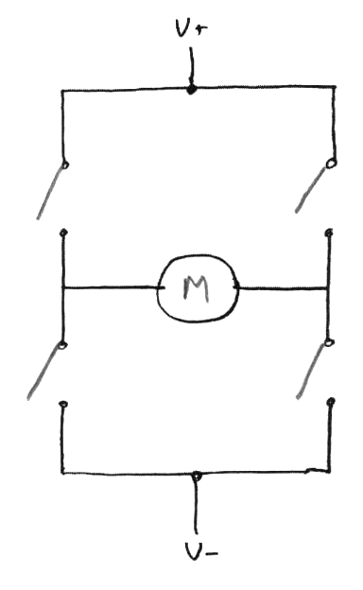
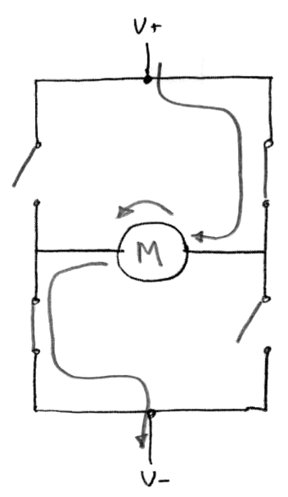
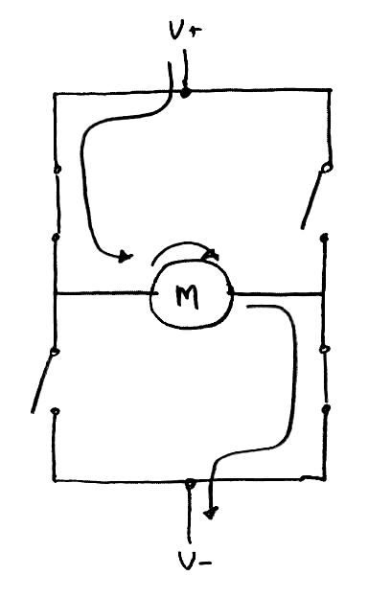
How H-Bridge works
Off
Forward
Reverse

Slide 33

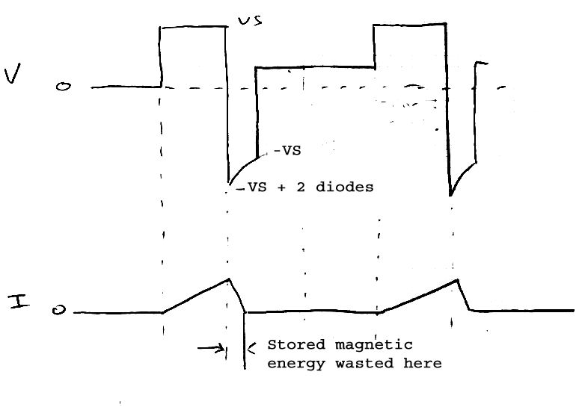
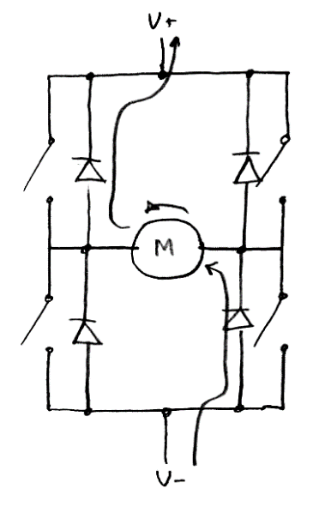
How H-Bridge Works
This represents traditional PWM motor control
Note low average current flow

Slide 34
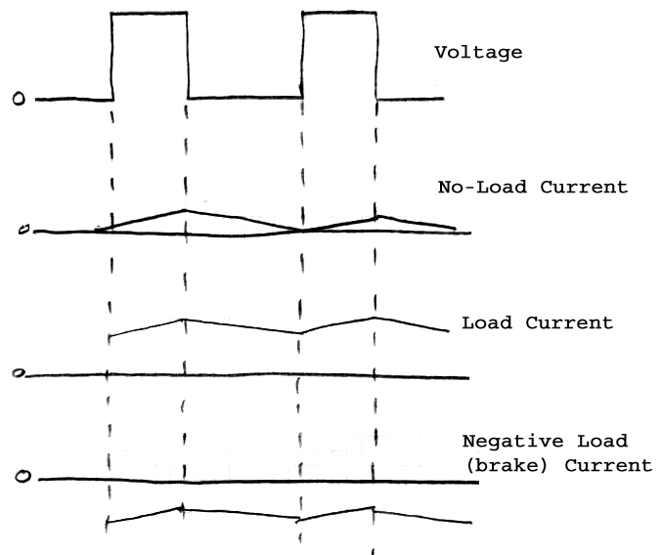
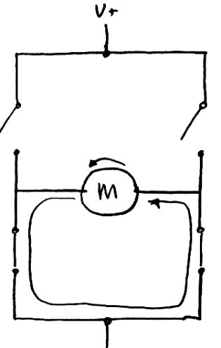
H-Bridge: Synchronous Rectification
Use switches instead of diodes
Much more efficient, regenerative braking

Slide 35
H-Bridge Locked-Antiphase
Pro: one line needed for forward/reverse
Con: higher frequencies needed

Slide 36
H-Bridge Examples
L293, L298, MC33886, TLE5206, TPIC0108b, etc
Simple logic: output = input. Some chips have disables to disconnect all outputs. Advance chips output protection.
Functional Truth Table
IN1 | IN2 | OUT1 | OUT2 | Comments
L | L | L | L | Brake; both low transistors on
L | H | L | H | Forward
H | L | H | L | Reverse
H | H | H | H | Brake; both high transistors on.

Slide 37
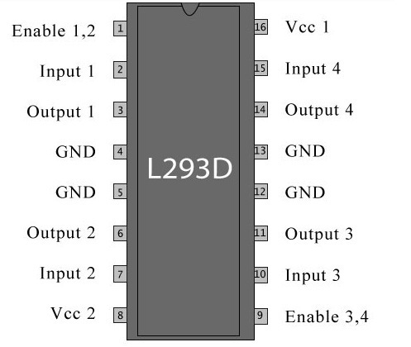
L293

Slide 38
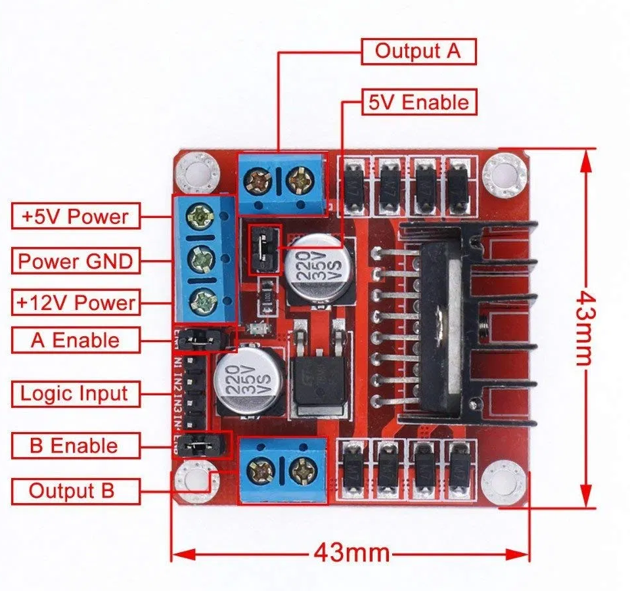
L298

Slide 39
H-Bridge Examples
LM18200, TLE5205, TPIC0107b, etc.
Functional Truth Table (LM18200)
PWM | DIR | Brake | OUT1 | OUT2 | Comments
H | H | L | H | L | Forward
H | L | L | L | H | Reverse
L | X | L | H | H | High Side BRAKE
H | H | H | L | L | Low Side Brake
H | L | H | L | L | Low Side BRAKE
L | X | H | Z | Z | None

Slide 40
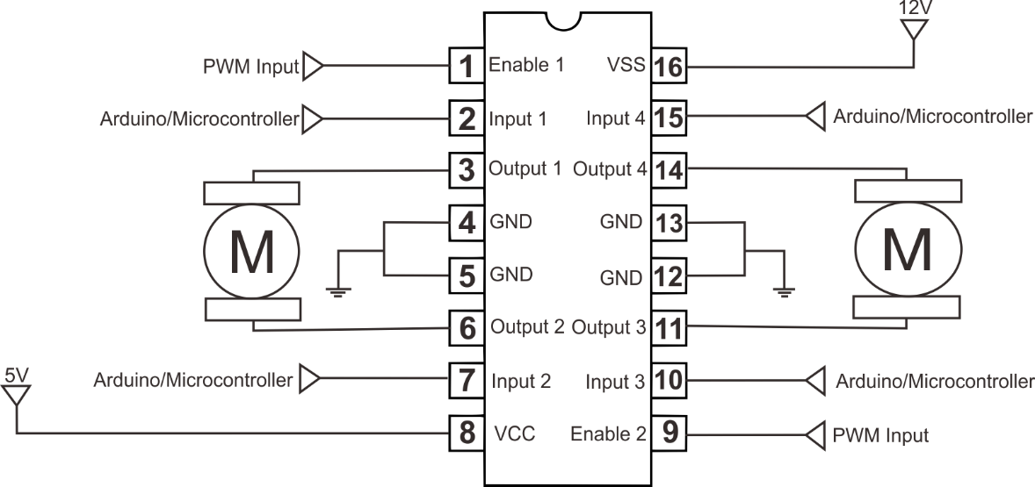

Slide 41
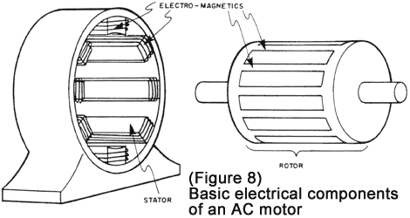
AC motors
Lots of everything there
Single phase
Three-phase
Difficult to manage
Need to generate a
sinusoid
Let's leave it for the next time

Slide 42
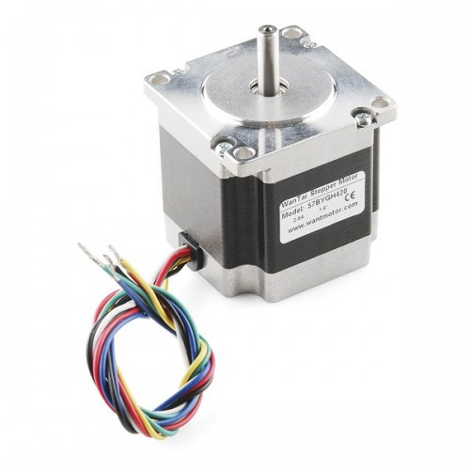
Stepper motors

Slide 43
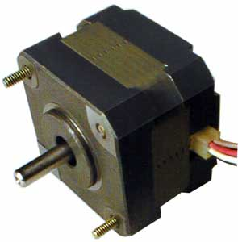
Stepper Motors

Slide 44
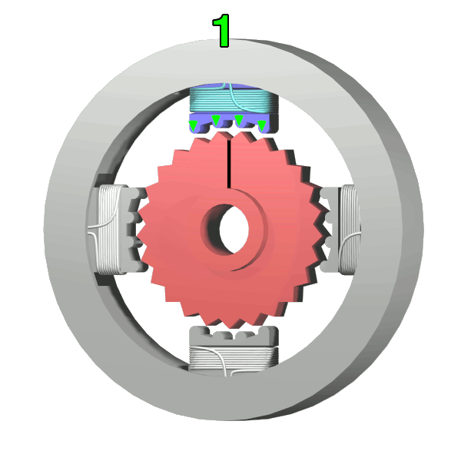

Slide 45
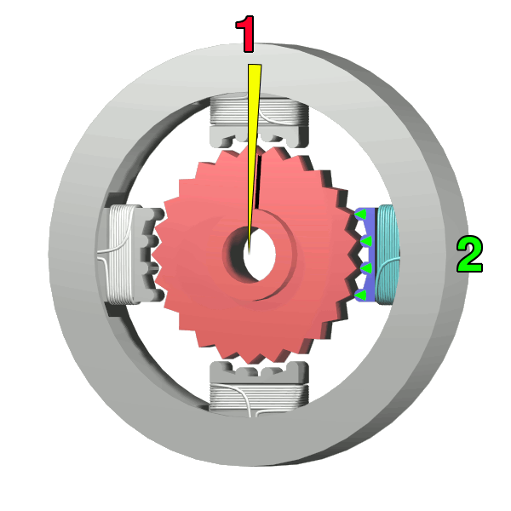

Slide 46
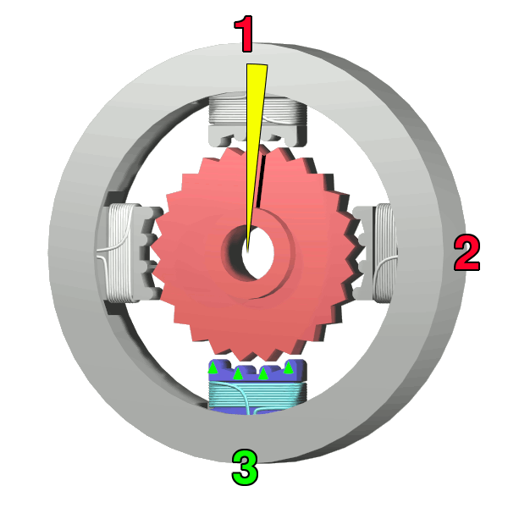

Slide 47
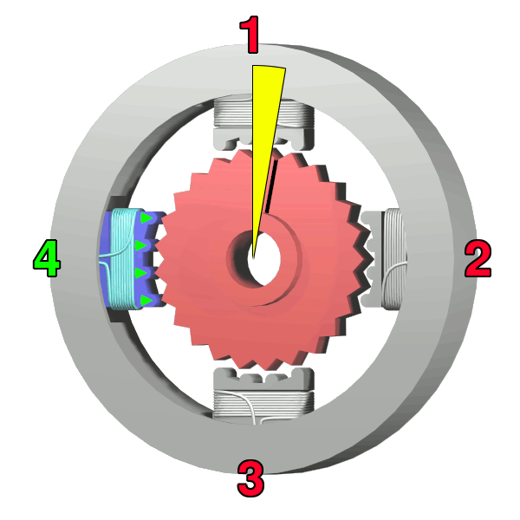

Slide 48
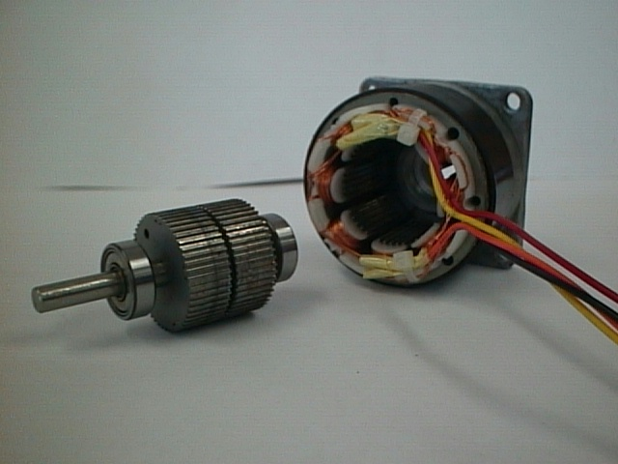

Slide 49
Stepper Motor Selection
Permanent Magnet / Variable Reluctance
Unipolar vs. Bipolar
Number of Stacks
Number of Phases
Degrees Per Step
Microstepping
Pull-In/Pull-Out Torque
Detent Torque

Slide 50
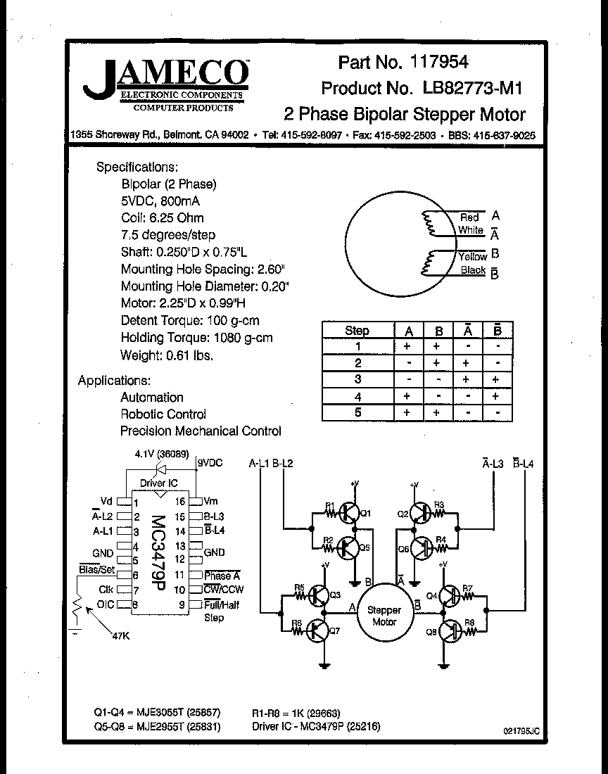

Slide 51
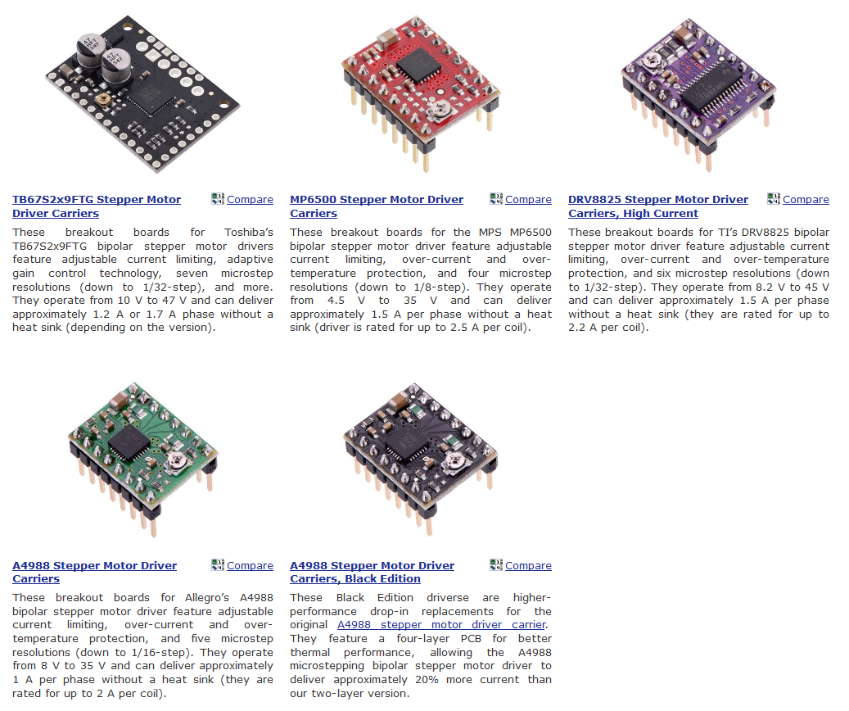

Slide 52
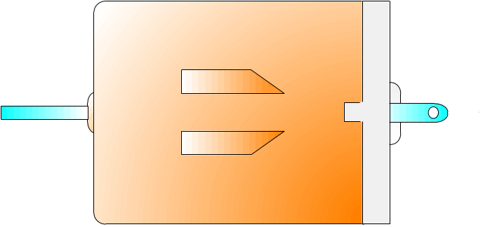
Control sequence to turn a stepper motor
+
Step 1 | 0 | 0 | 1 | 1
Step 2 | 1 | 0 | 1 | 0
Step 3 | 1 | 1 | 0 | 0
Step 4 | 0 | 1 | 0 | 1
CW
CCW

Slide 53
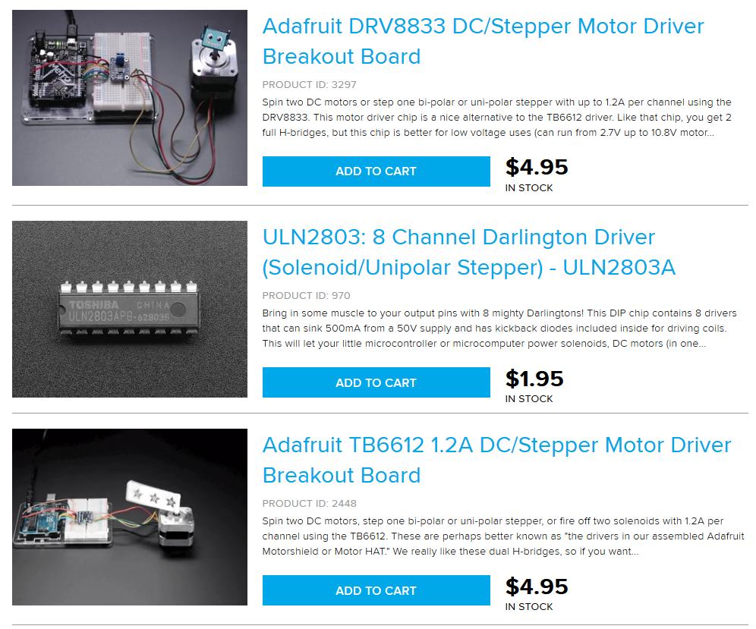

Slide 54
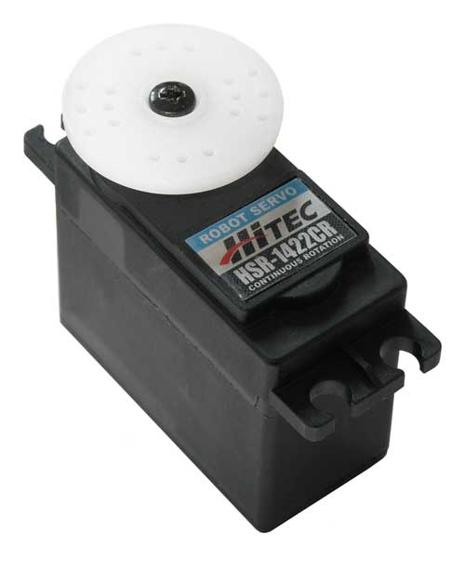
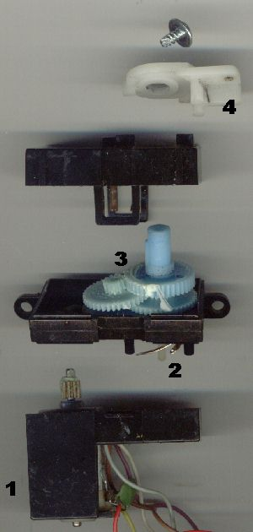
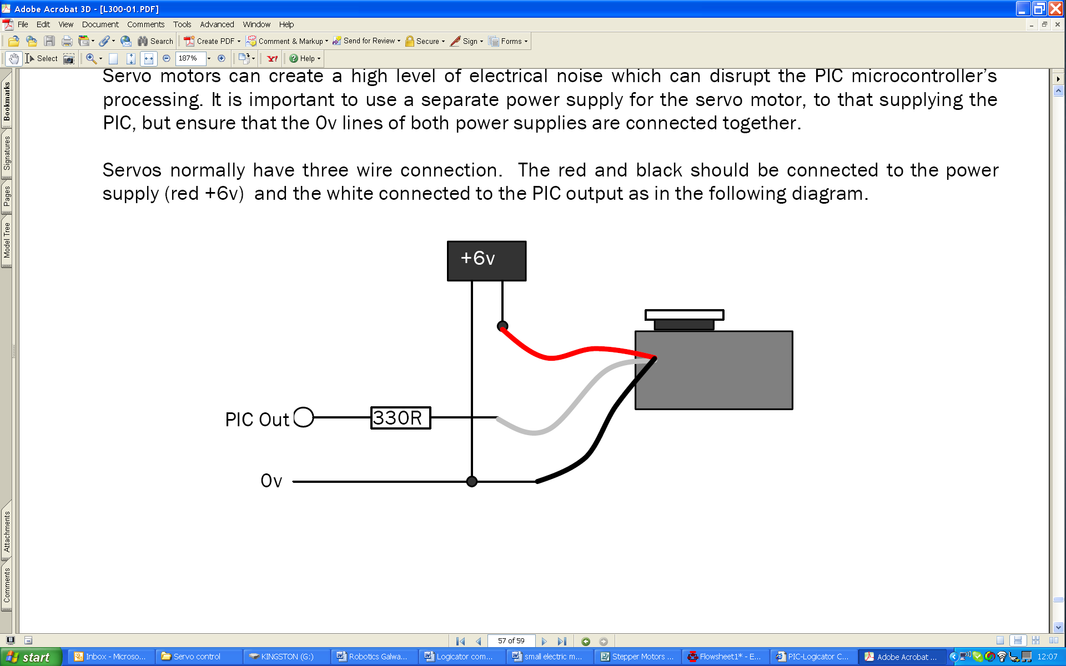
Servo Motor Detail
Actuator
Reduction gear
Position feedback
Potentiometer
(closed loop system)
+ 5V
Small electric DC motor

Slide 55
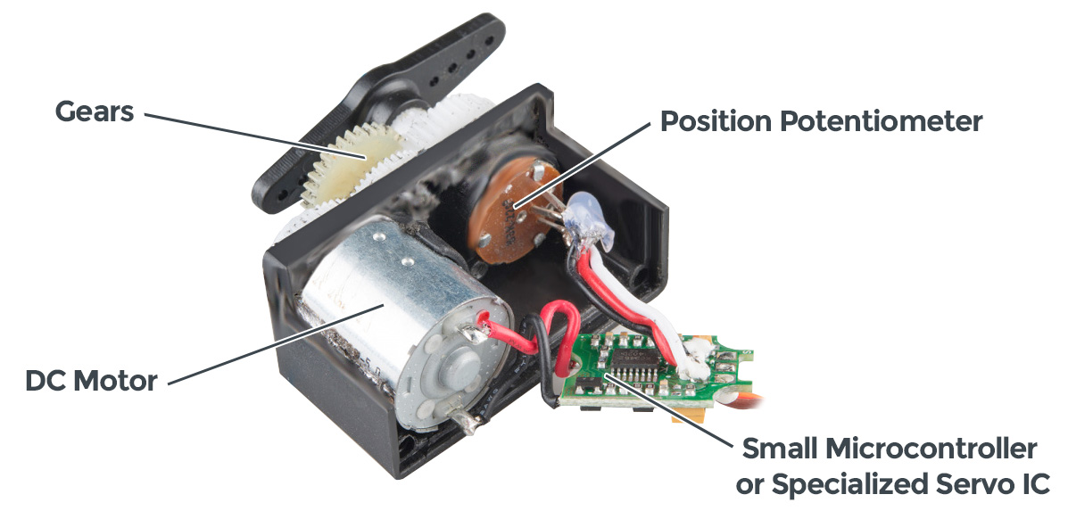

Slide 56
Brushless Motors and Control

Slide 57
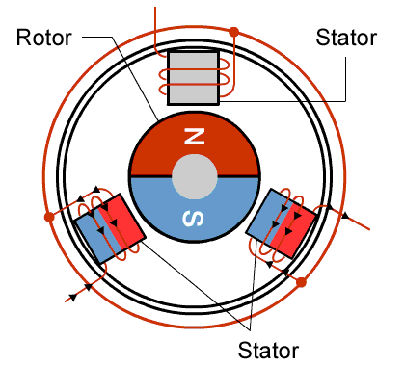
How do Brushless DC Motors Work?
[8]
Switch the position of the magnets and coils.

Slide 58
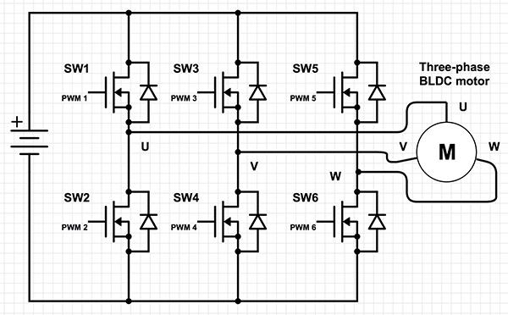
Brushless Control
[12]

Slide 59
Brushless Motors
Brushed Motors
Long lifespan
Very high efficiency
Low noise generation
High power to size ratio
Cheap
Easy to use
Requires few wires
Simple control circuitry

