Slide 1
Introduction to robotics
7. Protocols
Aistis Raudys ir Vytautas Valaitis
2021

Slide 2
How hardware components communicate
UART – serial - TTY - RS232 – RS244
1-Wire
I2C
SPI
USB
Ethernet
Irda
Bluetooth
CSI (camera)

Slide 3
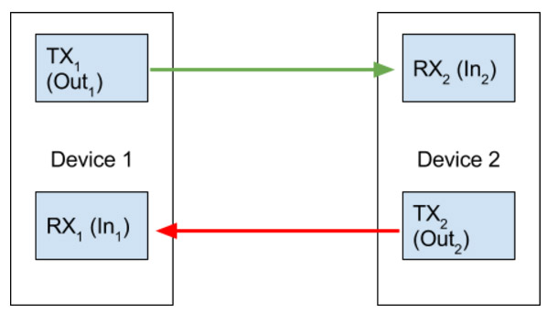
Universal Asynchronous Receiver-Transmitter
(UART)

Slide 4
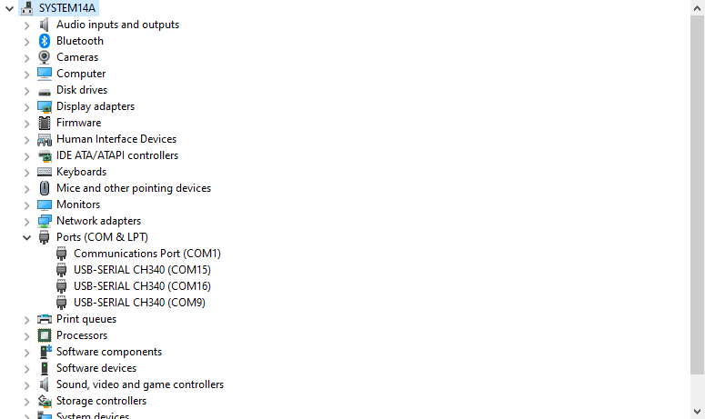
Serial ports on Windows

Slide 5
Serial data-transmission
The Transmitter Holding Register (8-bits)
Software outputs a byte
of data to the THR
The bits are immediately
copied into an internal
‘shift’-register
The bits are shifted out,
one-at-a-time, in sync
with a clock-pulse
0
1
1
0
0
0
0
1
0
1
1
0
0
0
0
1
1-0-1-1-0-0-0-0-1-0
The transmitter’s internal ‘shift’ register
data-bits
clock
stop
bit
start
bit
clock-pulses
trigger bit-shifts

Slide 6
Serial data reception
input voltage
clock
clock-pulses trigger
voltage-sampling
and bit-shifts
at regular intervals
The receiver’s internal ‘shift’ register
1-0-1-1-0-0-0-0-1-0
0
1
1
0
0
0
0
1
data-bits
stop
bit
start
bit
Software can input
the received byte
from the RBR
0
1
1
0
0
0
0
1
The Receiver Buffer Register (8-bits)

Slide 7
Processors and networks
For a device to be “intelligent” it needs some computation (a processor) and some communication (a network).
In the simplest case, the “processor” only provides communication between some sensors and a remote computer.
This is the idea behind the “1-wire” system.

Slide 8
1-wire system
The “wire” carries both power and communication, hence 1-wire.
You still need a ground wire, so this is really a 2-wire system.
You talk to 1-wire devices directly through an interface chip, either serial or USB.

Slide 9
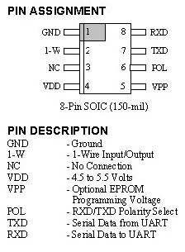
1-wire system
DS2480B: a serial
to 1-wire interface.
TXD and RXD are
serial data (POL sets
polarity)
GND, VDD, VPP are
power lines.
1-wire goes to the bus.

Slide 10
1-wire system
On a 1-wire bus, you can add: A/D and D/A converters, thermometers, timers,…
Each device has a unique address. The main processor can query the bus to find all the devices on it. Then it calls them individually.
Example

Slide 11
1-wire advantages
Simplest hardware, cheap, small devices. Two or 3-wire bus possible.
High-level drivers already written (in C, Java and MS Com).
Interfaces for serial or USB.

Slide 12
1-wire disadvantages
Slow: hard to achieve more than 30kb/s (although 100k is theoretically possible). Only useful for slow sensors: temp., light, etc.
Missing interfaces: PWM, r/c servo control
Low quality software: speed and reliability issues
Some software only available for PCs (no source code).

Slide 13
What is I²C
The name stands for “Inter - Integrated Circuit Bus”
A Small Area Network connecting ICs and other electronic systems
Originally intended for operation on one
single board / PCB
  Synchronous Serial Signal
  Two wires carry information between
  a number of devices
  One wire use for the data
  One wire used for the clock
Today, a variety of devices are available with I²C Interfaces
  Microcontroller, EEPROM, Real-Timer, interface chips, LCD driver, A/D converter

Slide 14
What is I²C used for?
Data transfer between ICs and systems at relatively low rates
  “Classic” I²C is rated to 100K bits/second
  “Fast Mode” devices support up to 400K bits/second
  A “High Speed Mode” is defined for operation up to 3.4M bits/second
Reduces Board Space and Cost By:
  Allowing use of ICs with fewer pins and smaller packages
  Greatly reducing interconnect complexity
  Allowing digitally controlled components to be located close to their point of use

Slide 15
I²C Bus Characteristics
Includes electrical and timing specifications,
and an associated bus protocol
Two wire serial data & control bus implemented with the serial data (SDA) and clock (SCL) lines
  For reliable operation, a third line is required:
  Common ground
Unique start and stop condition
Slave selection protocol uses a 7-Bit slave address
  The bus specification allows an extension to 10 bits
Bi-directional data transfer
Acknowledgement after each transferred byte
No fixed length of transfer

Slide 16
I²C Bus Characteristics (cont’d)
True multi-master capability
  Clock synchronization
  Arbitration procedure
Transmission speeds up to 100Khz
(classic I2C)
Max. line capacitance of 400pF,
approximately 4 meters (12 feet)
Allows series resistor for IC protection
Compatible with different IC technologies

Slide 17
I²C Bus Definitions
Master:
  Initiates a transfer by generating
  start and stop conditions
  Generates the clock
  Transmits the slave address
  Determines data transfer direction
Slave:
  Responds only when addressed
  Timing is controlled by the clock line

Slide 18
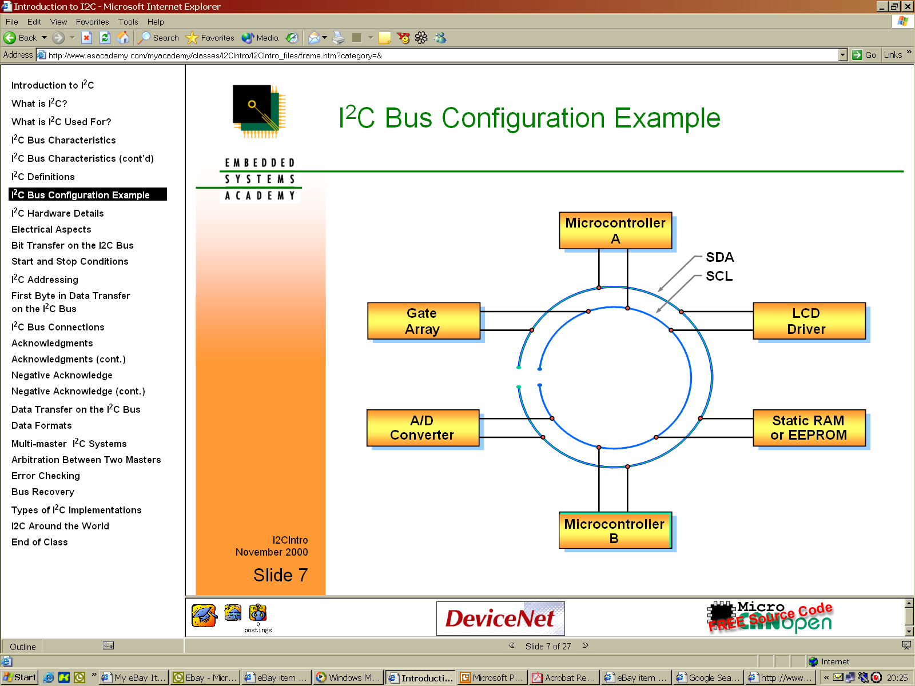
I²C Bus Configuration Example

Slide 19
I²C Hardware Details
Devices connected to the bus must have an open drain or open collector output for serial clock and data signal
The device must also be able to sense the logic level on these pins
All devices have a common ground reference
The serial clock and data lines are connected to Vdd(typically +5V) through pull up resistors
At any given moment the I2C bus is:
  Quiescent (Idle), or
  in Master transmit mode or
  in Master receive mode.

Slide 20
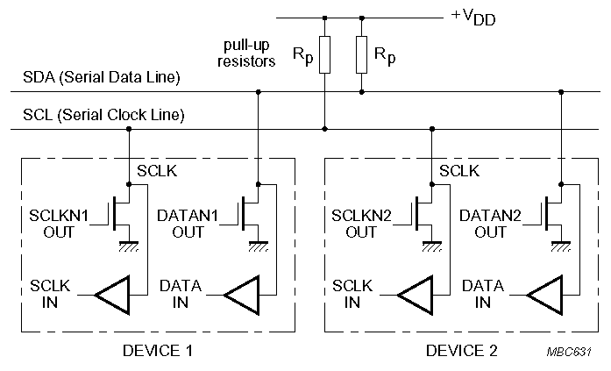
I²C Electrical Aspects
I²C devices are wire ANDed together.
If any single node writes a zero, the entire line is zero

Slide 21
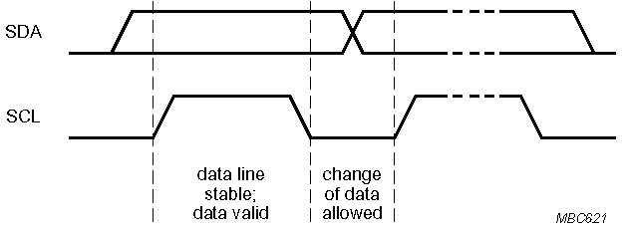
Bit Transfer on the I²C Bus
In normal data transfer, the data line only changes state when the clock is low
SDA
SCL
Data line stable; Data valid
Change of data allowed

Slide 22
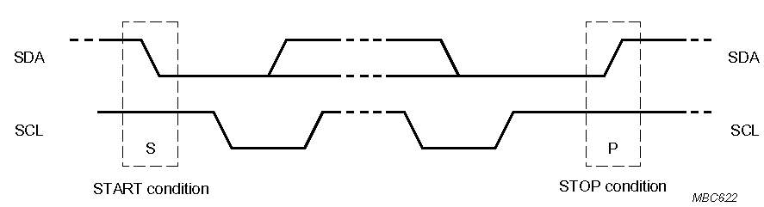
Start and Stop Conditions
A transition of the data line while the clock line is high is defined as either a start or a stop condition.
Both start and stop conditions are generated by the bus master
The bus is considered busy after a start condition, until a stop condition occurs
SDA
SDA
SCL
SCL
Start Condition
Stop Condition

Slide 23
I²C Addressing
Each node has a unique 7 (or 10) bit address
Peripherals often have fixed and programmable address portions
Addresses starting with 0000 or 1111 have special functions:-
  0000000 Is a General Call Address
  0000001 Is a Null (CBUS) Address
  1111XXX Address Extension
  1111111 Address Extension – Next Bytes are the Actual Address

Slide 24
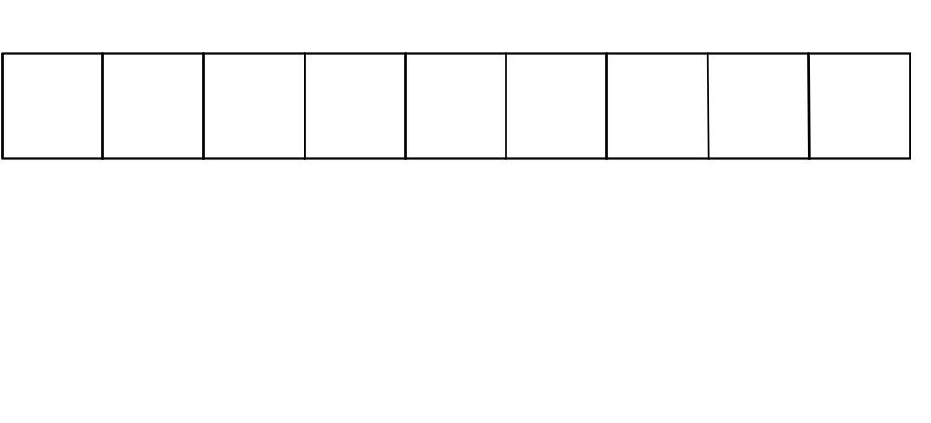
First Byte in Data Transfer on the I²C Bus
MSB
LSB
R / Wr
7 – Bit Slave Address
ACK
R/Wr
0 – Slave written to by Master
1 – Slave read by Master
ACK – Generated by the slave whose address has been output.

Slide 25
I²C Bus Connections
Masters can be
  Transmitter only
  Transmitter and receiver
Slaves can be
  Receiver only
  Receiver and transmitter

Slide 26
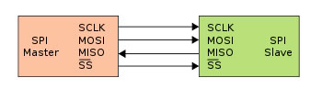
Serial Peripheral Interface
What is it?
Basic SPI
Capabilities
Protocol
Pros and Cons
Uses
Serial Peripheral Interface
http://upload.wikimedia.org/wikipedia/commons/thumb/e/ed/
SPI_single_slave.svg/350px-SPI_single_slave.svg.png

Slide 27
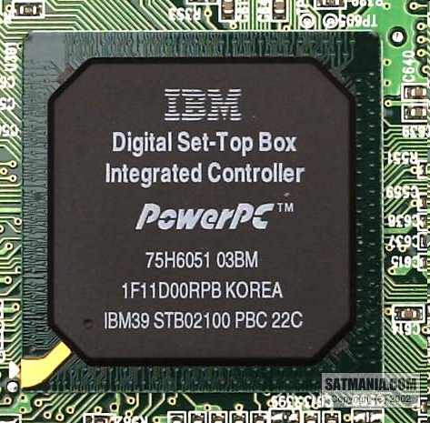
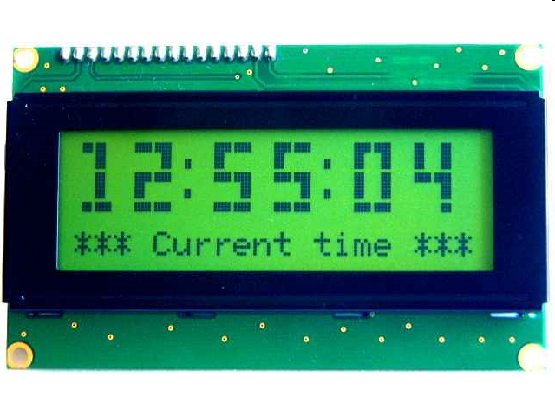
What is SPI?
Serial bus protocol
Fast, easy to use, and simple
Very widely used
Not “standardized”

Slide 28
SPI Basics
A 4-wire communications bus
Typically communicate across short distances
Supports
  Single master
  Multiple slaves
Synchronized
  Communications are “clocked”

Slide 29
SPI Capabilities
Always full-duplex
  Communicates in both directions simultaneously
  Transmitted (or received) data may not be meaningful
Multiple Mbps transmission speeds
  0-50 MHz clock speeds not uncommon
Transfer data in 4 to 16 bit characters
Supports multiple slaves

Slide 30
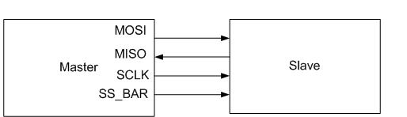
SPI bus wiring
Bus wires
  Master-Out, Slave-In (MOSI)
  Master-In, Slave-Out (MISO)
  System Clock (SCLK)
  Slave Select/Chip Select (SS1#, …, SS#n or CS1, …, CSn)
Master asserts slave/chip select line
Master generates clock signal
Shift registers shift data in and out

Slide 31
SPI signal functions
MOSI – carries data out of master to slave
MISO – carries data out of slave to master
  Both MOSI and MISO are active during every transmission
SS# (or CS) – unique line to select each slave chip
SCLK – produced by master to synchronize transfers

Slide 32
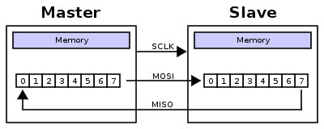
SPI uses a “shift register” model of communications
Master shifts out data to Slave, and shifts in data from Slave
http://upload.wikimedia.org/wikipedia/commons/thumb/b/bb/SPI_8-bit_circular_transfer.svg/400px-SPI_8-bit_circular_transfer.svg.png

Slide 33
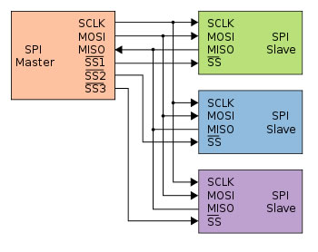
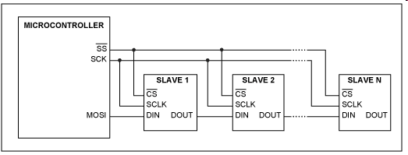
Two bus configuration models
Some wires have been renamed
Master and multiple daisy-chained slaves
http://www.maxim-ic.com/appnotes.cfm/an_pk/3947
Master and multiple independent slaves
http://upload.wikimedia.org/wikipedia/commons/thumb/f/fc/SPI_three_slaves.svg/350px-SPI_three_slaves.svg.png

Slide 34
SPI clocking: there is no “standard way”
Four clocking “modes”
  Two phases
  Two polarities
Master and selected slave must be in the same mode
During transfers with slaves A and B, Master must
  Configure clock to Slave A’s clock mode
  Select Slave A
  Do transfer
  Deselect Slave A
  Configure clock to Slave B’s clock mode
  Select Slave B
  Do transfer
  Deselect Slave B
Master reconfigures clock mode on-the-fly!

Slide 35
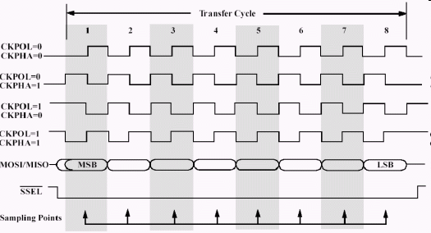
SPI timing diagram
Timing Diagram – Showing Clock polarities and phases
http://www.maxim-ic.com.cn/images/appnotes/3078/3078Fig02.gif

Slide 36
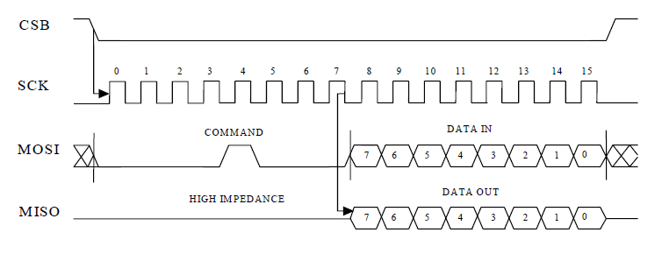
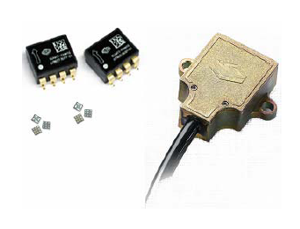

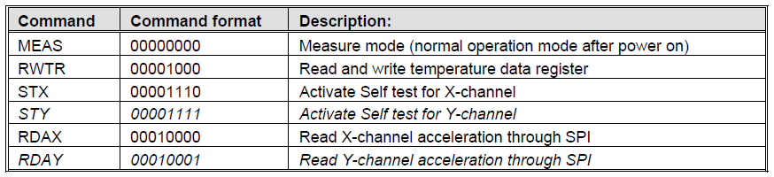
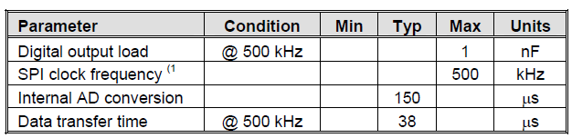
SPI example: decode what’s happening

Slide 37
SPI tradeoffs: the pros and cons
Pros
  Fast for point-to-point connections
  Easily allows streaming/constant data inflow
  No addressing in protocol, so it’s simple to implement
  Broadly supported
Cons
  Slave select/chip select makes multiple slaves more complex
  No acknowledgement (can’t tell if clocking in garbage)
  No inherent arbitration
  No flow control (must know slave speed)

Slide 38
SPI is used everywhere!
Peripherals
  LCDs
  Sensors
  Radios
  Lots of other chips
Microcontrollers
  Almost all MCUs have SPI masters
  Some have SPI slaves

Slide 39
Serial Networking
Slight tweaks on RS232: RS422 and RS485.
RS422 is a faster version of RS232: individual signal wires are replaced by twisted pairs, which can be driven faster (10Mb/s, up to 40 ft).
RS485 is a multi-drop version of RS422: in “half duplex” mode, many nodes can send and receive on the same twisted pair (10 Mb/s). RS485 is a true “network” and a good choice for networks of simple devices.

Slide 40
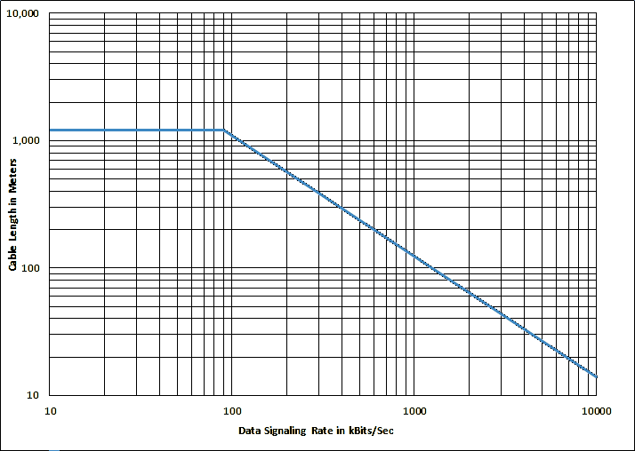
RS-422

Slide 41
USB
USB or Universal Serial Bus is a popular option for external device communication. USB 2.0 is very fast (480 Mb/s), USB 1.1 is 12 Mb/s.
It’s a 4-wire system, which is really point-to-point. A “network” is built using hubs.
Tricky to use for small networks, because of topology constraints (limited depth -> limited nodes in a chain), and the need for many hubs.

Slide 42
Ethernet
Like USB, really a point-to-point topology, so hubs needed to build networks.
Ethernet driver chips relatively complex and expensive and the protocol (TCP/IP) is complex.
Still the best way to put a device “on the network” without a supporting computer.

Slide 43
Irda
Infrared protocol based on serial communication. Many serial modules (e.g. the ones in PICs) support Irda.
2 Mb/s common.
Very limited range, high power required.

Slide 44
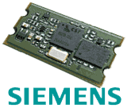

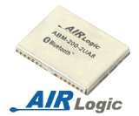
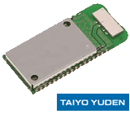
Bluetooth
Very popular wireless standard.
Class 2 Bluetooth (20m range)
available via compact (1” x ½”)
modules for $60-70.
Communication via fast serial
or USB. 768 kb/s typical.
Some support for analog data,
including speech.
See http://www.btdesigner.com/

Slide 45
Bluetooth
Fast - Bluetooth 2.0 + EDR
Low Energy - Bluetooth Low Energy
Serial – virtual serial port

Slide 46
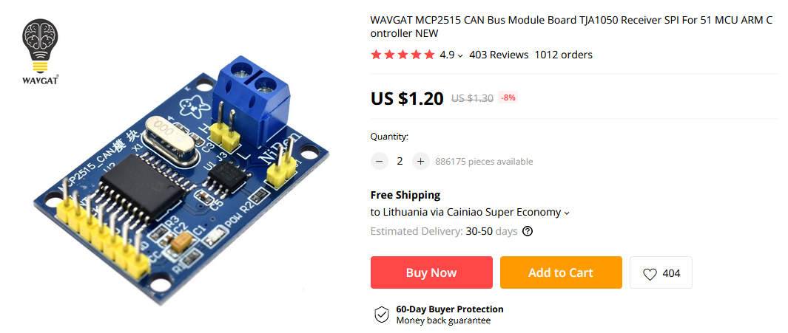
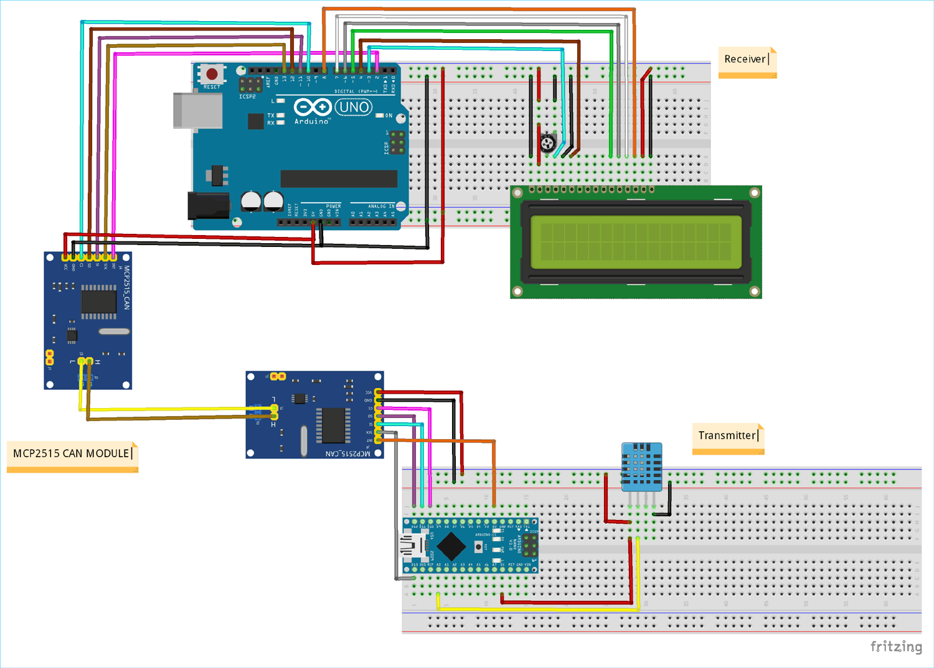
CANBUS
Automotive
Low Energy
Serial

