Slide 1
Introduction to robotics
4. Sensors
Aistis Raudys ir Vytautas Valaitis
2021

Slide 2
What type of sensors
Acoustics
Vibrations
Chemical
Environments (humidity, etc.)
Positions
Optical
Temperature
Distance
Others

Slide 3
Analogue and Digital Sensors
Digital - is or is not
Analog measures level
Subsequently, a digital signal is obtained in combination with the ADC
Or 0/1 when the limit is exceeded
Digital over I2C
Resistance varies
Thermocouples

Slide 4
Analog to Digital Converter (ADC)
Converts an analog signal to a digital one
Has accuracy measured in bits
10, 12, 16 bits

Slide 5
How the sensors work
Microphones
Vibration measurement
Seismic meters

Slide 6
Sensor ideas
The environment changes materials
Generates a weak current
  Microphones
  Thermo
Changes the resistance
  Photo
  Pressure
  Thermo
  Angle
The capacitor capacity changes
Other

Slide 7
Detectable Phenomenon
Stimulus | Quantity
Acoustic | Wave (amplitude, phase, polarization), Spectrum, Wave Velocity
Biological & Chemical | Fluid Concentrations (Gas or Liquid)
Electric | Charge, Voltage, Current, Electric Field (amplitude, phase, polarization), Conductivity, Permittivity
Magnetic | Magnetic Field (amplitude, phase, polarization), Flux, Permeability
Optical | Refractive Index, Reflectivity, Absorption
Thermal | Temperature, Flux, Specific Heat, Thermal Conductivity
Mechanical | Position, Velocity, Acceleration, Force, Strain, Stress, Pressure, Torque

Slide 8
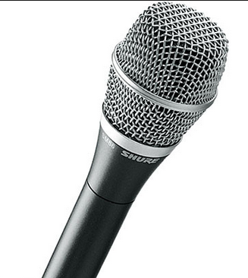
Microphones
Converts sound / vibrations into electrical pulses
  dynamic microphone
  condenser microphone
  Electret microphone
Converts electrical pulses to a digital signal (ADC)

Slide 9
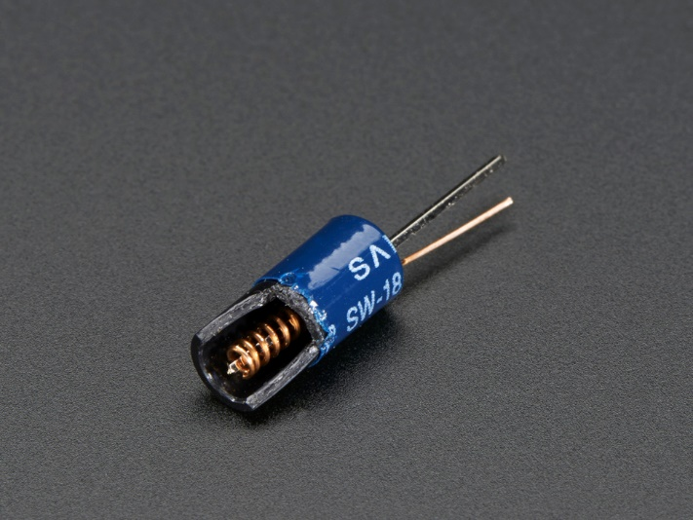
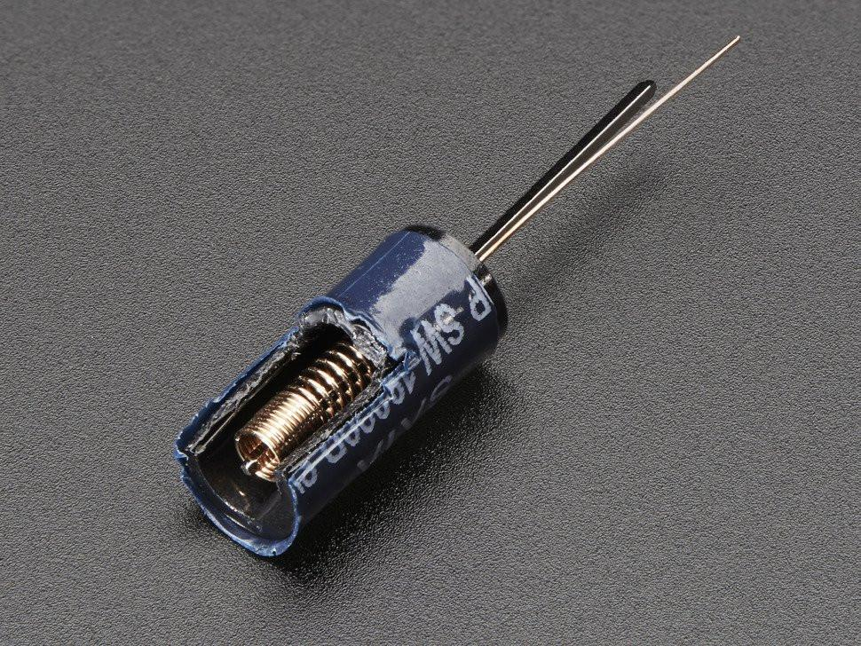
Vibrations

Slide 10
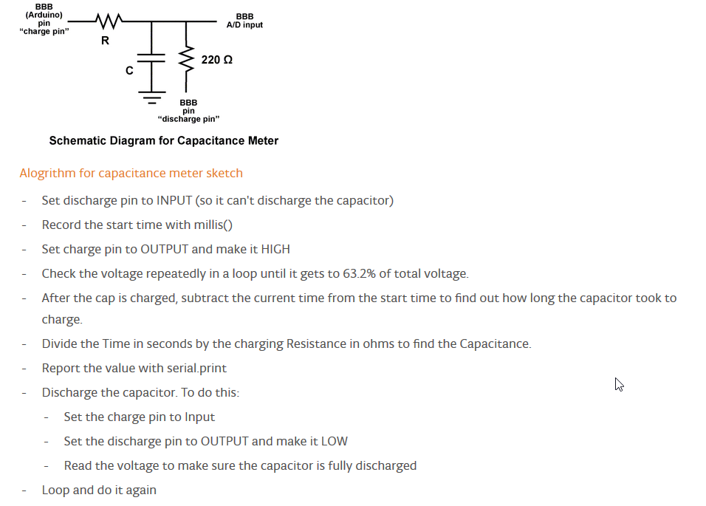
Capacitor capacity
https://www.arduino.cc/en/Tutorial/CapacitanceMeter

Slide 11
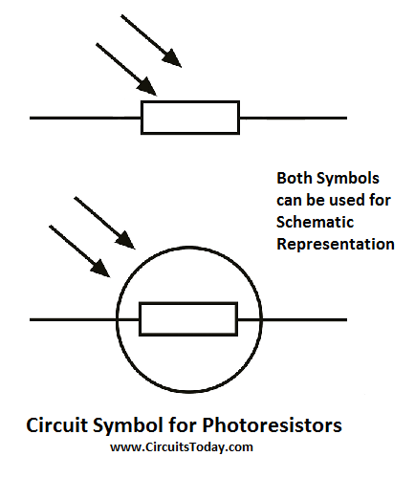
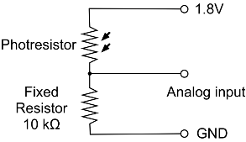
Photo resistors
http://www.circuitstoday.com/photoresistor

Slide 12
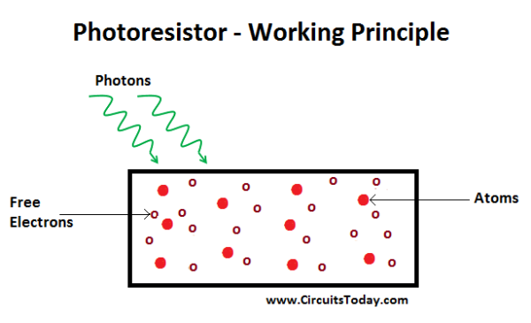
Photo resistors
http://www.circuitstoday.com/photoresistor

Slide 13
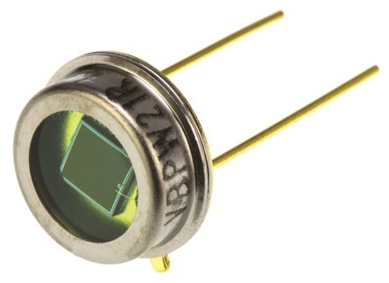
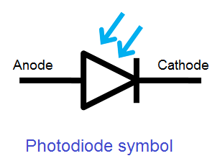
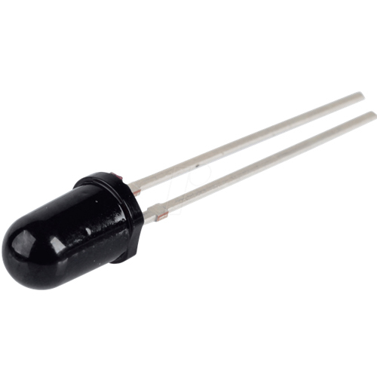
Foto diods

Slide 14
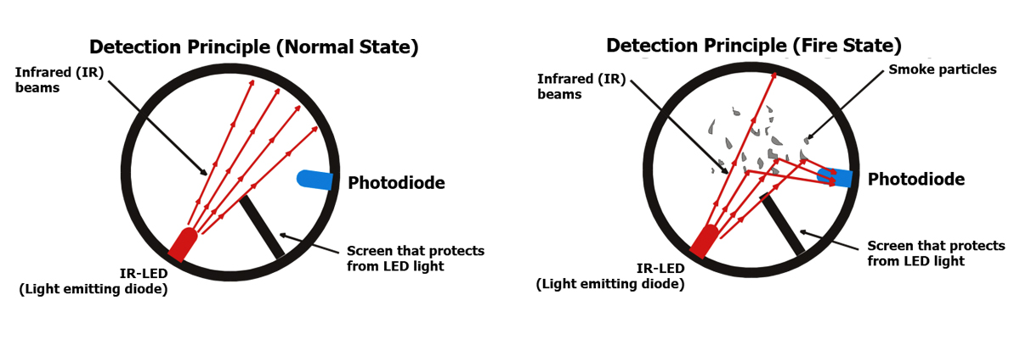
Foto diods

Slide 15
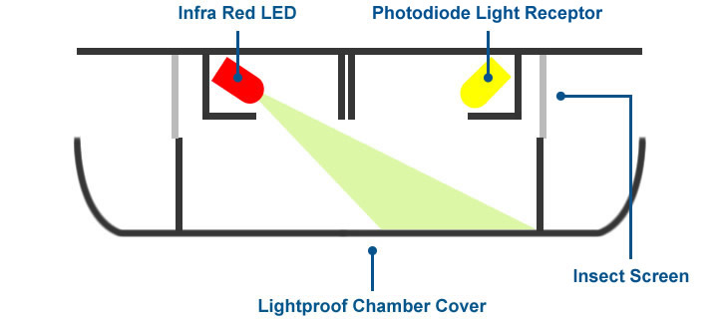
Smoke sensors

Slide 16
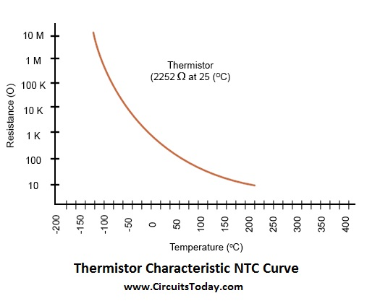
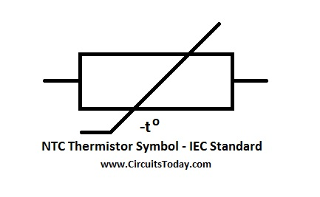
Thermistors
http://www.circuitstoday.com/thermistors-working-types-applications

Slide 17
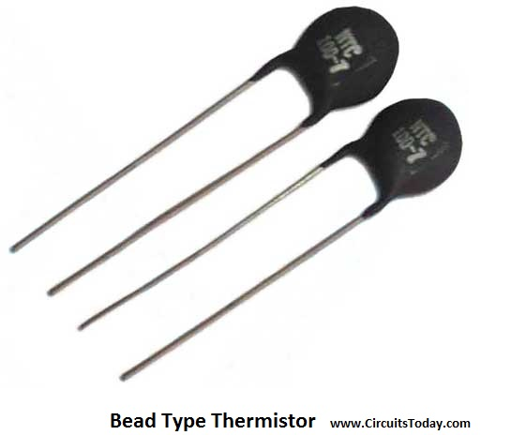
Thermistors
PTC Thermistor
NTC Thermistor
http://www.circuitstoday.com/thermistors-working-types-applications

Slide 18
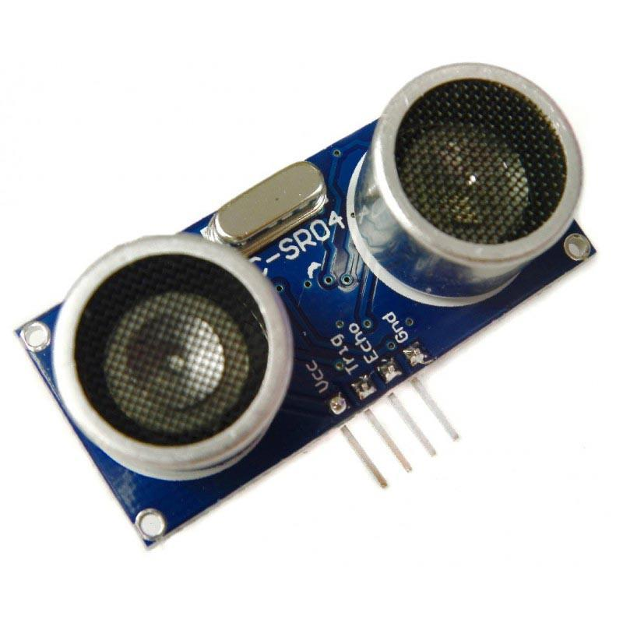
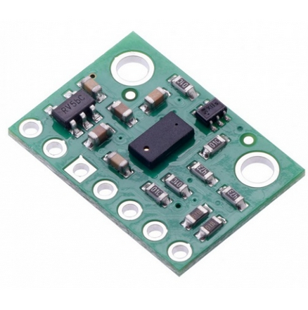
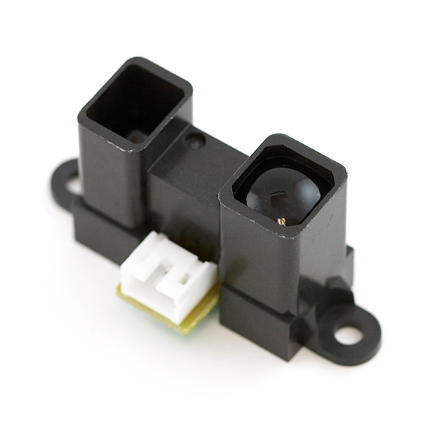
Distance sensors
Ultrasound
Infrared
Microwave
ToF
The police like it

Slide 19
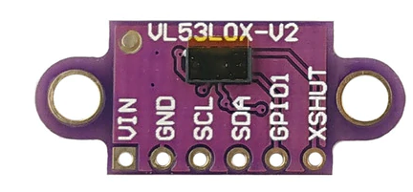
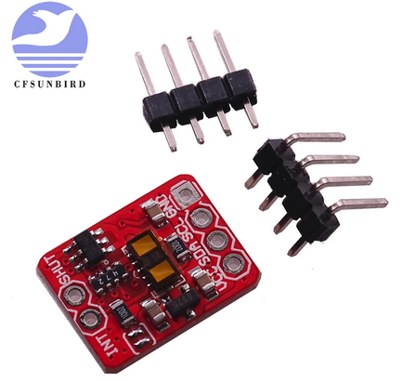
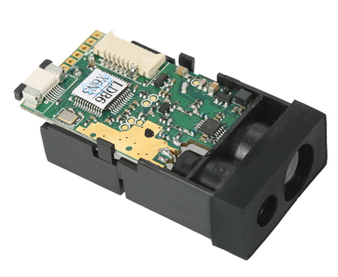
Distance sensors
ToF
Measures the speed of light
Used in LIDAR

Slide 20
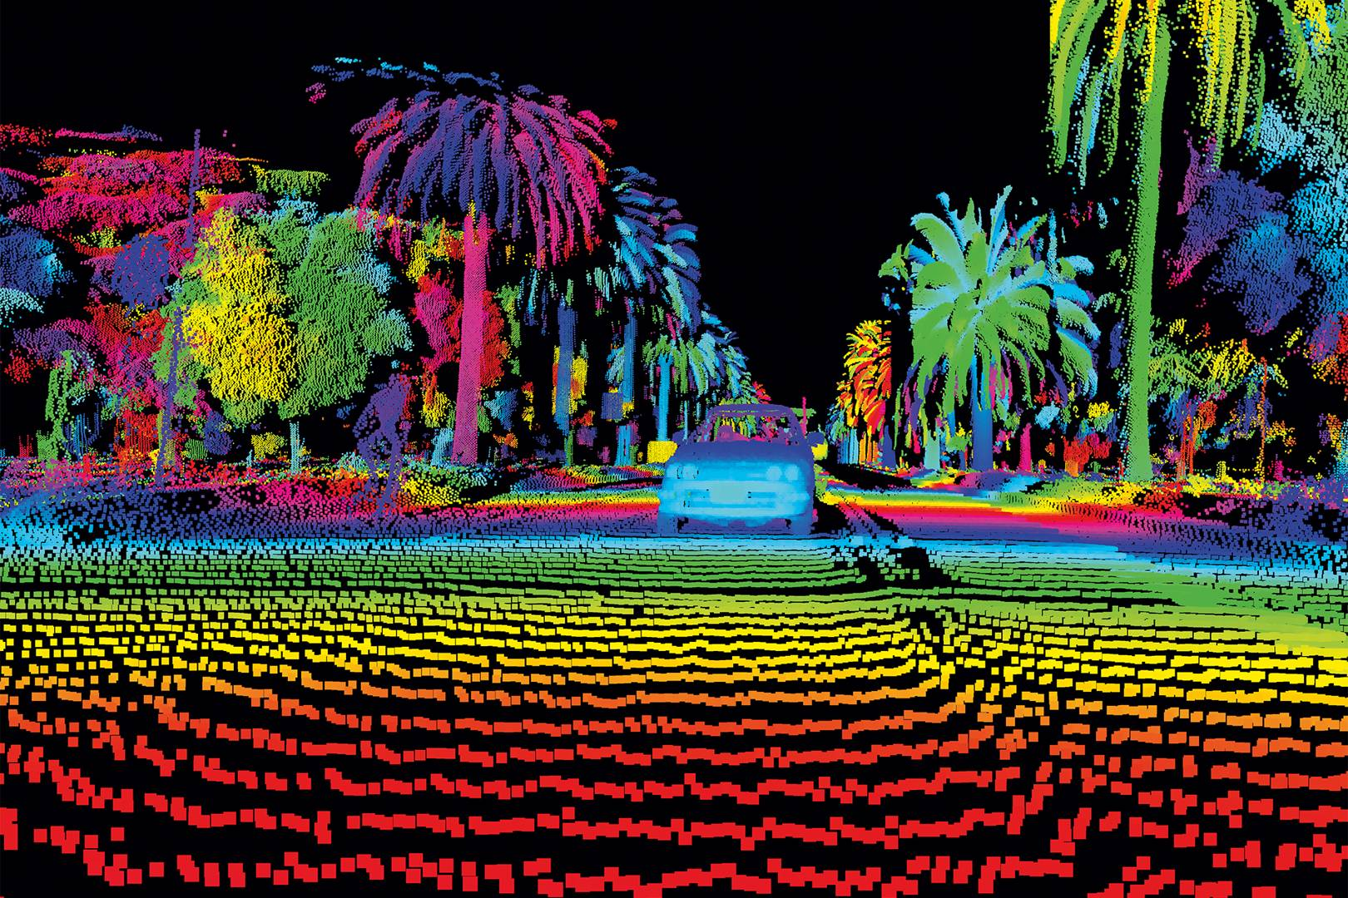

Slide 21
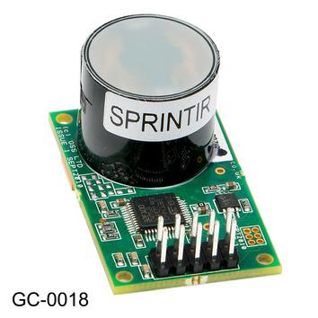
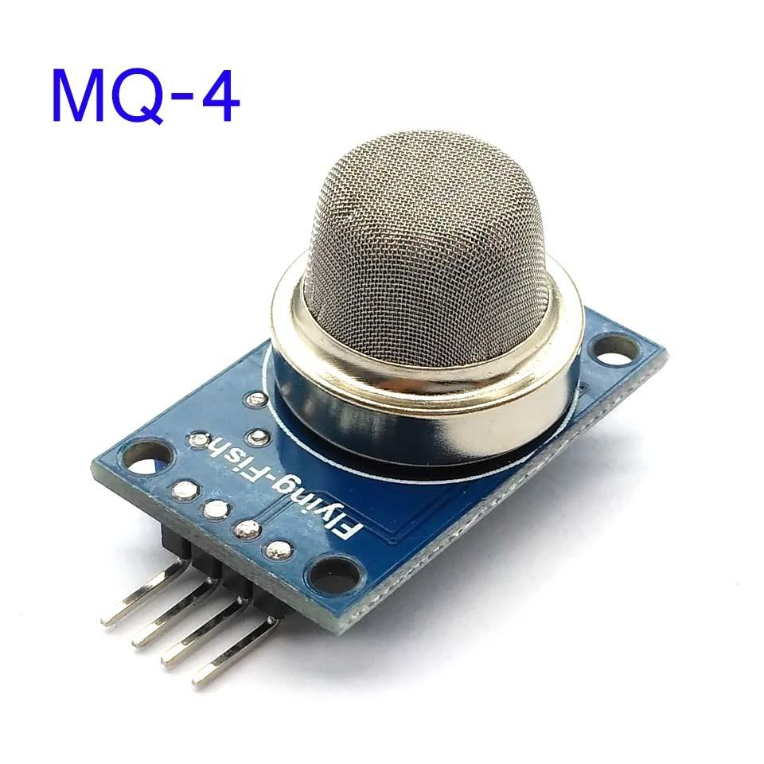
Gas sensors
CO2
CO
Methane
Alcohol vapor
Ir t.t.

Slide 22

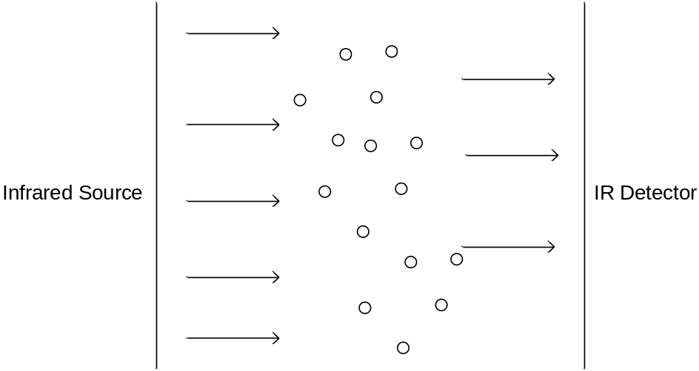
CO₂ Gas Sensor
CO₂ sensor measures gaseous CO₂ levels in an environment
Measures CO₂ levels in the range of 0-5000 ppm
Monitors how much infrared radiation is absorbed by CO₂ molecules

Slide 23
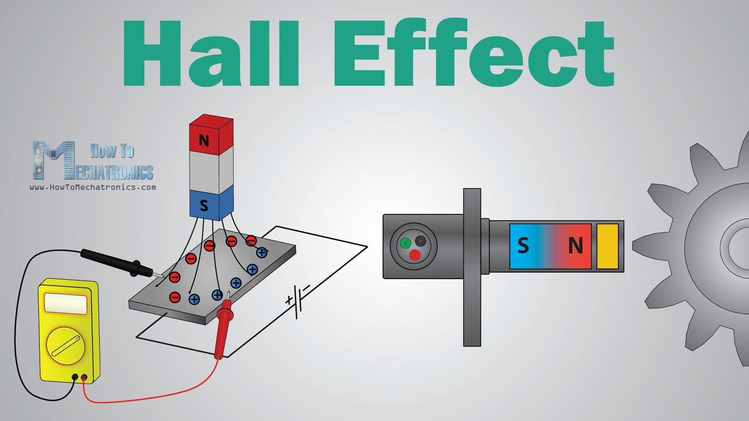
Magnetic field sensors
Hall effect
Analog
Digital
Can detect poles
https://en.wikipedia.org/wiki/Hall_effect

Slide 24
Hall_Sensor.mp4

Slide 25
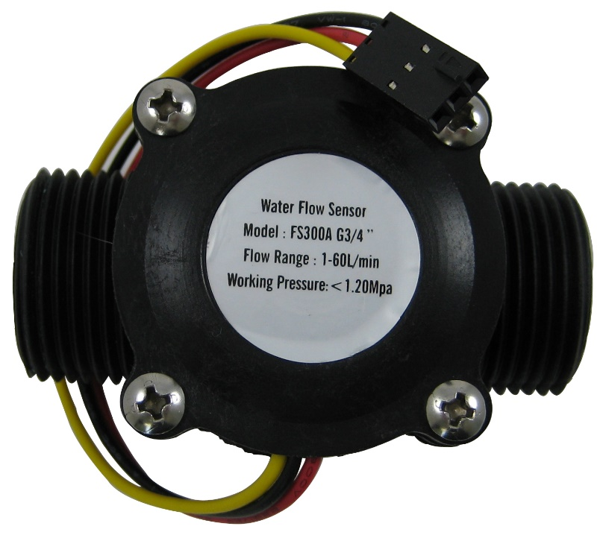
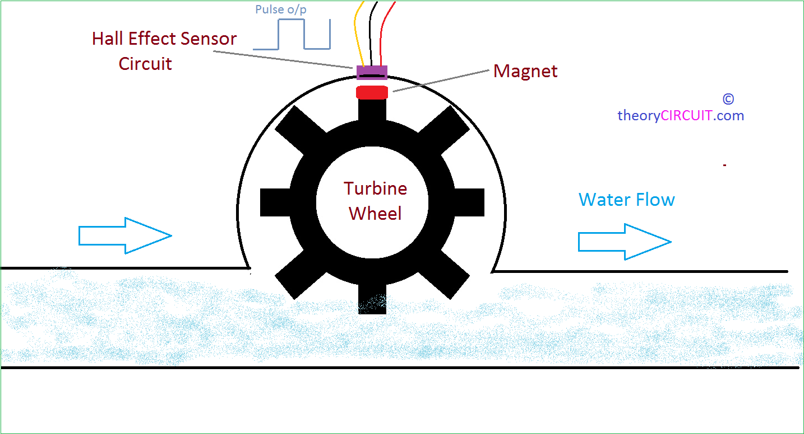
Water / liquid / air flow sensors
Uses hall or
Optical principle

Slide 26
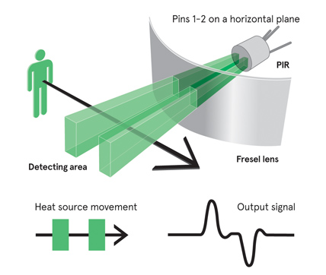
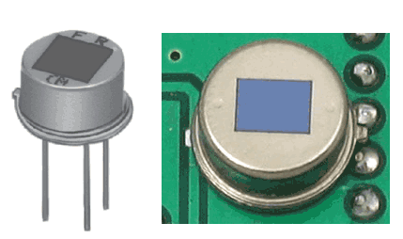
PIR seniors
Reacts to heat rays
Responds to change
https://learn.adafruit.com/pir-passive-infrared-proximity-motion-sensor/how-pirs-work

Slide 27
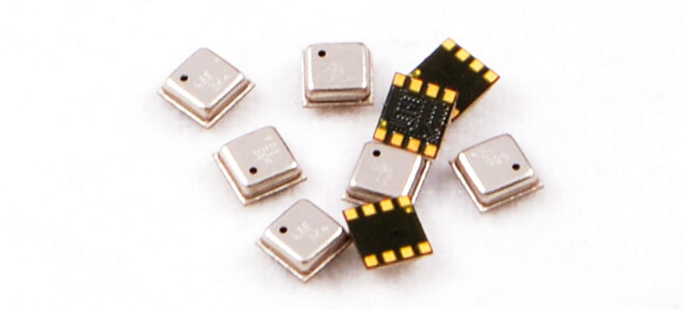
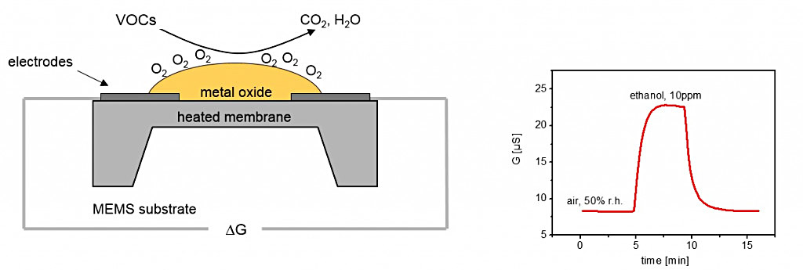
volatile organic compounds (VOC)
Bosch BME680
Working principle
These sensors work by initiating REDOX chemical reactions in a porous layer heated by a filament. This results in ionised local air and modified electrical resistance across the sensor, somewhat proportional to the air quality: A cleaner air will produce less such reactions, resulting in poor conductivity and increased resistance, while a polluted air will increase conductivity resulting in lower resistance.

Slide 28
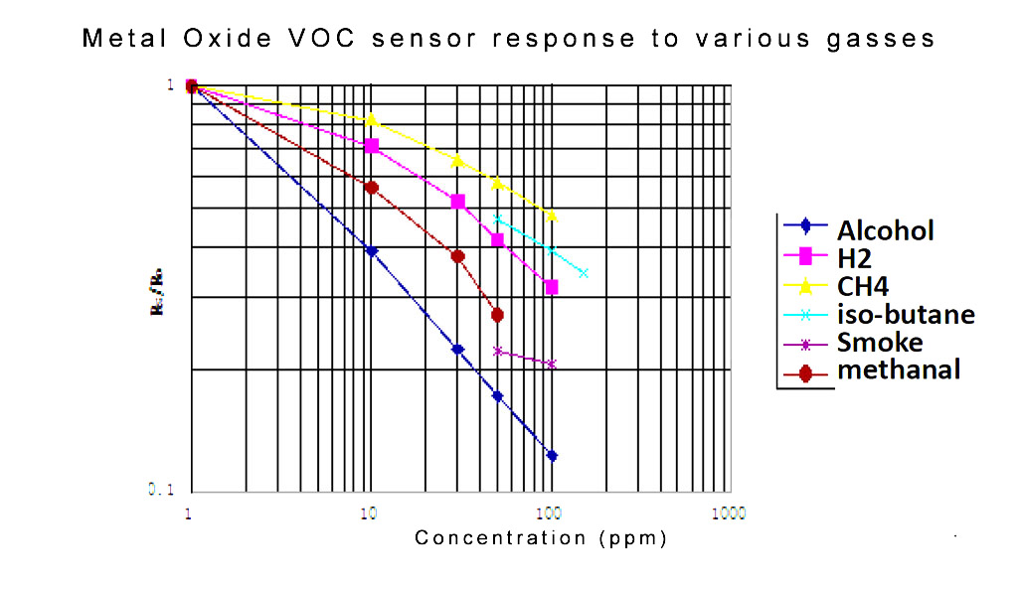
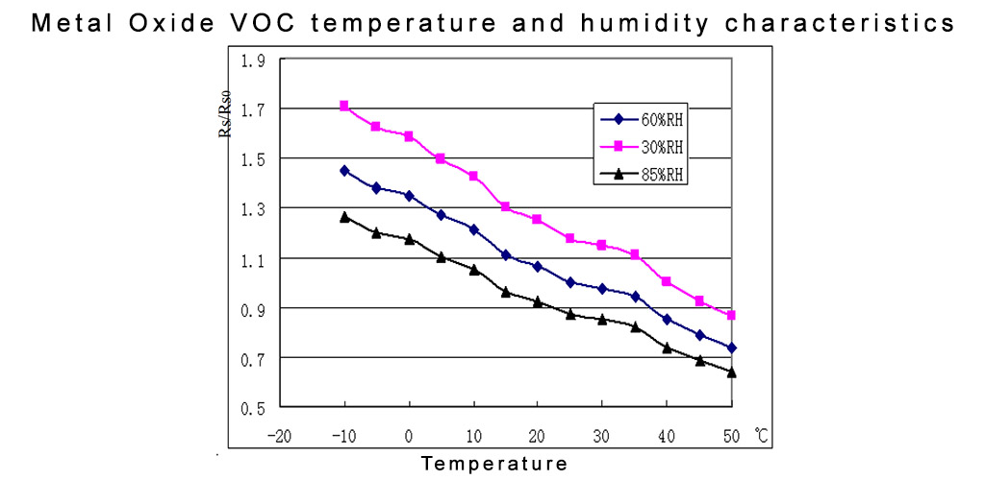
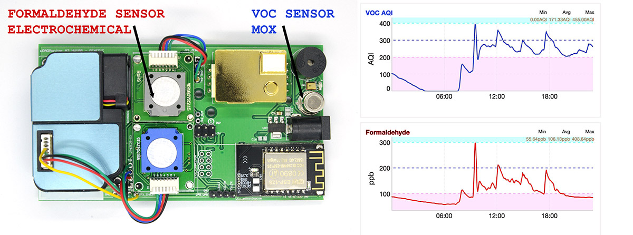

Slide 29
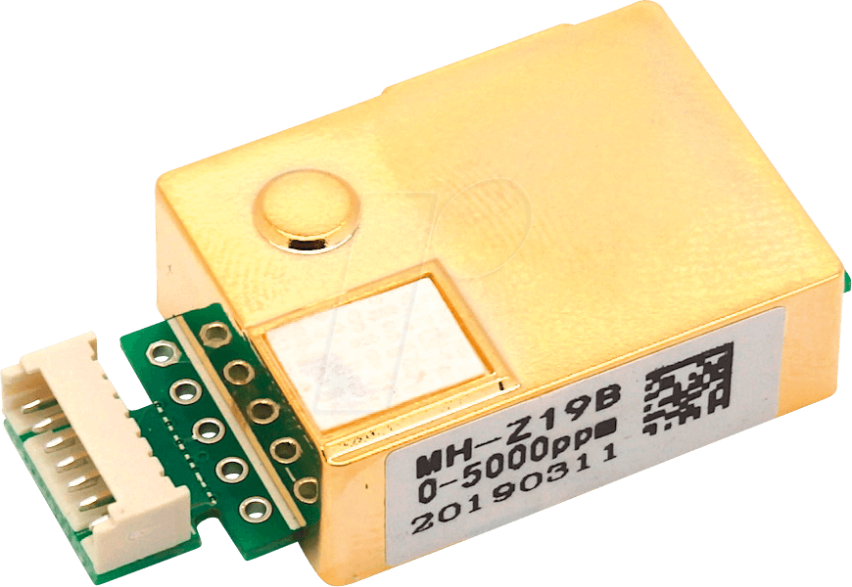
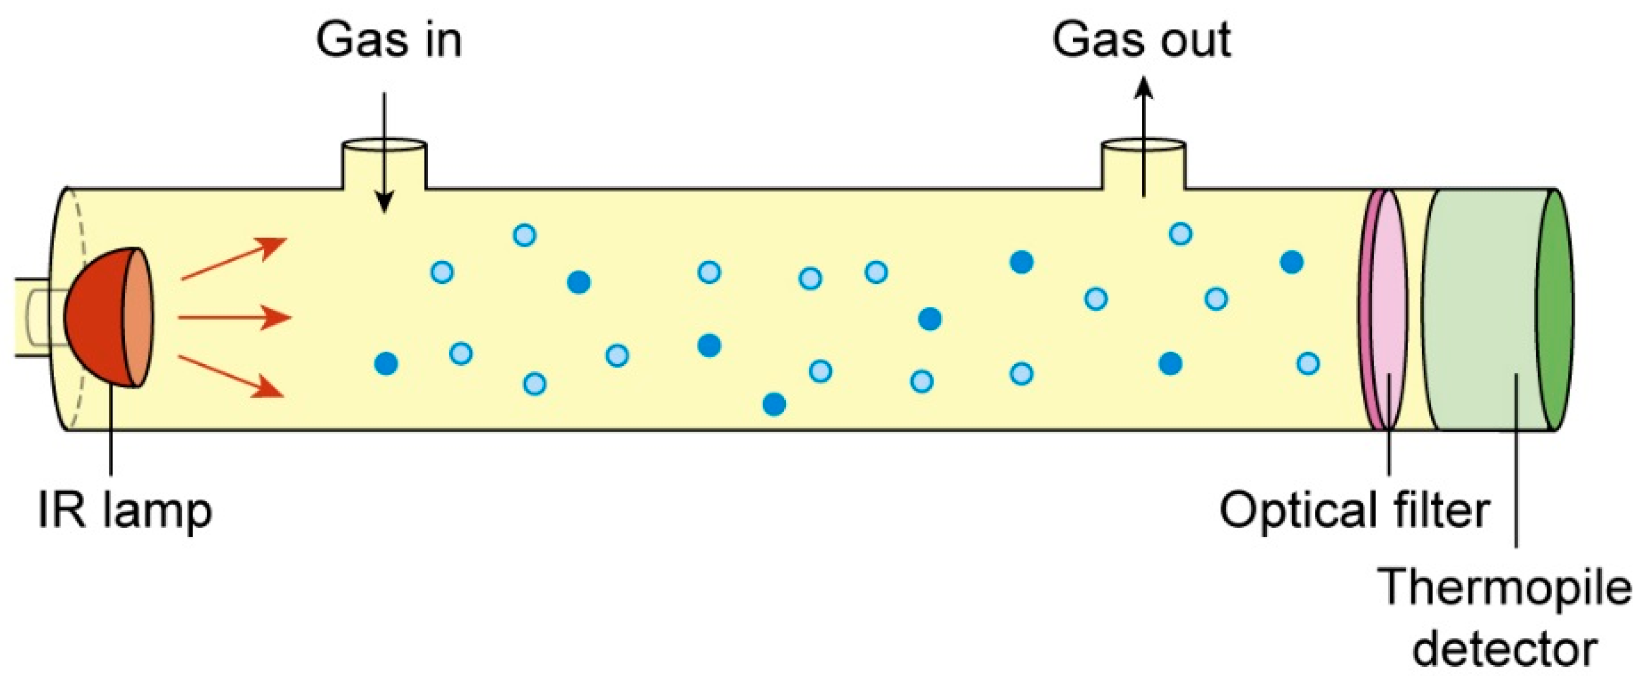
CO2 sensor

Slide 30
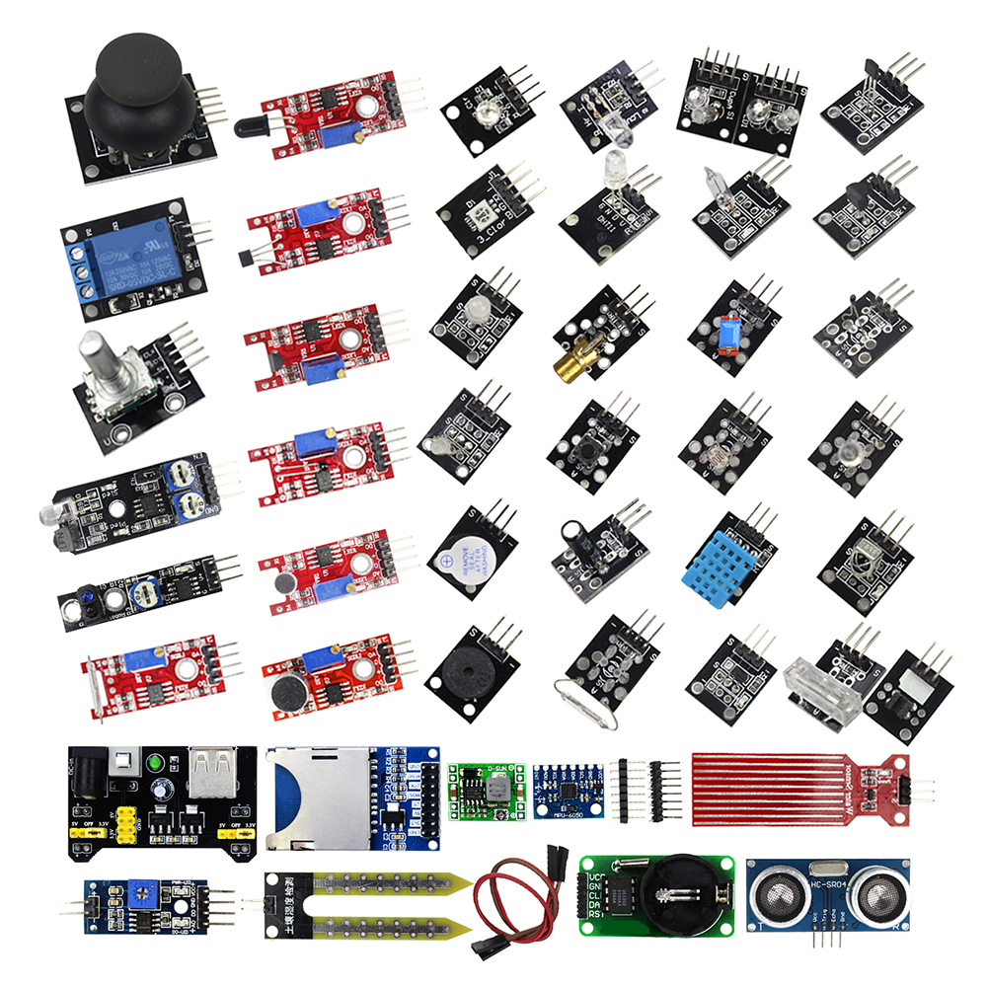

Slide 31
And many other sensors

