Slide 2
Introduction to PID Control
Brad Schofield, BE ICS AP

Slide 3
https://www.youtube.com/watch?v=ng2PVOePN68

Slide 4
Course plan
09:00-10:00: What is PID control?
10:00-10:30: The UNICOS PID controller
10:30-10:45: Coffee
10:45-11:15: Manual tuning
11:15-12:00: Manual tuning exercise
12:00-14:00: Lunch
14:00-15:00: Autotuning
15:00-16:00: Autotuning exercise
16:00-16:15: Coffee
16:15-17:00: Questions & Wrap-up

Slide 5
What is PID Control?
Let’s take a step back… What is control?
Control is just making a dynamic process behave in the way we want
We need 3 things to do this:
  A way to influence the process
  A way to see how the process behaves
  A way to define how we want it to behave

Slide 6
Defining behaviour
We usually specify a value we want some output of the system to have
  Usually called the Setpoint (SP)
Can be the temperature of a room, the level in a tank, the flow rate in a pipe…
The value can be fixed, or may change with time…

Slide 7
Influencing the process
We need some kind of control input which can create changes in the behavior of the process
Can be a heater, a valve, a pump…
Typically it is not the same physical quantity as what we are controlling

Slide 8
Observing behavior
If we knew exactly how the process worked, we would know what the output would be for a given control input…
Most of the time we don’t know exactly, so we need to measure what the process does
  Usually called Measured Variable (MV) or Process Variable (PV)

Slide 9
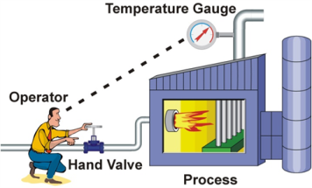
Feedback Control
Now we have a measurement (MV), some value that we want it to be (SP), and some way to make changes to the process (control input)
We can ‘close the loop’

Slide 10
The Controller as a System
Now we can see that any controller can be thought of as a system that takes a setpoint and a measured value as inputs, and gives a control signal as an output
SP
Controller
Control
MV

Slide 11
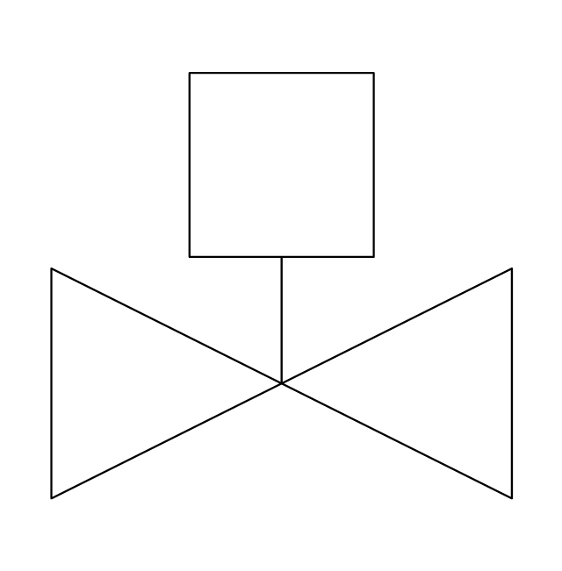

The Controller as a System
SP
Controller
Control
MV
The controller needs to convert two signals of one physical quantity (such as temperature) into one signal of another (such as valve position)

Slide 12
The Controller as a System
We know that the process is a dynamic system:
  Its outputs depend on current inputs as well as its past state
For the controller to deal with this, it makes sense that it should be a dynamic system too

Slide 13
The Error Signal
Very often we can think of the controller acting on the difference between SP and MV:
+
Error
Controller
SP
Σ
Control
-
MV

Slide 14
The Closed Loop
+
e
Controller
u
Process
SP
Σ
-
MV
This is the ‘classic’ closed loop block diagram representation of a control system

Slide 15
A Dynamic Controller
We said that since the process is dynamic (dependent on inputs made at different times), it makes sense that the controller should be too
How do we usually think of time?
  ‘Present’
  ‘Past’
  ‘Future’

Slide 16
Splitting the Controller
Present
+
e
u
Process
SP
Σ
Past
-
Future
MV

Slide 17
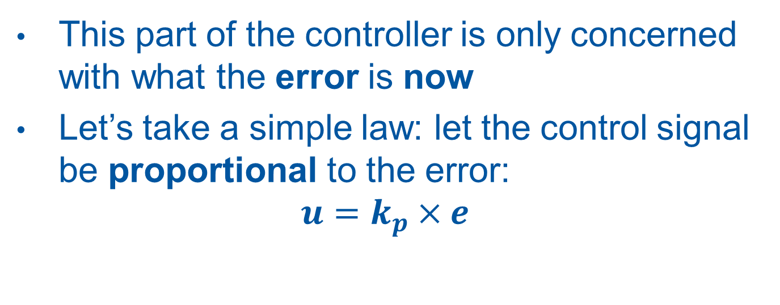
The ‘Present’
This part of the controller is only concerned with what the error is now
Let’s take a simple law: let the control signal be proportional to the error:
$$u=k_{p}×e$$

Slide 18
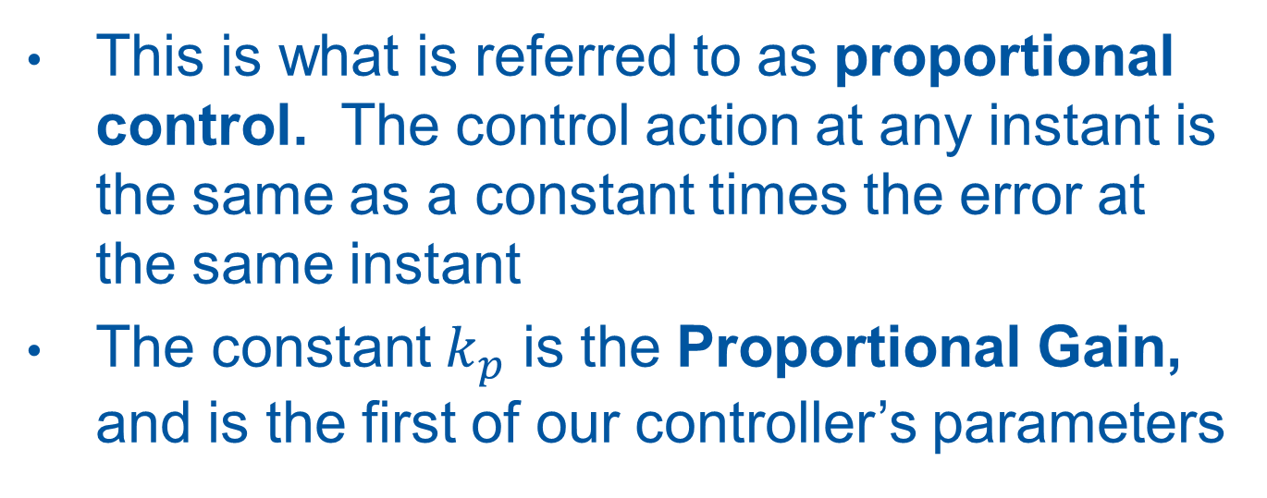
Proportional Control
This is what is referred to as proportional control. The control action at any instant is the same as a constant times the error at the same instant
The constant $k_{p}$ is the Proportional Gain, and is the first of our controller’s parameters

Slide 19

Proportional Control
$$u=k_{p}×e$$
Proportional
+
e
u
Process
SP
Σ
Past
-
Future
MV

Slide 20
Is Proportional Control enough?
Intuitively it seems like it should be fine on its own: when the error is big, the control input is big to correct it. As the error reduced so does the control input.
But there are problems…

Slide 21
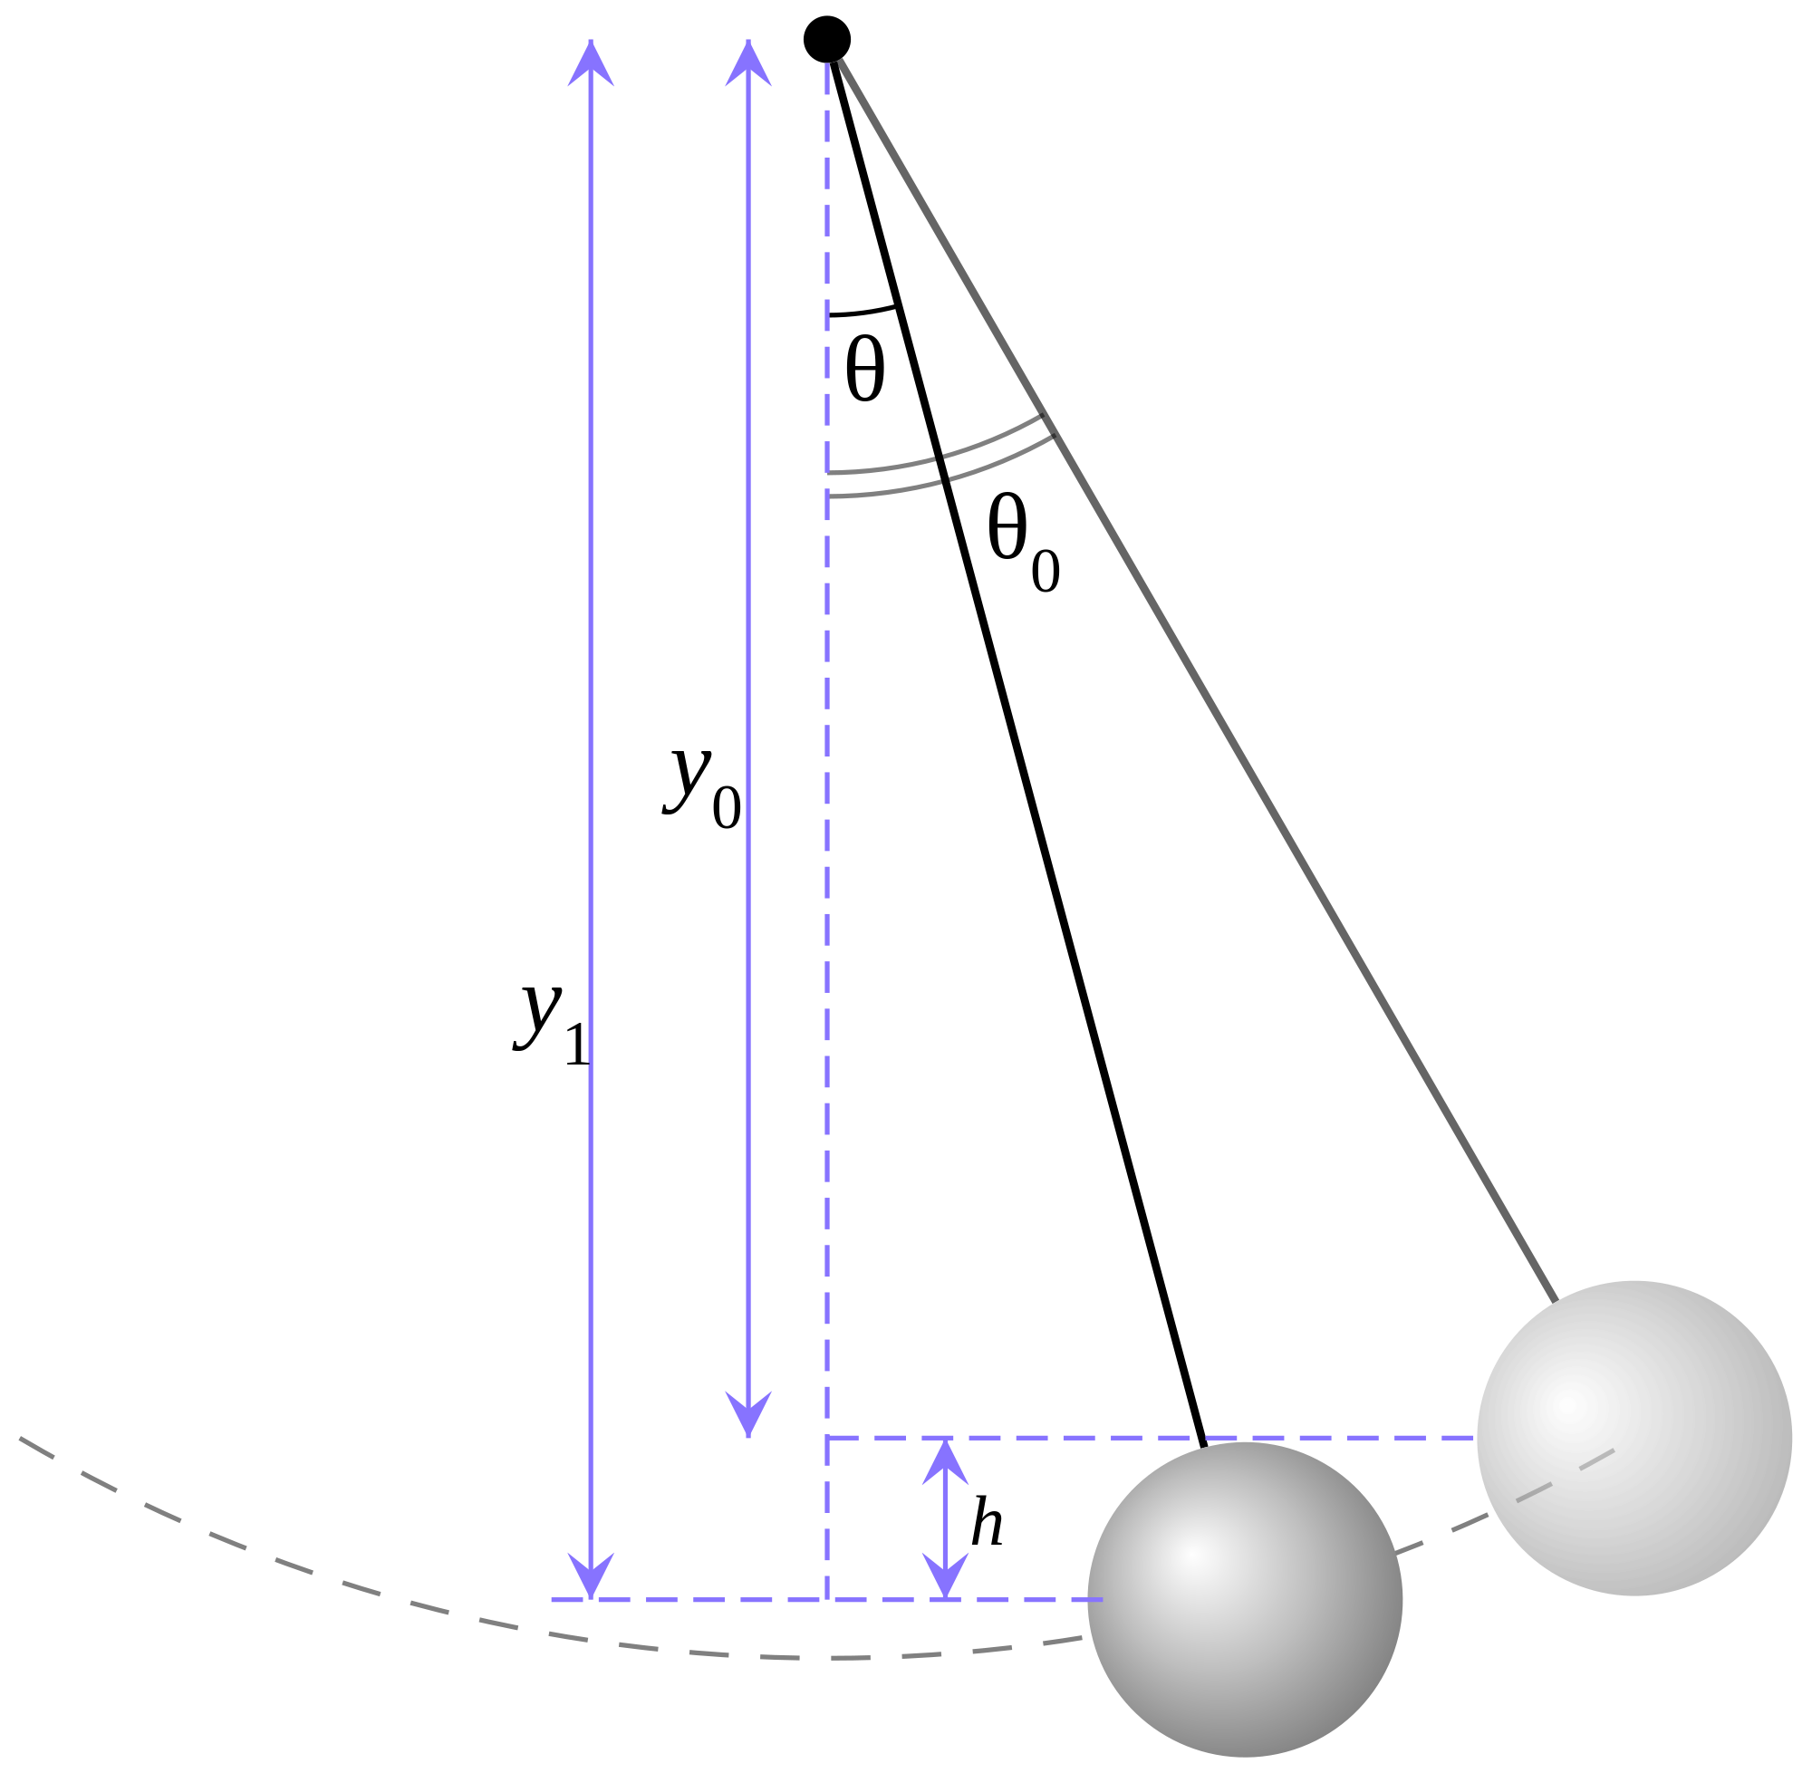
Problem 1
Think of a pendulum.
If the setpoint is hanging straight down, then gravity acts as a proportional controller for the position…
Pendulum will oscillate!

Slide 22
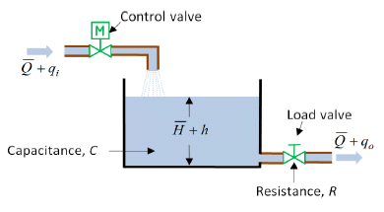
Problem 2
What happens when the error is zero?
Control input is zero.
Causes problems if we need to have a nonzero control value while at our setpoint

Slide 23
Problem 2: steady state error
This problem is normally called steady state error
It’s a confusing name. The issue is just that the controller can’t produce any output when the error is zero.
Easiest to see for tank level control: If there is a constant flow out of the tank, the controller must provide the same flow in, while the level is at the setpoint.

Slide 24
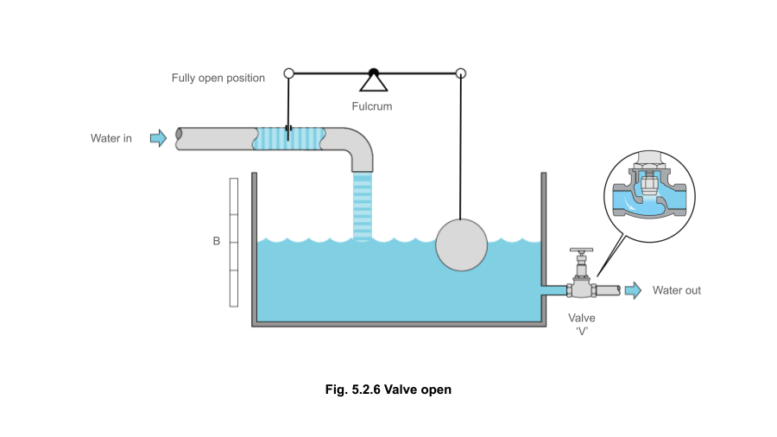
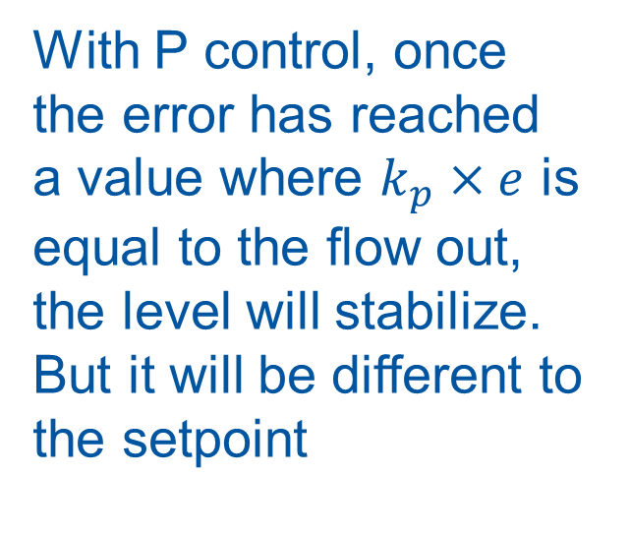
Problem 2: steady state error
With P control, once the error has reached a value where $k_{p}×e$ is equal to the flow out, the level will stabilize. But it will be different to the setpoint

Slide 25
P control problem summary
Problem 1: oscillations
  P control will give us oscillations in some processes, regardless of the value of the gain parameter.
Problem 2: steady state error
  P control cannot give us a nonzero value of the control at zero error for some types of process

Slide 26
Solving P control’s problems
How to get rid of steady state error?
Let’s ignore the present for the moment and concentrate on what has happened in the past

Slide 27
Solving steady state error: ‘the Past’
Proportional
+
e
u
Process
SP
Σ
Past
-
Future
MV
Let’s look at the error in the past

Slide 28
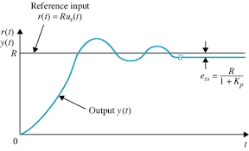
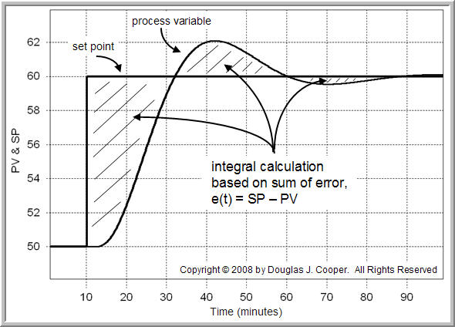
Solving steady state error
We can examine how the controller error has evolved in the past
If we sum up the past values of the error, we can get a value that increases when there is a constant error

Slide 29
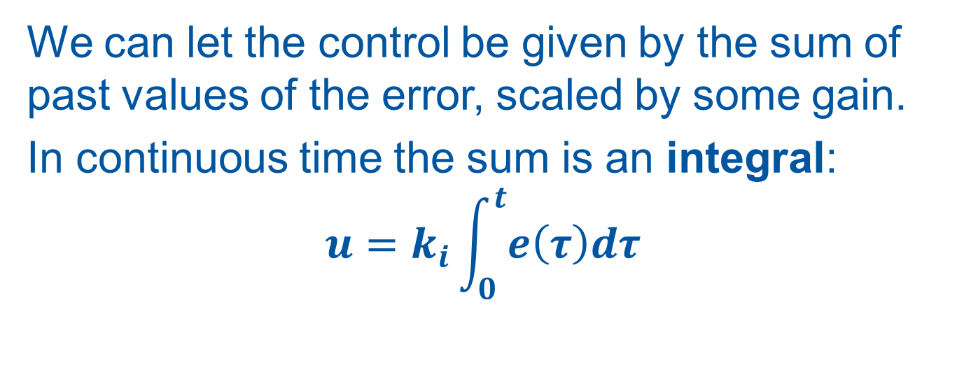
Integral Action
We can let the control be given by the sum of past values of the error, scaled by some gain.
In continuous time the sum is an integral:
$$u=k_{i}\int_{0}^{t}{e\left(τ\right)dτ}$$

Slide 30
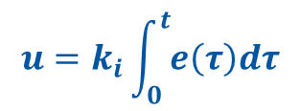
Integral Action
$$u=k_{i}\int_{0}^{t}{e\left(τ\right)dτ}$$
Proportional
+
e
u
Process
SP
Σ
Integral
-
Future
MV

Slide 31
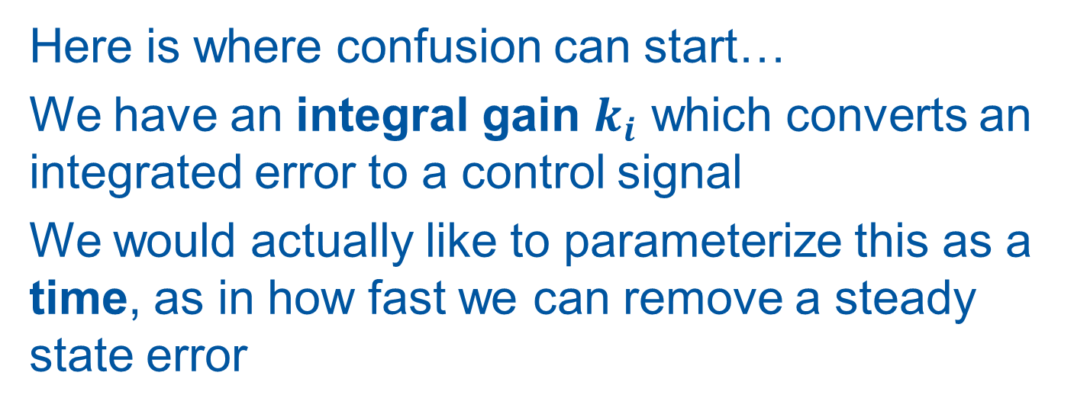
Integral gain, Integral time
Here is where confusion can start…
We have an integral gain $k_{i}$ which converts an integrated error to a control signal
We would actually like to parameterize this as a time, as in how fast we can remove a steady state error

Slide 32
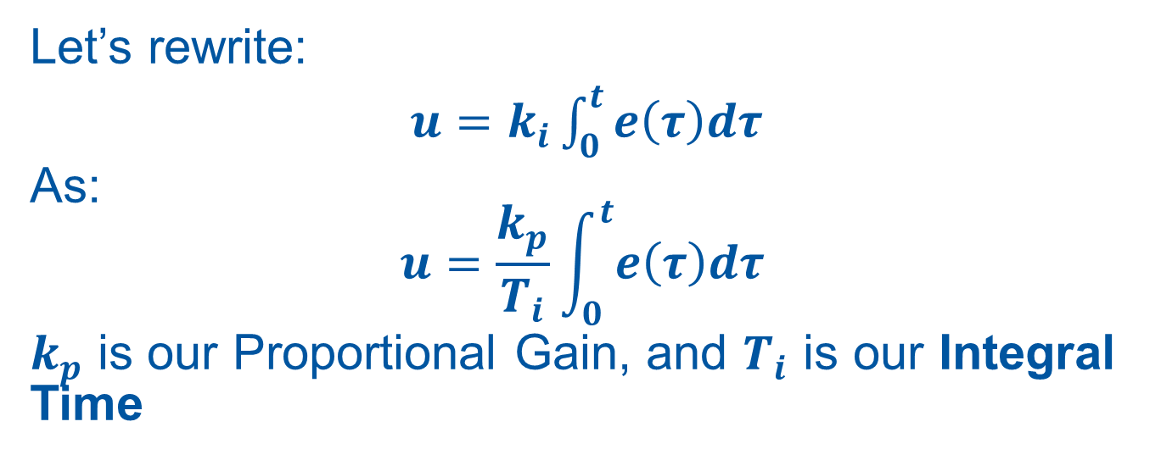
Integral gain, Integral time
Let’s rewrite:
$u=k_{i}\int_{0}^{t}{e\left(τ\right)dτ}$
As:
is our Proportional Gain, and $T_{i}$ is our Integral Time

Slide 33
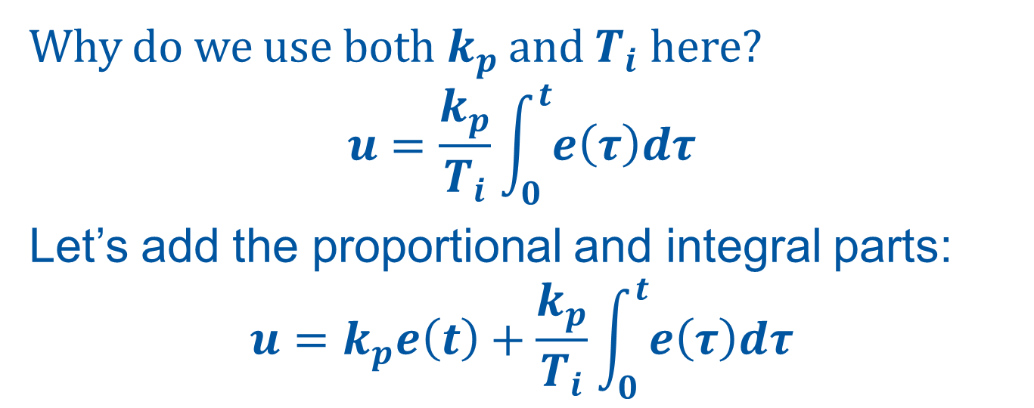
The Integral time
Why do we use both $k_{p}$ and $T_{i}$ here?
$$u=\frac{k_{p}}{T_{i}}\int_{0}^{t}{e\left(τ\right)dτ}$$
Let’s add the proportional and integral parts:
$$u=k_{p}e\left(t\right)+\frac{k_{p}}{T_{i}}\int_{0}^{t}{e\left(τ\right)dτ}$$

Slide 34
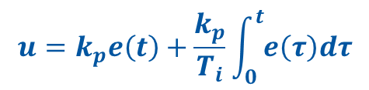
Proportional and Integral Controller
$$u=k_{p}e\left(t\right)+\frac{k_{p}}{T_{i}}\int_{0}^{t}{e\left(τ\right)dτ}$$
Proportional
+
e
u
Process
SP
Σ
Integral
-
Future
MV

Slide 35
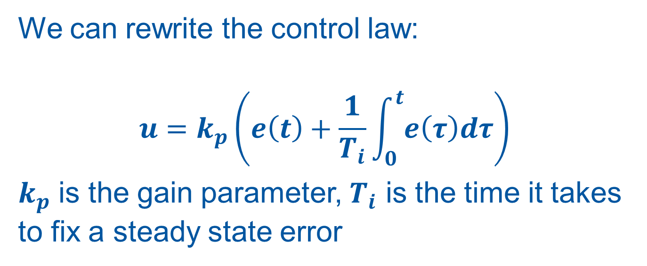
Proportional and Integral Controller = PI Controller
We can rewrite the control law:
$$u=k_{p}\left(e\left(t\right)+\frac{1}{T_{i}}\int_{0}^{t}{e\left(τ\right)dτ}\right)$$
$k_{p}$ is the gain parameter, $T_{i}$ is the time it takes to fix a steady state error

Slide 36
Solving P control’s problems revisited
We solved the steady state error by adding integral action (summing the past)
How can we solve the oscillation problem?
Let’s look at the future!

Slide 37
Solving oscillations: ‘the Future’
Proportional
+
e
u
Process
SP
Σ
Integral
-
Future
MV
Let’s look at the error in the future

Slide 38
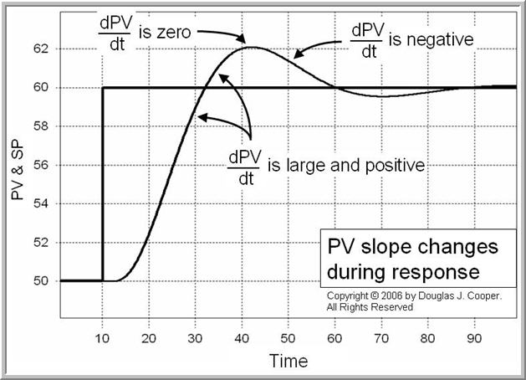
Solving oscillations: ‘the Future’
How do we predict the future of the error?
Look at its gradient!
If the gradient (the time derivative) of the error is in a direction that makes the error smaller, we can reduce the control input

Slide 39
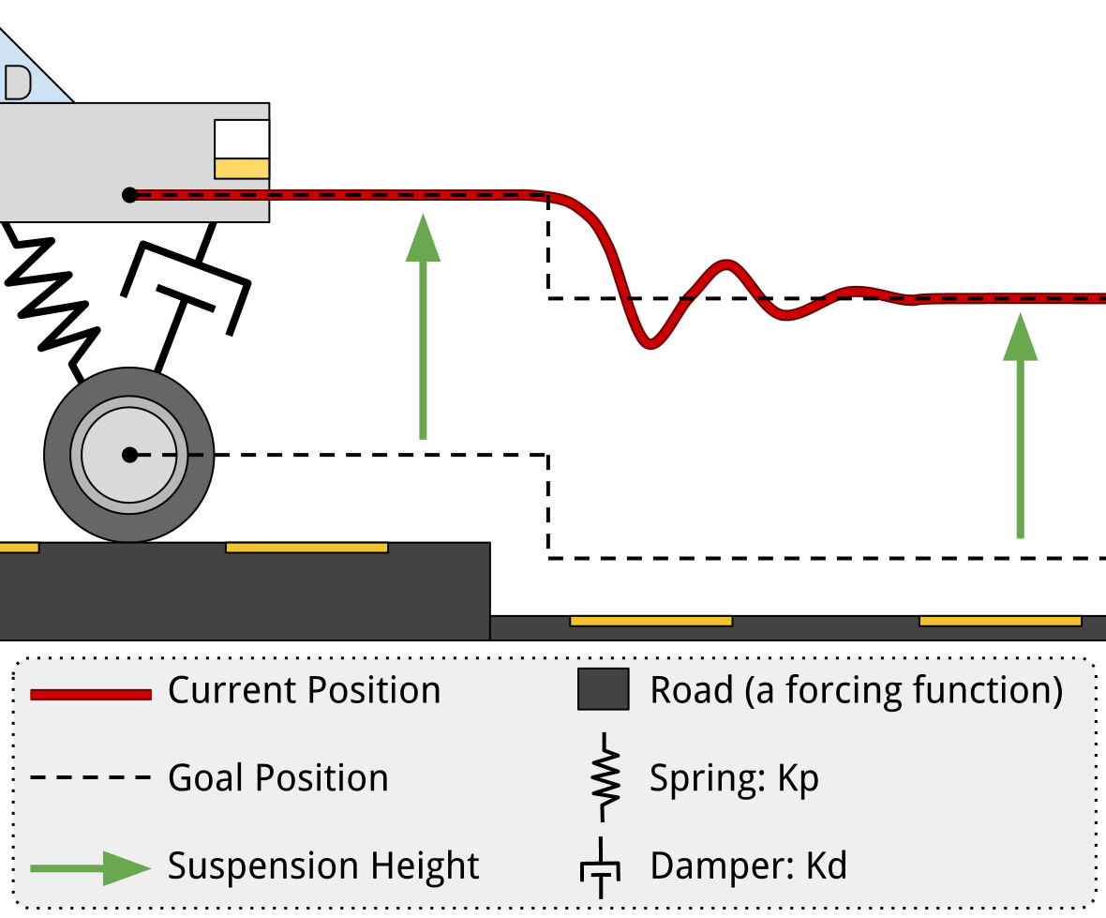
Damping
It can be easier to think of this as damping, something that resists velocity
Think of the wheel on your car…

Slide 40
Damping
The spring is a proportional controller for the wheel position. The damper adds a derivative action by opposing the velocity of the wheel

Slide 41
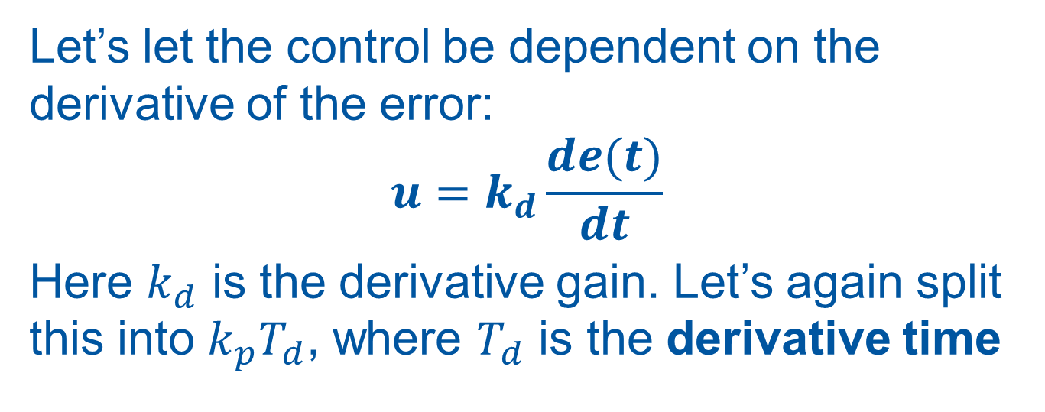
Derivative action
Let’s let the control be dependent on the derivative of the error:
$$u=k_{d}\frac{de(t)}{dt}$$
Here $k_{d}$ is the derivative gain. Let’s again split this into $k_{p}T_{d}$, where $T_{d}$ is the derivative time

Slide 42
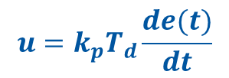
Derivative action
$$u=k_{p}T_{d}\frac{de(t)}{dt}$$
Proportional
+
e
u
Process
SP
Σ
Integral
-
Derivative
MV

Slide 43
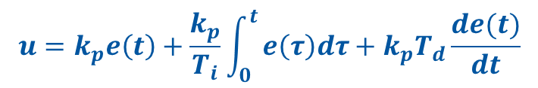
PID Controller!
$$u=k_{p}e\left(t\right)+\frac{k_{p}}{T_{i}}\int_{0}^{t}{e\left(τ\right)dτ+k_{p}T_{d}\frac{de(t)}{dt}}$$
Proportional
+
e
u
Process
SP
Σ
Integral
-
Derivative
MV

Slide 44
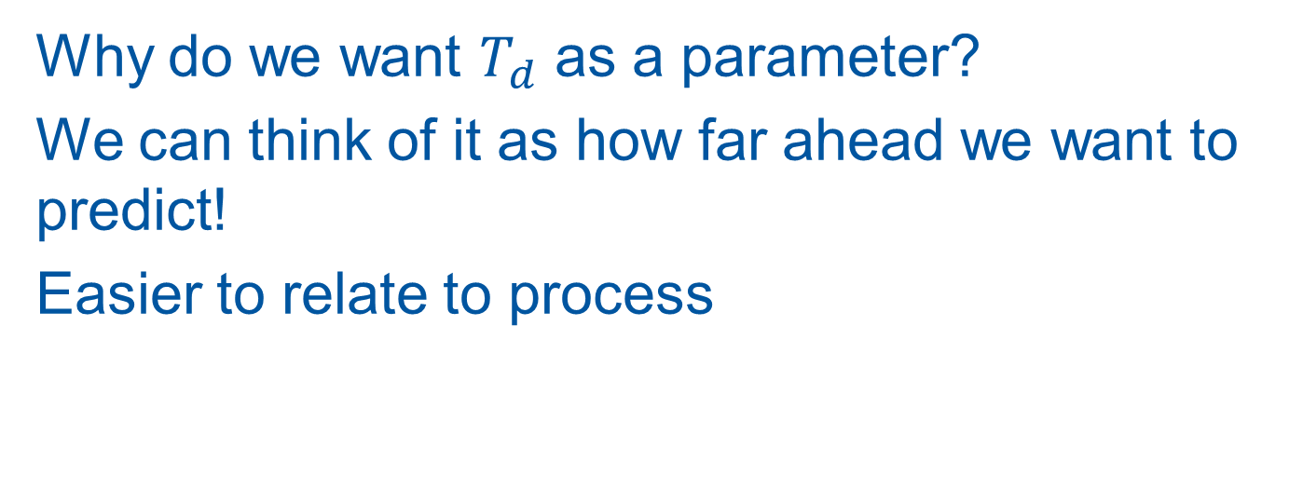
Derivative Time
Why do we want $T_{d}$ as a parameter?
We can think of it as how far ahead we want to predict!
Easier to relate to process

Slide 45
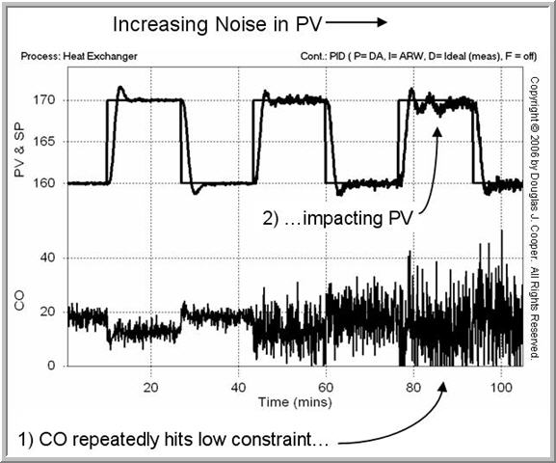
Problems with Derivative action
We know that a derivative amplifies quick changes.
We can get problems if MV is noisy.
Solution is to add low pass filter

Slide 46
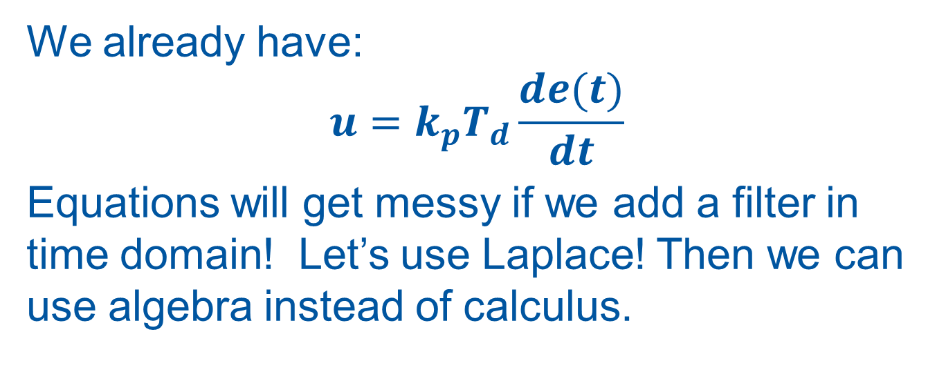
Derivative with filter
We already have:
$$u=k_{p}T_{d}\frac{de(t)}{dt}$$
Equations will get messy if we add a filter in time domain! Let’s use Laplace! Then we can use algebra instead of calculus.

Slide 47
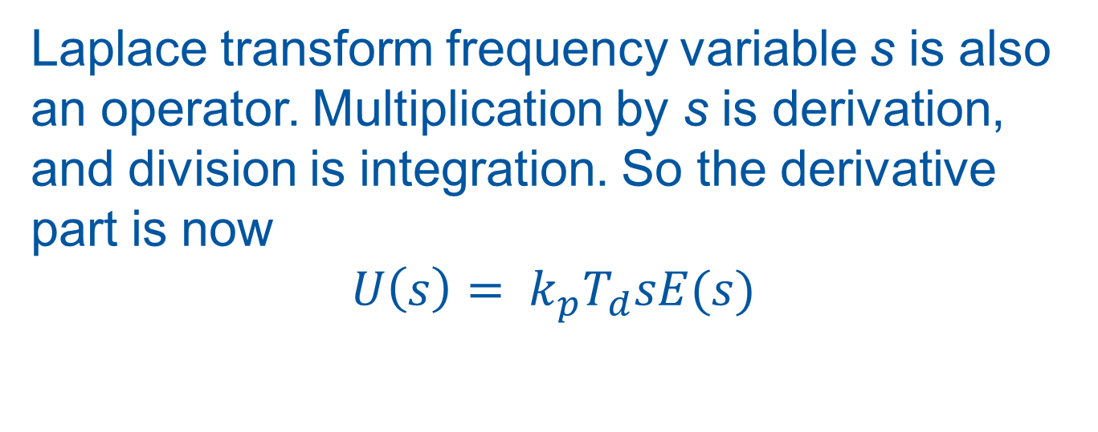
Derivative with filter
Laplace transform frequency variable s is also an operator. Multiplication by s is derivation, and division is integration. So the derivative part is now
$$U\left(s\right)= k_{p}T_{d}sE(s)$$

Slide 48
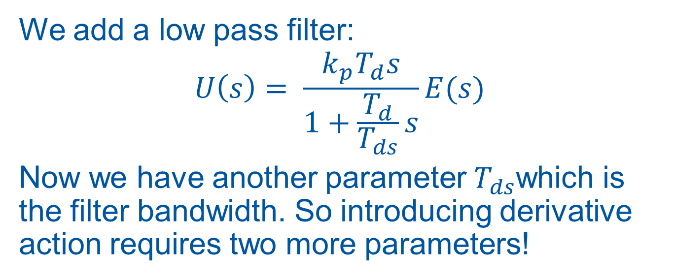
Derivative with filter
We add a low pass filter:
$$U\left(s\right)= \frac{k_{p}T_{d}s}{1+\frac{T_{d}}{T_{ds}}s}E(s)$$
Now we have another parameter $T_{ds}$which is the filter bandwidth. So introducing derivative action requires two more parameters!

Slide 49
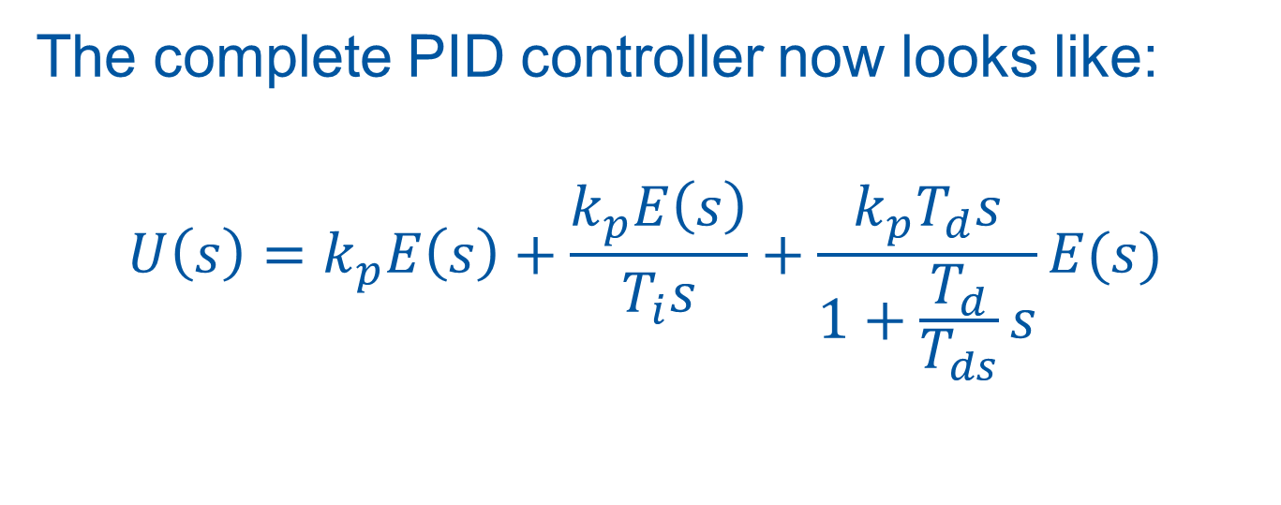
Full PID equation
The complete PID controller now looks like:
$$U\left(s\right)=k_{p}E\left(s\right)+\frac{k_{p}E\left(s\right)}{T_{i}s}+\frac{k_{p}T_{d}s}{1+\frac{T_{d}}{T_{ds}}s}E(s)$$

Slide 50
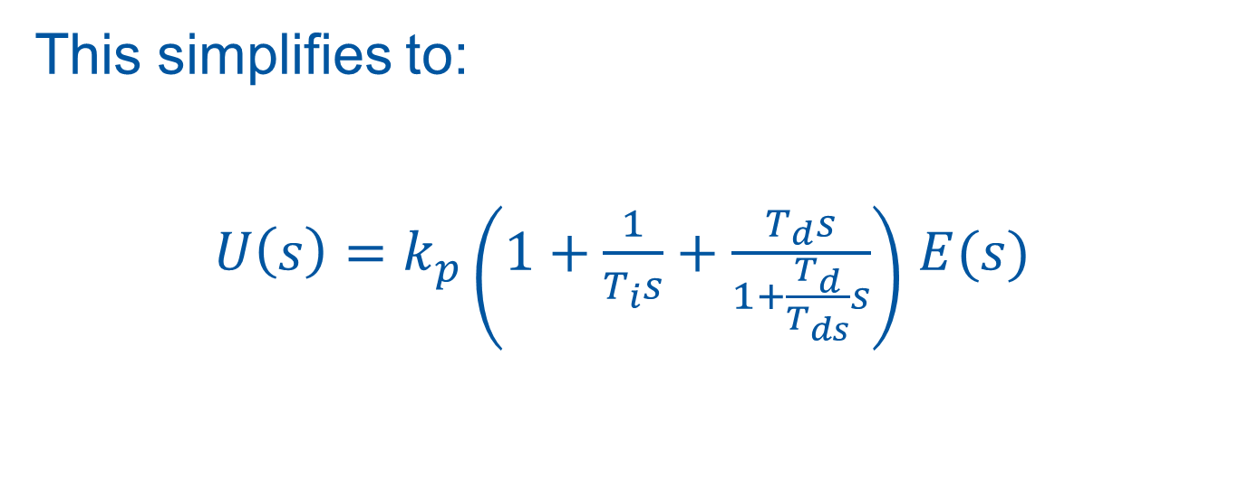
Full PID equation
This simplifies to:
$U\left(s\right)=k_{p}\left(1+\frac{1}{T_{i}s}+\frac{T_{d}s}{1+\frac{T_{d}}{T_{ds}}s}\right)$ $E(s)$

Slide 51
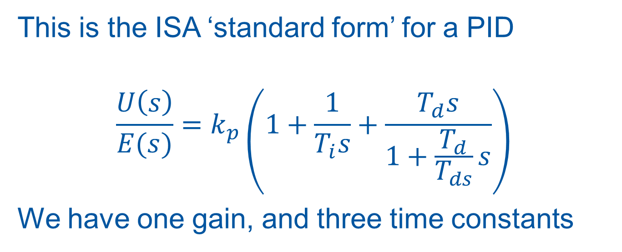
ISA PID Form
This is the ISA ‘standard form’ for a PID
$$\frac{U\left(s\right)}{E(s)}=k_{p}\left(1+\frac{1}{T_{i}s}+\frac{T_{d}s}{1+\frac{T_{d}}{T_{ds}}s}\right)$$
We have one gain, and three time constants

Slide 52
The UNICOS PID Controller
Features and quirks

Slide 53
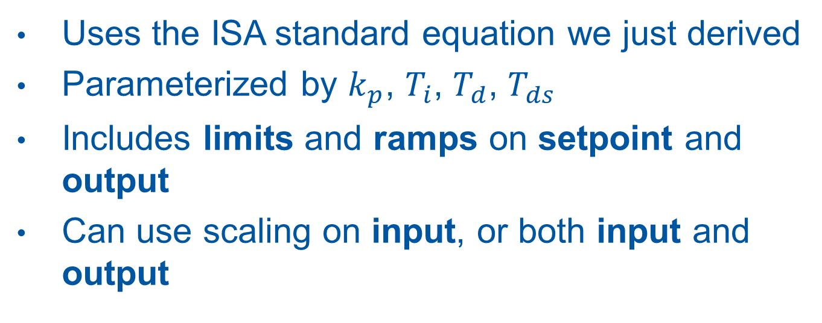
UNICOS PID Features
Uses the ISA standard equation we just derived
Parameterized by $k_{p}$, $T_{i}$, $T_{d}$, $T_{ds}$
Includes limits and ramps on setpoint and output
Can use scaling on input, or both input and output

Slide 54
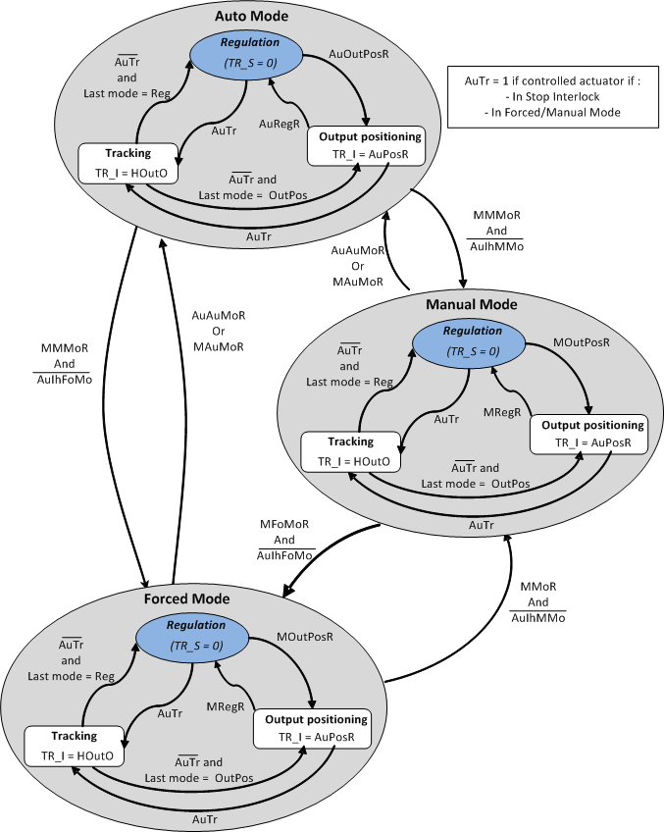
UNICOS PID Modes
Point to note:
Manual Mode is not open loop!
Use Output positioning to set
open loop control output

Slide 55
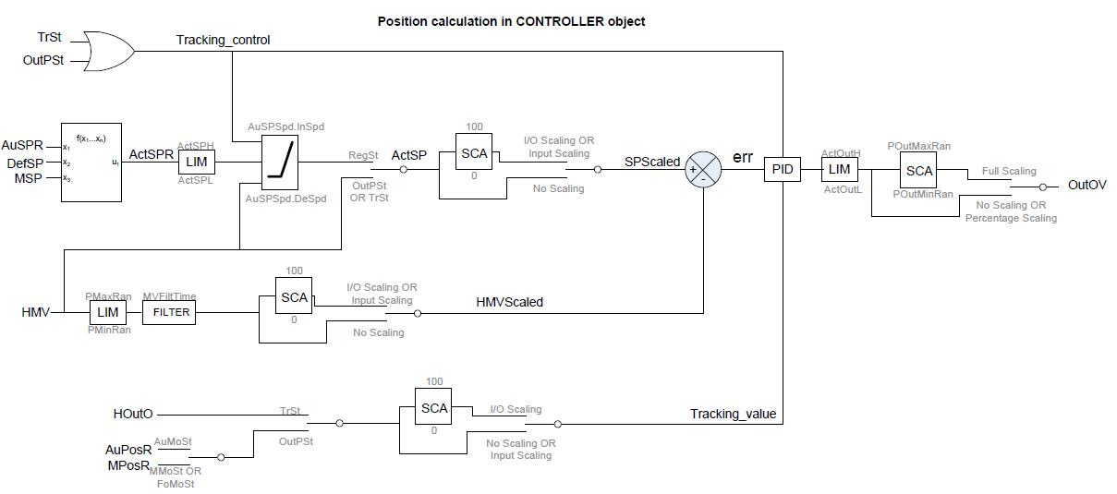
UNICOS PID Output Calculation
Note the scaling!

Slide 56
UNICOS PID Scaling
The scaling features are a little tricky, and have important consequences when tuning the controller!
Need to be very careful when applying tuning results! (More on this later!)

Slide 57
Scaling types
There are three types of scaling
  No scaling
  Input scaling
  Input and output (Full) scaling

Slide 58
No Scaling
This is the simplest. The inputs and outputs are applied directly to the PID equation, so it operates on engineering values. For example the MV and SP may be temperatures, and the output a power command to a heater

Slide 59
Input Scaling
Here the input is scaled from engineering values to a normalized value in the range 0-100%. Scaling parameters must be provided. For example 0 bar and 10 bar could be the low and high limits, which are then mapped to 0% and 100% as seen by the PID algorithm.

Slide 60
Full Scaling (Input and Output)
The input is converted to a 0-100% signal as before, and now the output of the controller is converted from 0-100% to engineering values before being applied to the process

Slide 61
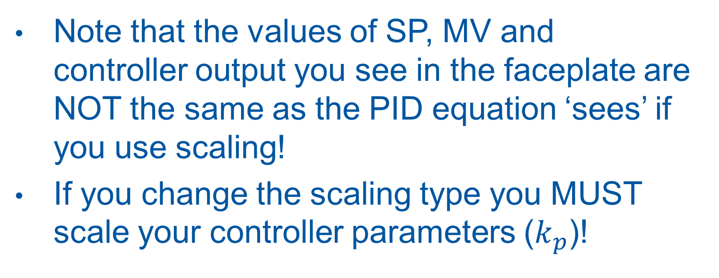
Scaling Pitfalls
Note that the values of SP, MV and controller output you see in the faceplate are NOT the same as the PID equation ‘sees’ if you use scaling!
If you change the scaling type you MUST scale your controller parameters ($k_{p}$)!

Slide 62
Manual PID Tuning

Slide 63
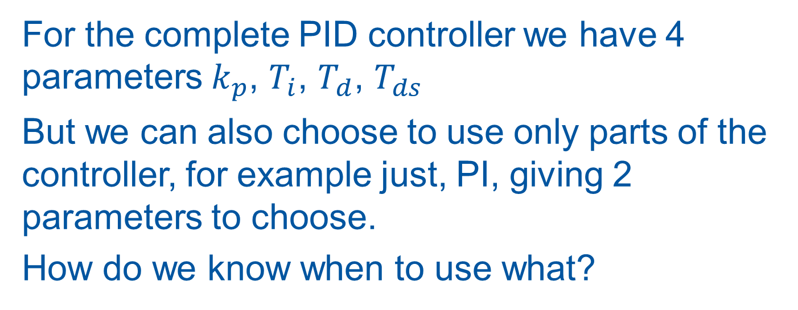
P, PI, PD, PID?
For the complete PID controller we have 4 parameters $k_{p}$, $T_{i}$, $T_{d}$, $T_{ds}$
But we can also choose to use only parts of the controller, for example just, PI, giving 2 parameters to choose.
How do we know when to use what?

Slide 64
The Process Model
We now know exactly what’s inside our controller, but so far we haven’t said anything about what’s inside our process!
To be able to tune the controller, we need to know something about it.

Slide 65
Open Loop Step Response
A good starting point is to make an open loop step test on the process
Note that this is a step on the controller output, not on the setpoint!

Slide 66
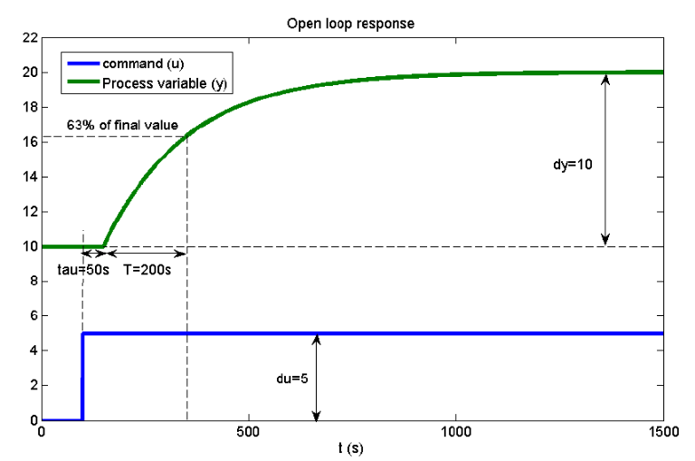
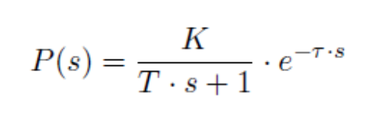
Open Loop Step Response
If our step response looks something like this, we have a stable system with a first order response

Slide 67
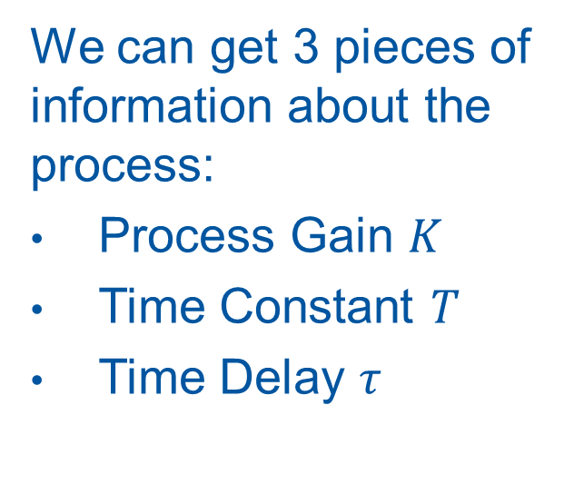
First Order System
We can get 3 pieces of information about the process:
Process Gain $K$
Time Constant $T$
Time Delay $τ$

Slide 68
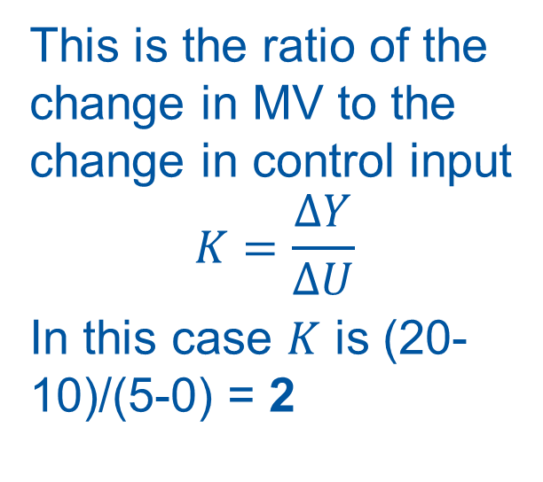
Process Gain
This is the ratio of the change in MV to the change in control input
$$K=\frac{∆Y}{∆U}$$
In this case $K$ is (20-10)/(5-0) = 2

Slide 69
Time Constant
This is the ‘speed’ of the process.
To read it from the trend, look for the time it takes for the MV to rise to 63% of its final value

Slide 70
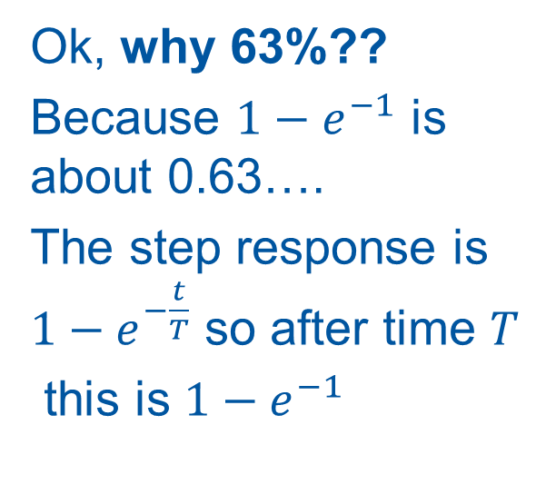
Time Constant
Ok, why 63%??
Because $1−e^{−1}$ is about 0.63….
The step response is $1−e^{−\frac{t}{T}}$ so after time $T$
this is $1−e^{−1}$

Slide 71
Time Delay
This is simpler, it is just the time it takes from the start of the step until the MV starts to move.

Slide 72
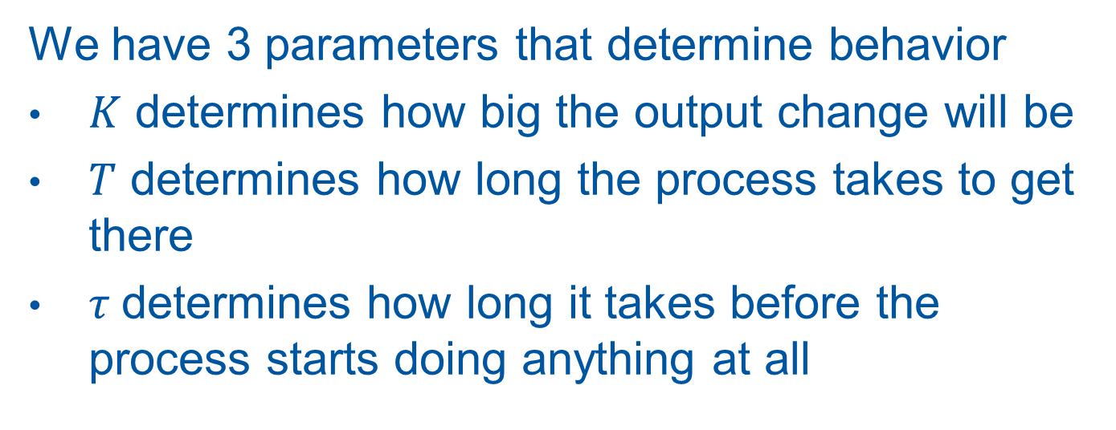
First order process model
We have 3 parameters that determine behavior
$K$ determines how big the output change will be
$T$ determines how long the process takes to get there
$τ$determines how long it takes before the process starts doing anything at all

Slide 73
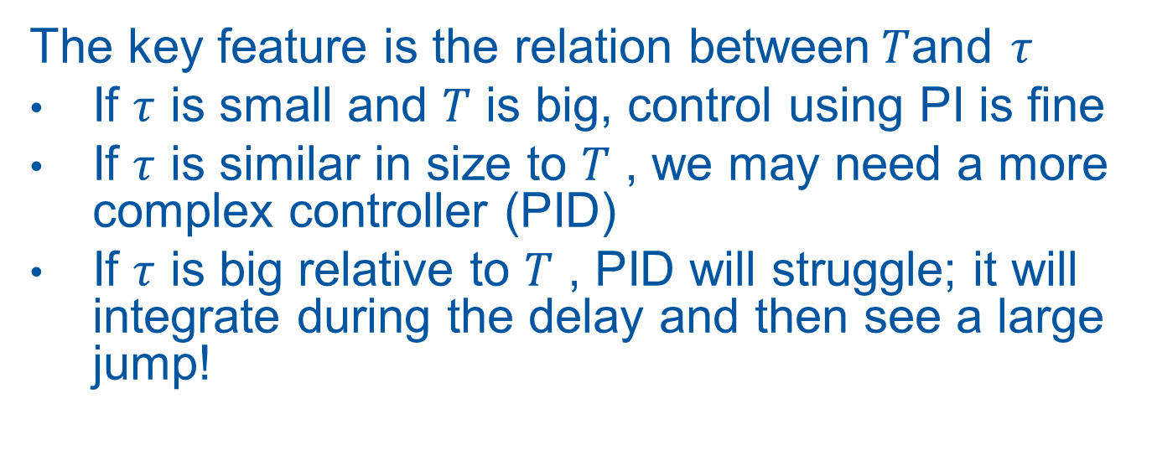
Implications for control
The key feature is the relation between$T$and $τ$
If $τ$ is small and $T$ is big, control using PI is fine
If $τ$ is similar in size to $T$ , we may need a more complex controller (PID)
If $τ$ is big relative to $T$ , PID will struggle; it will integrate during the delay and then see a large jump!

Slide 74
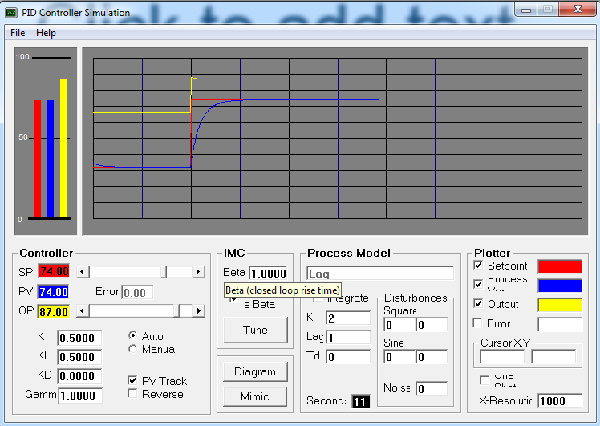
Mini Exercise: PIDSim
Play with the process model
Try open loop steps
What happens with large delay times?
What happens when adding an integrator?

Slide 75
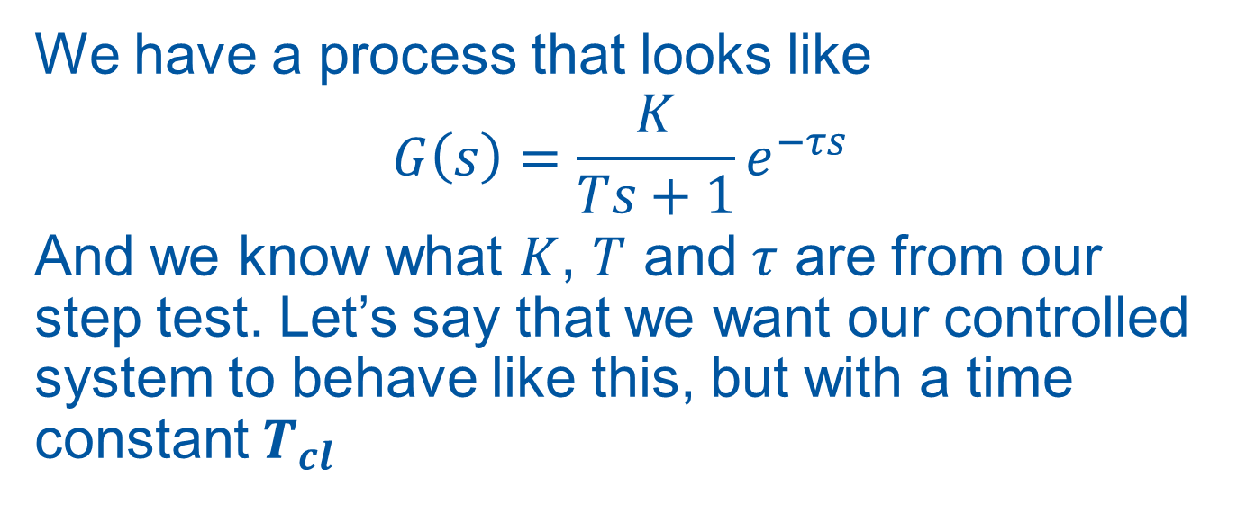
Tuning for a first order process
We have a process that looks like
$$G\left(s\right)=\frac{K}{Ts+1}e^{−τs}$$
And we know what $K$, $T$ and $τ$ are from our step test. Let’s say that we want our controlled system to behave like this, but with a time constant $T_{cl}$

Slide 76
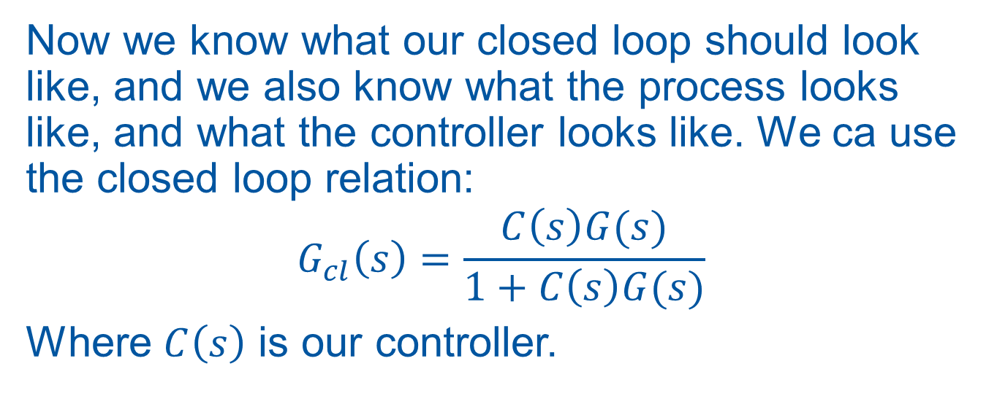
Tuning for a first order process
Now we know what our closed loop should look like, and we also know what the process looks like, and what the controller looks like. We ca use the closed loop relation:
$$G_{cl}\left(s\right)=\frac{C\left(s\right)G(s)}{1+C\left(s\right)G(s)}$$
Where $C\left(s\right)$ is our controller.

Slide 77
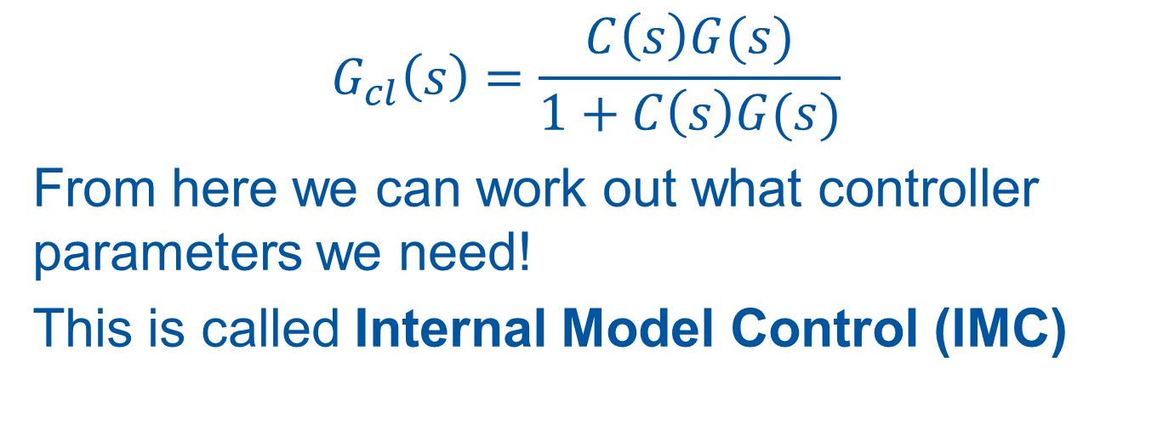
Tuning for a first order process
$$G_{cl}\left(s\right)=\frac{C\left(s\right)G(s)}{1+C\left(s\right)G(s)}$$
From here we can work out what controller parameters we need!
This is called Internal Model Control (IMC)

Slide 78
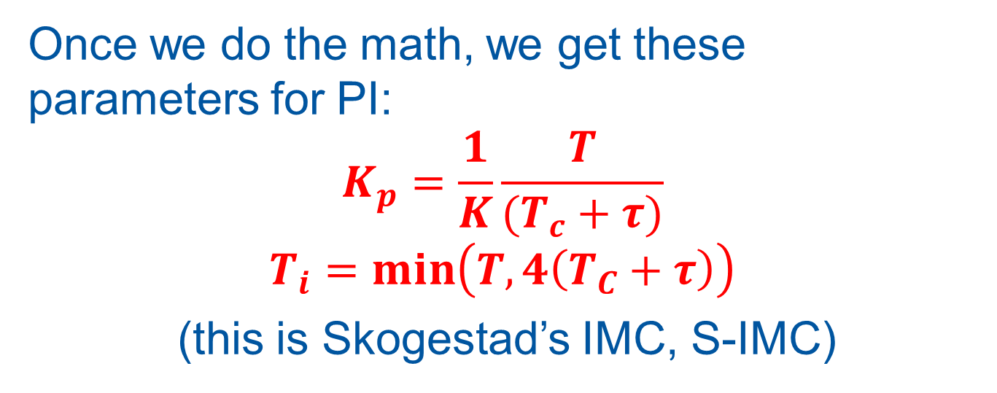
Internal Model Control (IMC)
Once we do the math, we get these parameters for PI:
$$K_{p}=\frac{1}{K}\frac{T}{(T_{c}+τ)}$$
$$T_{i}=\min\left(T, 4\left(T_{C}+τ\right)\right)$$
(this is Skogestad’s IMC, S-IMC)

Slide 79
Internal Model Control (IMC)
IMC rules are nice, because they are not just heuristics: they are calculated from a desired behavior.

Slide 80
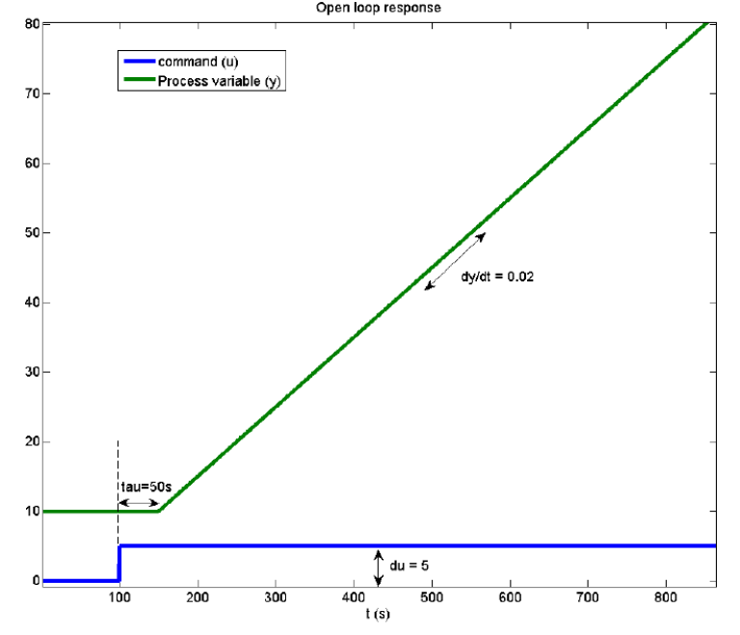

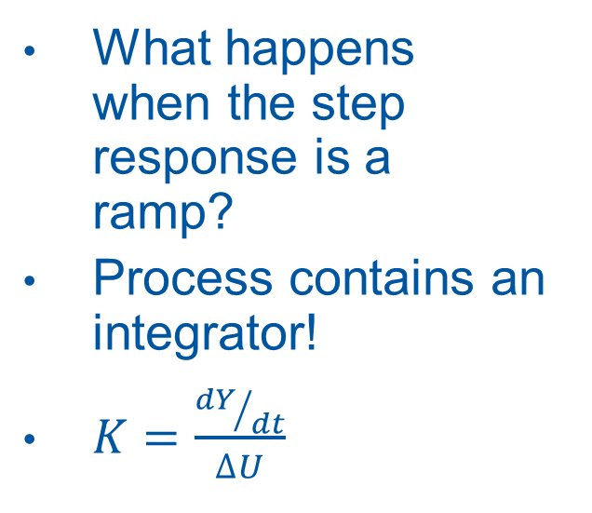
Integrating processes
What happens when the step response is a ramp?
Process contains an integrator!
$K=\frac{{dY}/{dt}}{∆U}$

Slide 81
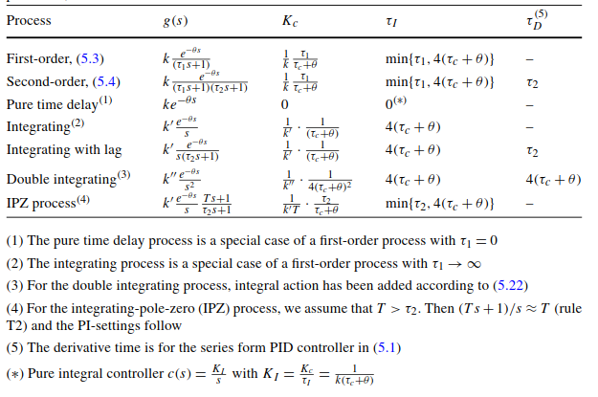
SIMC tuning rules
The rules can be derived for a number of different process models
http://folk.ntnu.no/skoge/publications/2012/skogestad-improved-simc-pid/PIDbook-chapter5.pdf

Slide 82

SIMC for UNICOS PID
Point to note: SIMC rules apply for a ‘cascade’ PID structure, not the ISA standard used by UNICOS. For PI and PD they are the same, but for the full PID we need to do a transformation of the parameters:
$K_{p}=K_{p}^{c}(1+\frac{τ_{d}^{c}}{τ_{i}^{c}})$, $τ_{i}=τ_{i}^{c}(1+\frac{τ_{d}^{c}}{τ_{i}^{c}})$, $τ_{d}=\frac{τ_{d}^{c}}{1+\frac{τ_{d}^{c}}{τ_{i}^{c}}}$

Slide 83

Other tuning rules
There are MANY other sets of tuning rules!

Slide 84
Ziegler-Nichols
You may have come across Ziegler-Nichols
  Early work (1942)
  Actually developed for fast setpoint tracking, so they are really too aggressive for process control!
  We will revisit them later!

Slide 85
Tuning rule warning
Lots of tuning rules are based on heuristics, which might only fit certain process types. In addition, you need to be sure what controller structure they are for. You also need to know what the control aim is (setpoint following, disturbance rejection)

Slide 86
Recommendation: SIMC
SIMC is good because:
  It forces you to do a step test and learn about the process
  You can adjust the rules with an intuitive parameter
  They are easily derived and therefore understood

Slide 87
Recommendation: SIMC
Recommendation is to start with SIMC.
If you’re still not happy, you can use it as a baseline, and make manual adjustments from there.
Let’s now make a tuning ‘recipe’!

Slide 88
Tuning ‘recipe’
Step 1: Preparation:
  Make sure it’s ok to put the process into open loop
  Make sure the process is settled (steady state)
  Make sure you are close to your normal operating point

Slide 89
Tuning ‘recipe’
Step 2: Open loop step test
  Put the controller into Output Positioning
  Make a small step in the output value
  Observe the MV, make sure it doesn’t hit the limits!
  Once the MV has settled, make a step back to where you started.
  Put the controller back in regulation

Slide 90

Tuning ‘recipe’
Step 3: Calculate process parameters
  Find $K$, $T$ and $τ$
    $K=\frac{∆Y}{∆U}$ (watch out for scaling!)
    $T$ is the time taken to rise to 0.63 $∆Y$
    $τ$ is the time between your step input and the first change in MV

Slide 91

Tuning ‘recipe’
Step 4: Calculate controller parameters
  Use SIMC: choose closed loop time $T_{cl}$
  Apply tuning rules:
$$K_{p}=\frac{1}{K}\frac{T}{(T_{c}+τ)}$$
$$T_{i}=\min\left(T, 4\left(T_{C}+τ\right)\right)$$

Slide 92

Tuning ‘recipe’
Step 5: Set parameters and test
  Apply the new parameters in the controller
  Make a small set point change and see how the controller reacts
  If too aggressive, increase $T_{cl}$ and recalculate parameters
  If too slow, decrease $T_{cl}$ and recalculate parameters

Slide 93

Exercise: Manual tuning in UNICOS

Slide 94


Hints! Input and I/O scaling
Input Scaling
Find $∆Y$ from the trend
Calculate new $∆Y^{s}$:
$$∆Y^{s}=\frac{∆Y}{(P_{max}−P_{min})}x100\%$$
I/O Scaling
Find $∆Y$, $∆U$
Calculate new $∆Y^{s}$:
$∆Y^{s}=\frac{∆Y}{(P_{max}−P_{min})}x100\%$
$∆U^{s}=\frac{∆U}{(O_{max}−O_{min})}x100\%$

Slide 95
Autotuning
The UNICOS Autotuning tool

Slide 96
Autotuning
What is autotuning?
  It is NOT a system which continuously updates the controller parameters (this is adaptive control)
  It is just a set of tools to automate the procedure of finding a set of parameters

Slide 97
Open vs Closed Loop
In our manual tuning we did an open loop experiment (step test) and found parameters from there. This procedure can be automated
There are also methods that allow us to keep the loop closed

Slide 98
Automated SIMC Tuning
Let’s revisit the SIMC method
Doing the calculations and keeping track of the scaling was a pain
The UNICOS autotuner automates most of this for us

Slide 99

UNICOS SIMC Autotune
Open the controller faceplate and go to Autotune
Select SIMC (1)
First, we need to identify the process parameters (2)
1
3
4
2

Slide 100

UNICOS SIMC Autotune
We enter a step size, and it performs the step test, stopping when MV has settled.

Slide 101

UNICOS SIMC Autotune
Now we select the closed loop response time $T_{cl}$ (3)
This gives us the proposed parameters (4)
We can apply them to the controller (unless set by APAR; these must be set manually)
1
3
4
2

Slide 102
Closed Loop Autotuning
What if we want to remain in closed loop when tuning?
We can use the Relay Method
Effectively exchanges the PID for an on/off control

Slide 103

Relay Method
Control only has 2 values, depending on whether MV is higher or lower than SP
Gives a square wave oscillation

Slide 104


Relay Method: detail
Control goes between $+d$ and $−d$ from its original value, with some hysteresis

Slide 105


Relay Method: detail
Output oscillates with an amplitude $a$
We get two pieces of information from this: Ultimate gain $K_{u}$and Ultimate Period $P_{u}$

Slide 106


Relay Method: calculation
Ultimate gain $K_{u}$ comes from the amplitude of the fundamental frequency of the square wave
$$K_{u}=\frac{4d}{πa}$$
Ultimate Period $P_{u}$ is just the period of the resulting oscillation

Slide 107

Relay Method: tuning
Again we have MANY rules to choose from.
Ziegler-Nichols are the most well known
Time delay and time constant similar
Integrator and time delay system
Time delay dominated system

Slide 108


UNICOS Relay Autotuner
The current version uses the Ziegler-Nichols rules
You may find the result too ‘aggressive’
You can always ‘detune’ by reducing $K_{p}$ and increasing $T_{i}$by small amounts

Slide 109

UNICOS Relay Autotuner
Select method RELAY and controller type (1)
We need to give an amplitude (2). Before starting, we should be in steady state. Then we can input Max and Min values (ideally symmetric!)
1
2
4
3

Slide 110
UNICOS Relay Autotuner
We also need to give the number of cycles (2). 3 to 5 is usually enough.
Start the relay experiment (3)
1
2
4
3

Slide 111

UNICOS Relay Autotuner
Popup opens. Observe that we get a nice square wave with fairly constant period.
After the given number of cycles, it will stop automatically

Slide 112
UNICOS Relay Autotuner
Ziegler-Nichols tuning rules are applied internally. There is no user parameter
Results are displayed (4) and we can choose to apply the new parameters
1
2
4
3

Slide 113
UNICOS Relay Autotuner
Practical notes:
The experiment begins by checking for steady state. It may take some time before the relay cycles start
If the experiment starts far from steady state, it can cause problems

Slide 114

Iterative Feedback Tuning
IFT tries to adjust the control parameters in order to minimize a cost function
We won’t look at it in detail here
1
2
4
3

Slide 115

Exercise: Autotuning in UNICOS
Let’s try out the SIMC and Relay methods
Compare the results to your results from manual tuning
Can you improve the autotuning results?

Slide 116
Thanks for your attention!

