Slide 1
Introduction to robotics
4. Microcontrolers
Aistis Raudys ir Vytautas Valaitis
2020

Slide 2
Processors
Execute programs
  Serial execution of instructions
  Simple, Universal
Instruction execution engine: fetch/execute cycle
  flow of control determined by modifications to program counter
  instruction classes:
    data: move, arithmetic and logical operations
    control: branch, loop, subroutine call
    interface: load, store from external memory
Traditional architecture goal: Performance
  Caches
  Branch prediction
  Multiple/OOO issue

Slide 3
Embedded Processors
Processor is a Universal computing engine
  Program can compute arbitrary functions
  Use a processor for simple/specific tasks
Advantages:
  High-level language
  Compilers/Debuggers
  arbitrary control structures
  arbitrary data structures
Disadvantages:
  Cost/Size

Slide 4
Embedded Processor (Microcontroller)
Processor optimized for low cost
  No cache
  Small memory
  No disks
  4 bit/8 bit/16 bit
  No FP
  No complicated datapath
  Multicycle instruction interpretation
  Simple/no operating system
  Programs are static
Low performance
  1 MIPS is enough if 1 ms is the time scale
Integrate on a single chip

Slide 5
General-purpose processor
Programmed by user
New applications are developed routinely
General-purpose
  must handle a wide ranging variety of applications
Interacts with environment through memory
  all devices communicate through memory
  DMA operations between disk and I/O devices
  dual-ported memory (as for display screen)
  oblivious to passage of time (takes all the time it needs)

Slide 6
Embedded processors
Programmed once by manufacturer of system
Executes a single program (or a limited suite) with few parameters
Task-specific
  can be optimized for specific application
Interacts with environment in many ways
  direct sensing and control of signal wires
  communication protocols to environment and other devices
  real-time interactions and constraints

Slide 7
Typical general-purpose architecture
Display
(with
dual-port
video RAM)
CPU
Memory
system bus
I/O
(serial line,
keyboard,
mouse)
Disk
Network
Interface
all the parts around the
processor are usually required
standard interfaces

Slide 8
Typical task-specific architecture
medium-speed
interactions
low-speed
interactions
Microcontroller
I/O
Interface
custom
logic
ROM
RAM
high-speed
interactions
any of the parts around the
microcontroller are optional
standard interface

Slide 9
How does this change things?
Sense and control of environment
  processor must be able to “read” and “write” individual signal wires
  controls I/O devices directly
Program has to do everything
  sense input bits
  change output bits
  do computation
  measure time
    many applications require precise spacing of events
Problems with this
  Precise timing?
  Too slow?

Slide 10
Connecting to inputs/outputs
Map external wire to a bit of a variable (memory or register)
  if (a & 1) . . .
  X = 2;

Slide 11
Example Problem: Accelerometer Interface
Accelerometer output has one wire!
  Acceleration coded as the duty cycle
    pulse-width/cycle-length
      20% = -128
      80% = +127
    cycle time = 10ms
Write a C program that measures the acceleration
  Input is low-order bit of variable X
  Assign result to variable Z
  Make up whatever you need

Slide 12
Memory-mapped inputs
Map external wire to a bit in the address space
of the processor
External register buffers values coming
from environment
  map register into address space
  decoder needed to select register for reading
  output enable (OE) so that many registers can use the same data bus
RD
WR
OE
decoder
ADDR
CPU
WAIT
RD
to data bus
OUT
ADDR
DATA
IN
from environment

Slide 13
Memory-mapped outputs
Map external wire to a bit in the address space
of the processor
Connect output of memory-mapped register
to environment
  map register into address space
  decoder need to select register for writing (holds value indefinitely)
  input enable (EN) so that many registers can use the same data bus
RD
WR
ADDR
decoder
Micro-
processor
WAIT
WR
EN
ADDR
OUT
to environment
DATA
DATA
IN

Slide 14
On-chip support for communication
Processor may not be fast enough
Offload standard protocols
Built-in device drivers
  for common communication protocols
  serial-line protocols most common as they require few pins
e.g. RS-232 serial interface
  special registers in memory space for interaction
Increases level of integration
  pull external devices on-chip
    must be standard
  eliminate need for shared memory or system bus

Slide 15
Measuring Time
Keep track of detailed timing of each instruction's execution
  highly dependent on code
  hard to use with compilers
  not enough control over code generation
  interactions with caches/instruction-buffers
Loops to implement delays
  keep track of time in counters
  keeps processor busy counting and not doing other useful things
Real-time clock
  sample at different points in the program
  simple difference to measure time delay

Slide 16
Timers
Separate and parallel counting unit(s)
  co-processor to microprocessor
  does not require microprocessor intervention
  in simple case, like a real-time clock
    set timer/read timer
  interrupt generated when expired
More interesting timer units
  self reloading timers for regular interrupts
  pre-scaling for measuring larger times
  started by external events

Slide 17
Input/output events
Input capture
  record precise time when input event occurred
  to be used in later handling of event
Output compare
  set output to happen at a point in the future
  reactive outputs – set output to happen a pre-defined
  time after some input
  processor can go on to do other things in the meantime

Slide 18
Example Microcontroller: 8051
Very old, very common and very cheap microcontroller
  Lots of variants
Review online documentation
  learn how to read documentation
Instruction set
  instruction capabilities
  timing
Special registers and integrated I/O devices
  I/O ports
  serial interface
Interrupt organization
Memory space and its allocation
Timers

Slide 19
Why this choice?
Used on the XESS board we are using
Atmel part with 20K on-chip flash memory
  dispense with external memory for instructions
8051
  very common microcontroller with simple instruction set
  lots of features
  lots of alternatives
  lots of support and resources
  good tools available: we will use the Keil software
    Assembler
    C compiler
    Debugger
  we will use the C compiler mostly
    requires a good understanding of the 8051 architecture

Slide 20
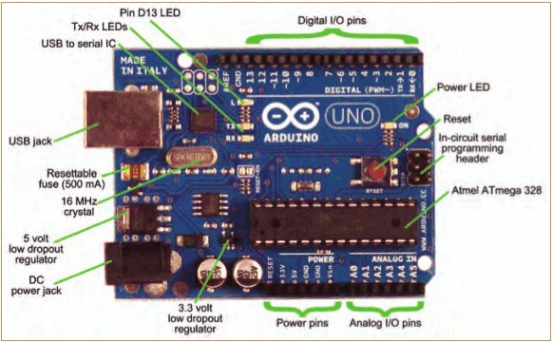
The Arduino Development Board
Making-robots-with-arduino.pdf

Slide 21
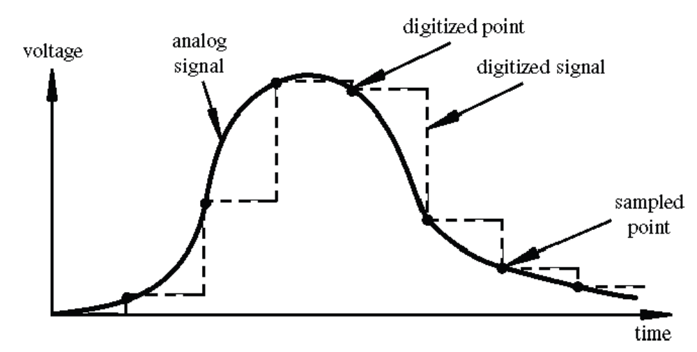
Digital? Analog?
Digital has two values: on and off
Analog has many (infinite) values
Computers don’t really do analog, they quantize
Remember the 6 analog input pins---here’s how they work
todbot.com/blog/bionicarduino

Slide 22
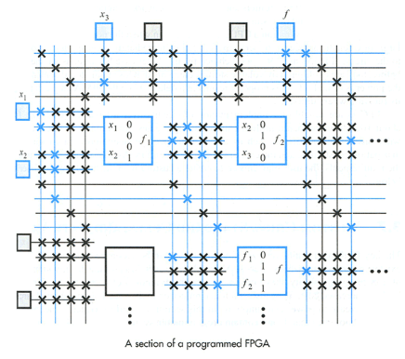
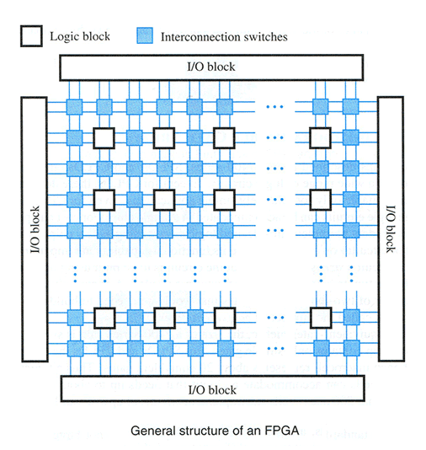
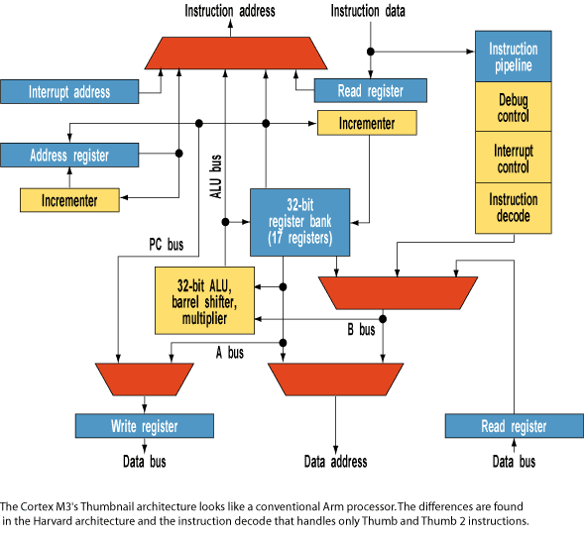
MPU FPGA

Slide 23
IDEA
Program Arduino in assembly language ?

Slide 24
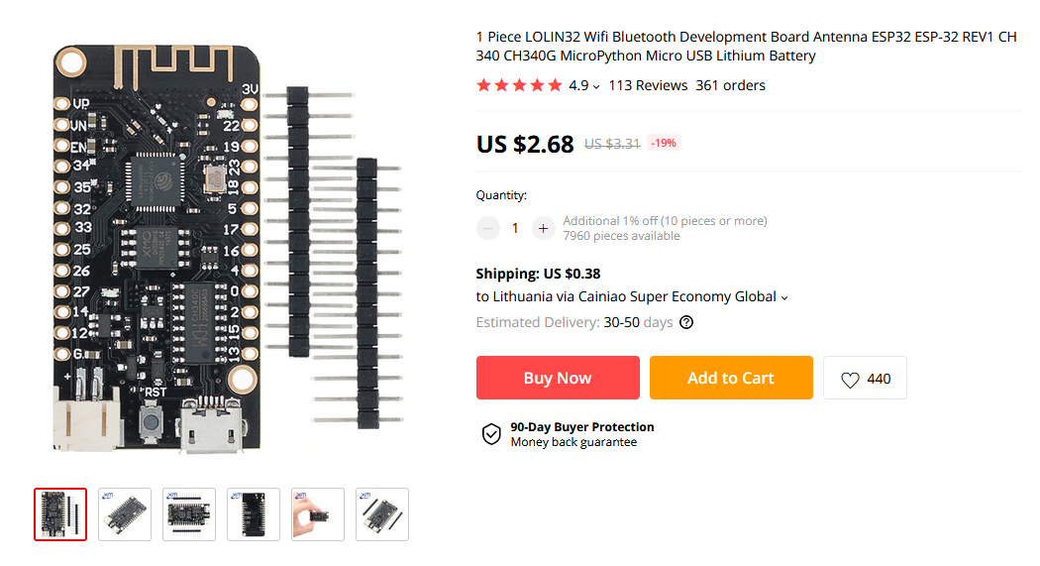
Get ESP32
Fantastic product for IoT
https://leanpub.com/kolban-ESP32
https://www.aliexpress.com/item/33009178296.html?spm=a2g0s.9042311.0.0.27424c4d6o8ypS

